Slide 1
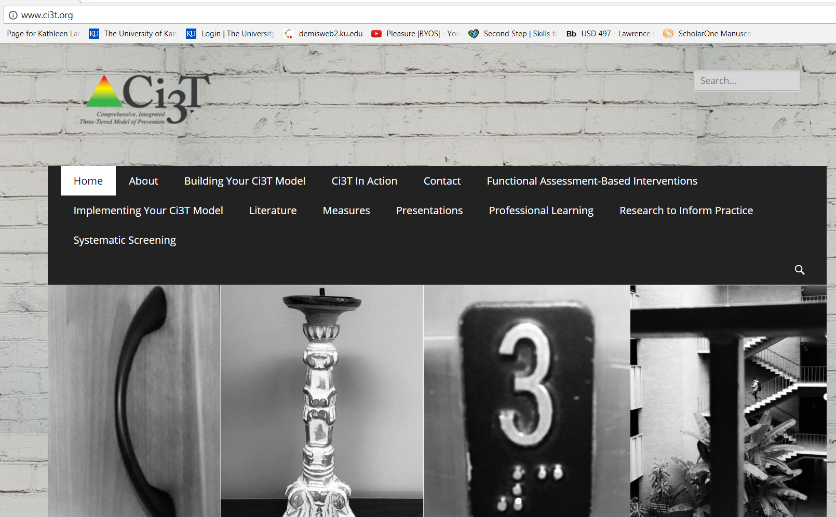


Comprehensive, Integrated, Three-Tiered (Ci3T) Models to Support School Success
Blue Valley School District, Principals’ Meeting
February 27, 2019
Kathleen Lynne Lane, Ph.D., BCBA-D
Mark Buckman, MS.Ed.
Wendy Oakes, Ph.D.

Slide 2
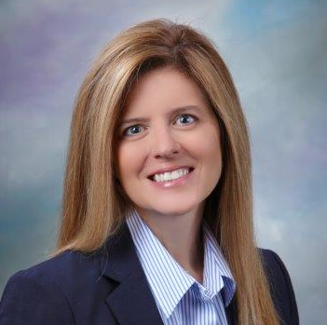


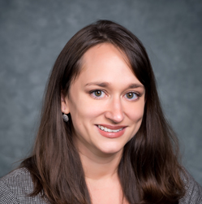
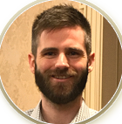


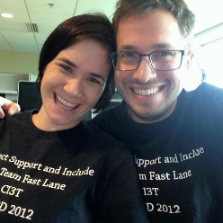
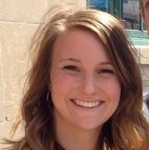
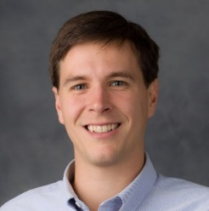










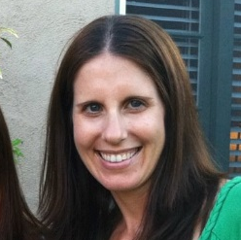
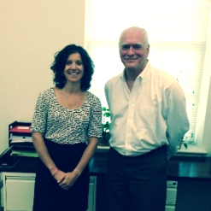
Agenda
Comprehensive, Integrated, Three-tiered (Ci3T) Models of Prevention
The Importance of Systematic Screening
Using Screening Data ...
  implications for primary prevention efforts
  implications for teachers
  implications for student-based interventions at Tier 2 and Tier 3

Slide 3
Thank you…
Commitment to Students
Students with emotional and behavioral disorders (EBD) represent a diverse and challenging group of students to teach (Forness, Freeman, Paparella, Kauffman, & Walker, 2011)
Historically as a field we have
viewed behavioral and social challenges to be within individual deficits (Landrum & Tankersley, 2013)
Relied on reactive approaches to address these challenges (Horner & Sugai, 2015)
Internalizing
Externalizing
ED … <1%
EBD … 12%
Shift … Systems Level Perspective
Notes:
We are moving away from a reactive approach to managing challenging behaviors and viewing behavioral and social challenges as within child problems (Landrum & Tankersley, 2013; Sugai & Horner). As field, we are now shifting towards a systemic approach. Most recently, we have begun to approach academic, behavioral, and social domains in a more comprehensive, integrated fashion and from a systemic approach, using data-informed decision making to support students with more intensive needs (Lane, Oakes, & Menzies, 2014; McIntosh, Chard, Boland, & Horner, 20016). This is evident in multi-tiered systems of support (MTSS), that have now shifted to comprehensive, integrated, three-tiered (Ci3T) models of prevention that blend response to intervention for reading and math, positive behavior intervention and supports (PBIS), and validated social skills curriculum (e.g., Positive Action) intended to meet students multiple needs. Such models contain a graduated continuum of support ranging from Tier 1 primary prevention efforts for all students, Tier 2 secondary prevention efforts all some students with common acquisition and performance deficits, and Tier 3 tertiary prevention efforts for some students for those with the most intensive needs. While there are not randomized control trials of these integrated models blending academic, behavioral, and social needs, there are randomized trials of RtI, PBIS (Bradshaw), and social domains (e.g., Positive Action) established the evidence of each. This move towards better understanding integrated models of graduated supports is important in meeting students’ multiple needs. At 2014 National Positive Behavior Intervention and Support (PBIS) Leadership Michael Yudin - Assistant Secretary for the Office of Special Education and Rehabilitation of the United States Department of Education – made an explicit call for placing equal importance on behavior and social domains as we do academic instruction. Specifically, Yudin urged educators and educational systems to “pay as much attention to students’ social and behavioral needs as we do academics,” noting that all too often students with the most pronounced needs are often missing the most instruction. School systems and the research community are responding to this call.

Slide 4
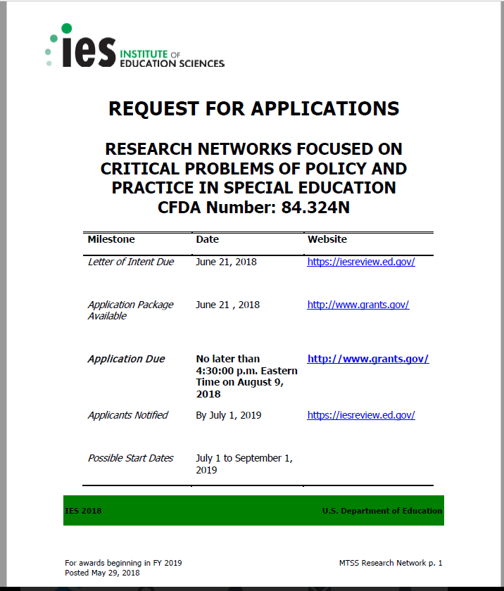
Michael Yudin urged educators and educational system leaders to “pay as much attention to students’ social and behavioral needs as we do academics” …
2014 National PBIS Leadership Conference, Michael Yudin, Assistant Secretary for the Office of Special Education and Rehabilitation of the United States Department of Education

Slide 6
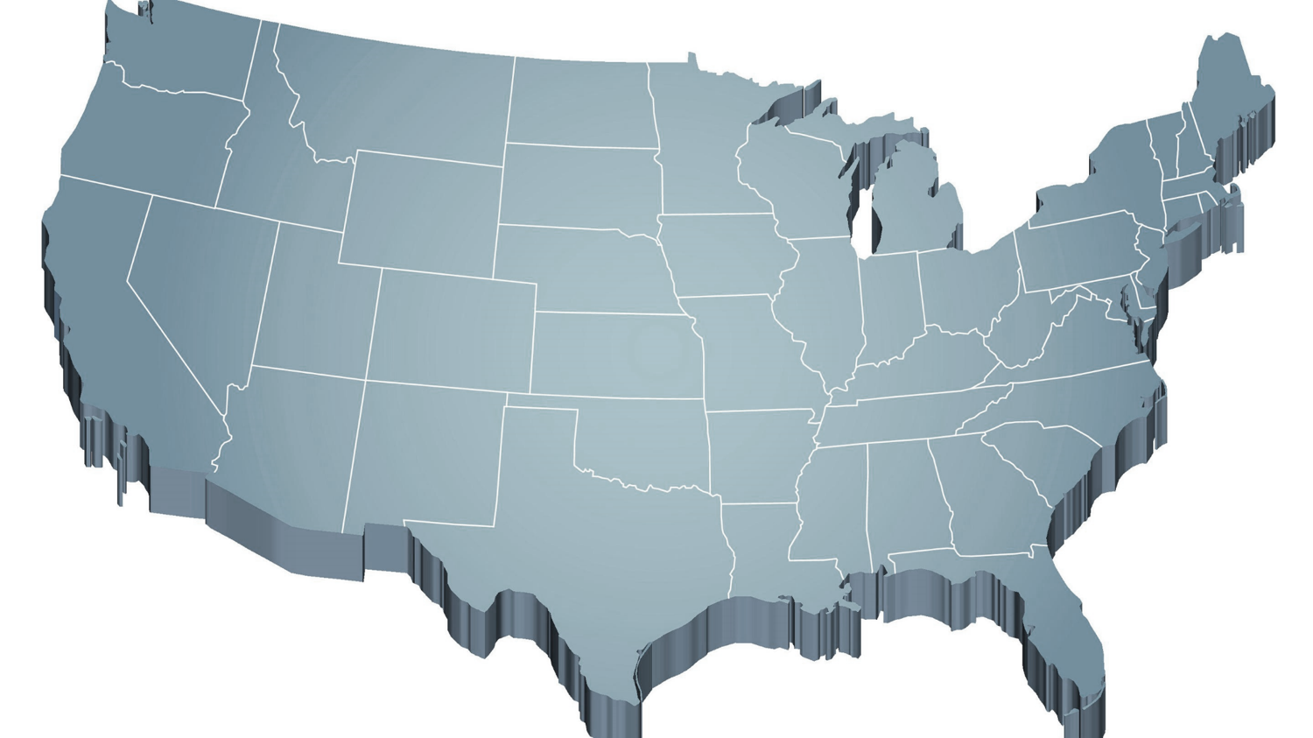



The Journey of Comprehensive, Integrated, Three-tiered (Ci3T) Models of Prevention
Notes:
CA & AZ start→ Tennessee → North Carolina→ Kansas
Trainings (MO, KANSAS, VERMONT, AZ)
MO, KS, UAB

Slide 7

Ci3T Professional Learning Series
Pre-Training Activities
  Team member selection
  Schoolwide Expectations Survey for Specific Settings (SESSS)
Session 1:
2 hours
  Ci3T model overview
Session 2:
Full day
  Building the primary prevention plan
Session 3:
2 hours
  How to monitor the plan
  Student team members attend
Session 4:
Full day
  Building Tier 2 supports
Session 5:
2 hours
  Building Tier 3 supports
  Student team members attend
Session 6:
Full day
  Preparing to implement
Implementation
Homework
Share overview with faculty and staff; Build reactive plan
Homework
Finalize and share expectation matrix and teaching & reinforcing components
Homework
Share screeners; Complete assessment schedule
Homework
Homework
Share Ci3T plan; Complete PIRS; Complete secondary grid
Share revised Ci3T plan; Complete Ci3T Feedback Form

Slide 8
Reading Street
District & State Standards
High Quality Instruction

Slide 9
Positive Behavior Interventions and Supports (PBIS)

Slide 10
Behavioral Component:
Positive Behavioral Interventions and Supports (PBIS)
A Framework, Not a Curriculum
Establish, clarify, and define expectations
Teach all students the expectations, planned and implemented by all adults in the school
Give opportunities to practice
Reinforce students consistently, facilitate success
Consider rules, routines, and physical arrangements
Monitor the plan using school-wide data to identify students who need more support
Monitor student progress
Source: Horner, R.H., & Sugai, G. (2015). School-wide PBIS: An example of applied behavior analysis implemented at a scale of social importance. Behavior Analysis in Practice, 8, 80-85.

Slide 11
ELEMENTARY | Settings
 | Classroom | Hallway | Cafeteria | Playground | Bathroom | Bus
Respect | - Follow directions -Use kind words and actions - Control your temper - Cooperate with others - Use an inside voice | - Use a quiet voice - Walk on the right side of the hallway - Keep hands to yourself | - Use an inside voice - Use manners - Listen to and follow adult requests | - Respect other peoples’ personal space - Follow the rules of the game | - Use the restroom and then return to class - Stay in your own bathroom stall - Little talking | - Use kind words towards the bus driver and other students - Listen to and follow the bus drivers’ rules
Responsibility | - Arrive to class on time - Remain in school for the whole day - Bring your required materials - Turn in finished work - Exercise self-control | - Keep hands to yourself - Walk in the hallway - Stay in line with your class | - Make your choices quickly - Eat your own food - Choose a seat and stick with it - Clean up after yourself | - Play approved games - Use equipment appropriately - Return equipment when you are done - Line up when the bell rings | - Flush toilet - Wash hands with soap - Throw away any trash properly - Report any problems to your teacher | - Talk quietly with others - Listen to and follow the bus drivers’ rules - Remain in seat after you enter the bus - Use self-control
Best Effort | - Participate in class activities - Complete work with best effort - Ask for help politely | - Walk quietly - Walk directly to next location | - Use your table manners - Use an inside voice | - Include others in your games - Be active - Follow the rules of the game | - Take care of your business quickly - Keep bathroom tidy | - Listen to and follow the bus drivers’ rules - Keep hands and feet to self
Establish, Clarify, Define Expectations
Source: Lane, K.L., Kalberg, J.R., & Menzies, H.M. (2009). Developing schoolwide programs to prevent and manage problem behaviors: A step-by-step approach. New York, NY: Guilford Press.

Slide 12




Positive Action
Notes:
Emily, could you please link the Connect with Kids logo with this arrow

Slide 13
Social Component:
Examples of Schoolwide Programs
Social-emotional
Connect With Kids
connectwithkids.com
Character Education
A curricula using real stories presented through documentary-style videos, non-fiction books, teaching guides and patent resources.
Attendance and achievement
Bullying and violence prevention
Character and Life skills
Digital citizenship
Alcohol and drug prevention
Health and Wellness
Customizable units are:
Positive Action
www.positiveaction.net
Improves academics, behavior, and character
Curriculum-based approach
Effectively increases positive behaviors and decreases negative behaviors
6-7 units per grade
Optional components:
  site-wide climate development
  drug education
  bullying / conflict resolution
  counselor, parent, and family classes
  community/coalition components

Slide 14
Top 10 School-related Social Skills
Listens to Others
Follows Directions
Follows Classroom Rules
Ignores Peer Distractions
Asks for Help
Takes Turns in Conversations
Cooperates With Others
Controls Temper in Conflict Situations
Acts Responsibly With Others
Shows Kindness to Other
(Lane et al. 2004, 2007; Gresham & Elliott, 2008)

Slide 16
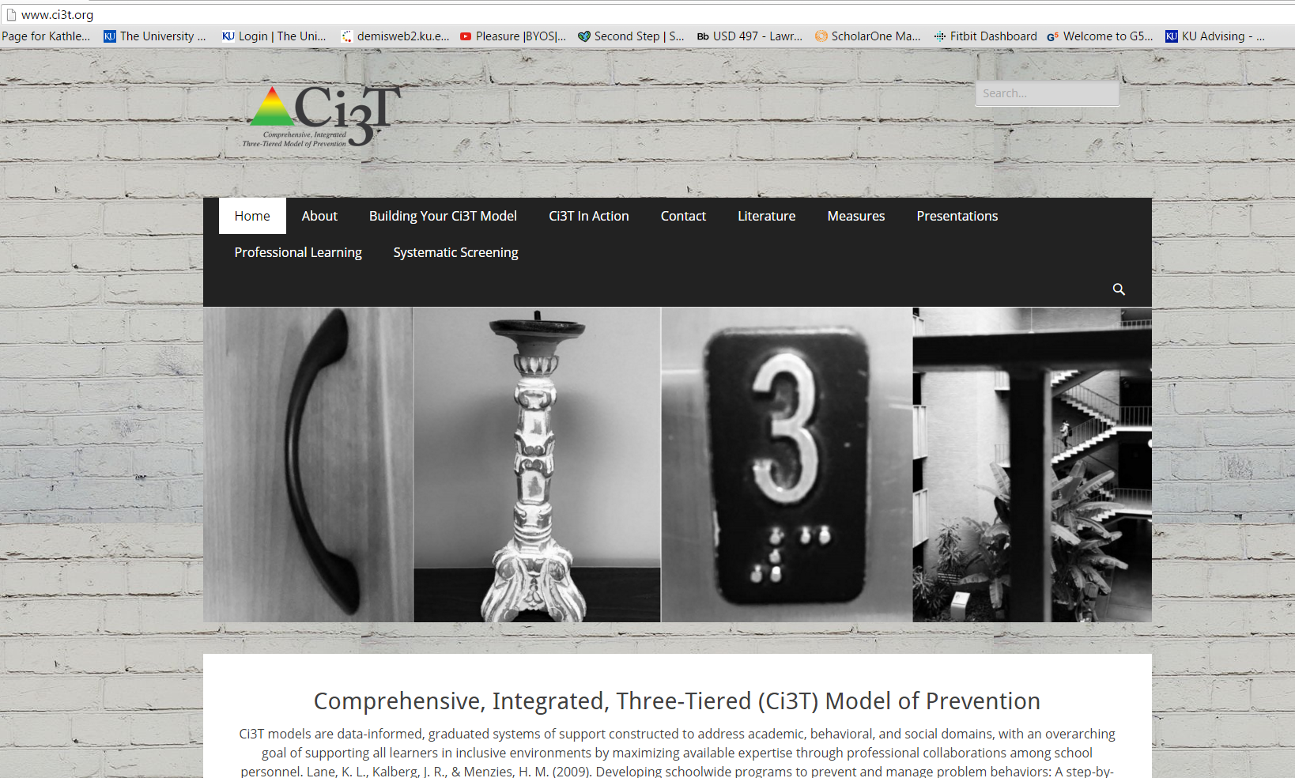

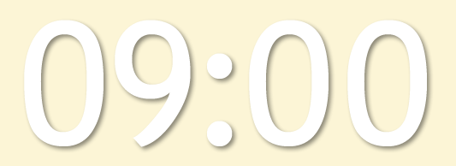










Notes:
10 min Using this PowerPoint break timer
**Is timer set to correct time. Do we want 25 or 10? Same question for above slide.
This PowerPoint slide uses images, custom animation, and timing to provide a countdown timer that you can use in any presentation. When you open the template, you’ll notice that the timer is set at 00:00. However, when you start the slide show, the timer will start at the correct time and count down by 1-minute intervals until it gets to 1 minute. At that point, it will count down in two 30-seconds intervals to 00:00.
To insert this slide into your presentation
Save this template as a presentation (.ppt file) on your computer.
Open the presentation that will contain the timer.
On the Slides tab, place your insertion point after the slide that will precede the timer. (Make sure you don't select a slide. Your insertion point should be between the slides.)
On the Insert menu, click Slides from Files.
In the Slide Finder dialog box, click the Find Presentation tab.
Click Browse, locate and select the timer presentation, and then click Open.
In the Slides from Files dialog box, select the timer slide.
Select the Keep source formatting check box. If you do not select this check box, the copied slide will inherit the design of the slide that precedes it in the presentation.
Click Insert.
Click Close.

Slide 17
Ci3T Professional Learning Series
Pre-Training Activities
  Team member selection
  Schoolwide Expectations Survey for Specific Settings (SESSS)
Session 1:
2 hours
  Ci3T model overview
Session 2:
Full day
  Building the primary prevention plan
Session 3:
2 hours
  How to monitor the plan
  Student team members attend
Session 4:
Full day
  Building Tier 2 supports
Session 5:
2 hours
  Building Tier 3 supports
  Student team members attend
Session 6:
Full day
  Preparing to implement
Implementation
Homework
Share overview with faculty and staff; Build reactive plan
Homework
Finalize and share expectation matrix and teaching & reinforcing components
Homework
Share screeners; Complete assessment schedule
Homework
Homework
Share Ci3T plan; Complete PIRS; Complete secondary grid
Share revised Ci3T plan; Complete Ci3T Feedback Form

Slide 18
Lawrence Public Schools … Ci3T Training & Implementation
Phase |  |  |  | Year
 | 2013-14 | 14-15 | 15-16 | 16-17 | 17-18 | 18-19 | 19-20
Elementary School
Ci3T Training
Implementation Year 1
Implementation Year 2
Sustain and Develop Practices
Middle and High Schools
Ci3T Training
Implementation Year 1
Implementation Year 2
Sustain and Develop Practices
College and Career Center
Ci3T Training
Implementation Year 1
Implementation Year 2
Sustain and Develop Practices

Slide 19


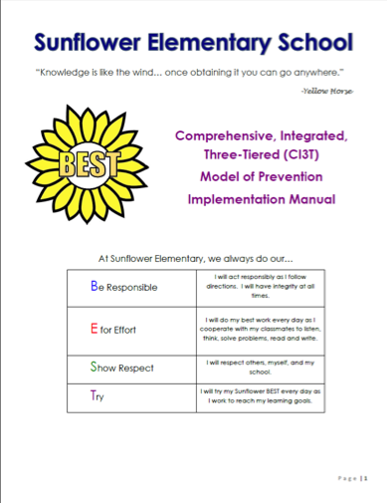


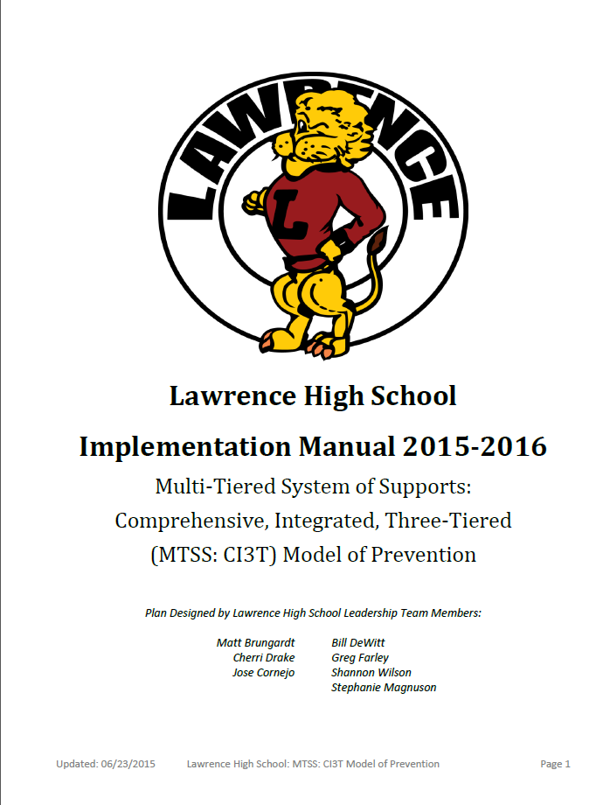



Slide 20
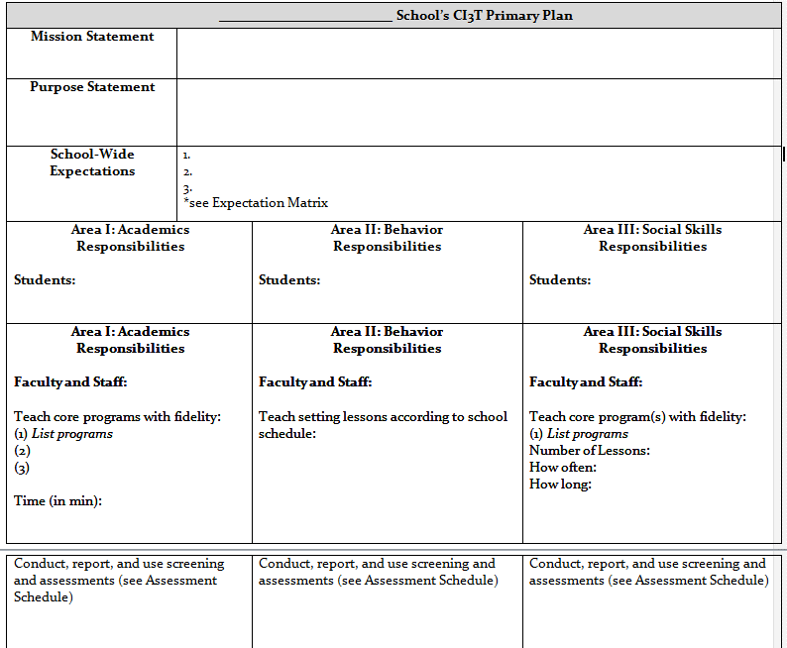
Ci3T Primary Plan: Roles and Responsibilities
all stakeholder groups

Slide 21
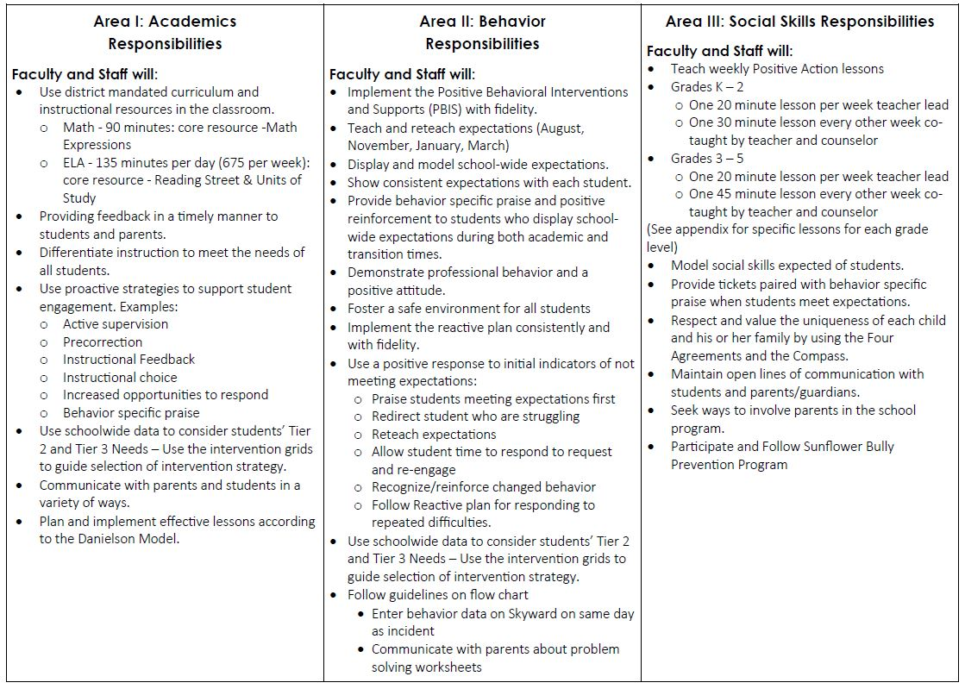
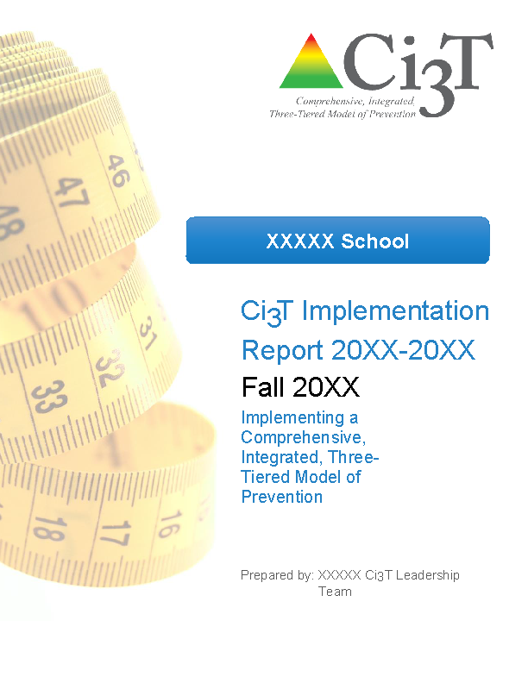
Ci3T Primary Plan: Procedures for Teaching
Ci3T Primary Plan: Procedures for Reinforcing
Ci3T Primary Plan: Procedures for Monitoring

Slide 22
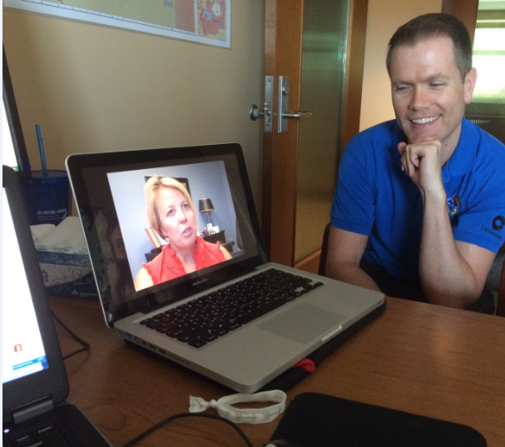
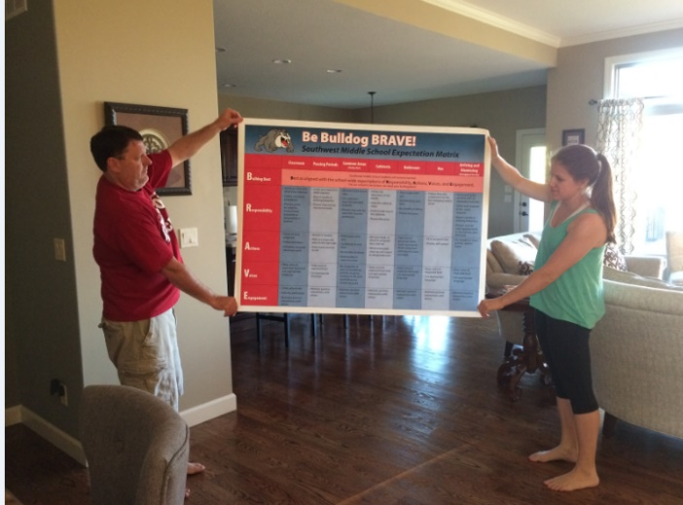
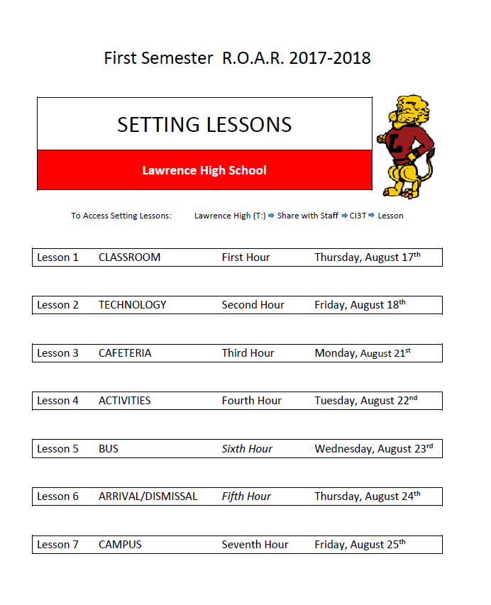
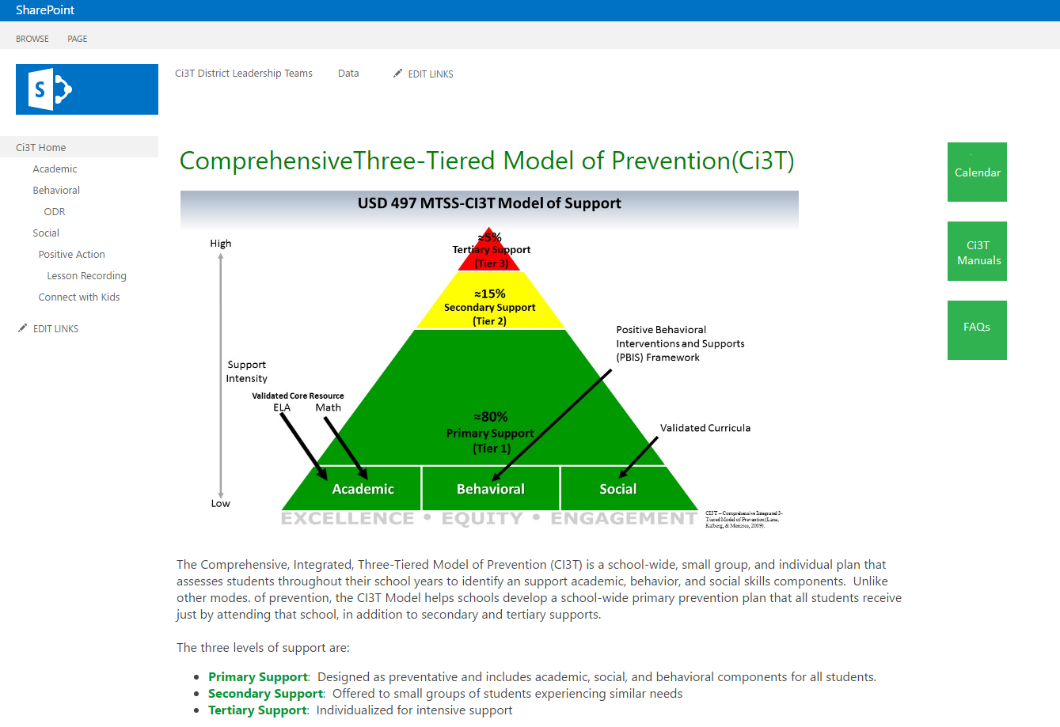

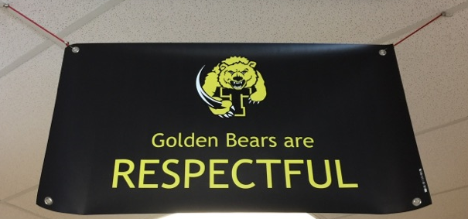
Procedures for Teaching
Faculty and Staff:
Students:
Parents/ Community:
https://youtu.be/b4swsa_knYE
Lane & Oakes 2012

Slide 23
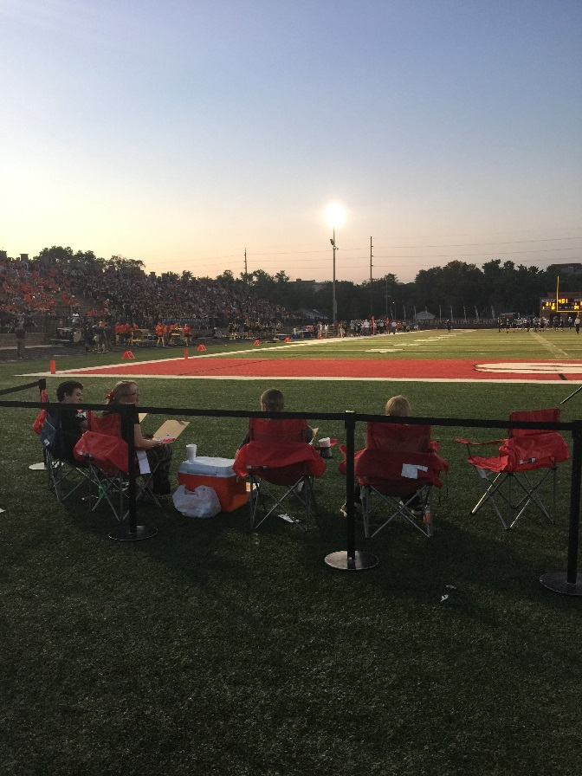

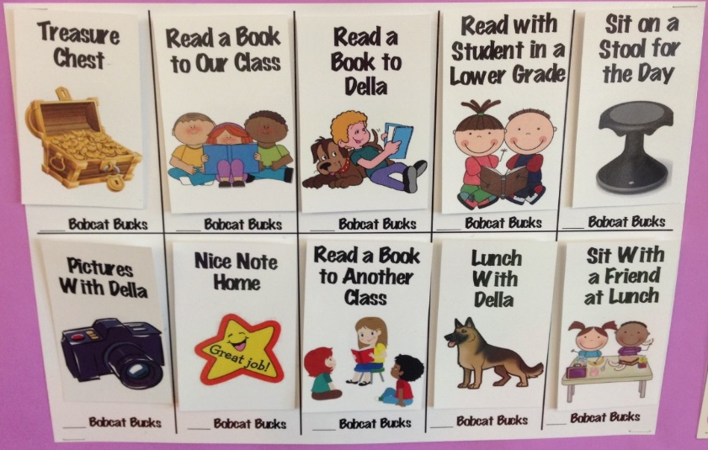
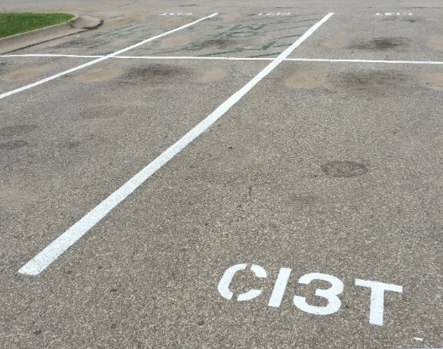
Procedures for Reinforcing
Faculty and Staff:
Students:
Parents/ Community:
Donation Coupon for:
1 box of Macaroni and Cheese to Community Food Drive
Lane & Oakes 2012

Slide 24
Essential Components of
Primary Prevention Efforts
Social Validity
Treatment Integrity
Systematic Screening
Academic
Behavior
Critical information for school and district teams

Slide 25
Measure | Aug | Sept | Oct | Nov | Dec | Jan | Feb | March | April | May
School Demographics
Student Demographic Information
Screening Measures
SRSS-IE
Student Outcome Measures - Academic
Student Outcome Measures - Behavior
Program Measures
Social Validity - PIRS
Schoolwide Evaluation Tool (SET)
CI3T Treatment Integrity

Slide 26

Secondary (Tier 2) Intervention Grids

Slide 27

Tertiary (Tier 3) Intervention Grids

Slide 28
Implementation Science
Adapted from Fixsen & Blasé, 2005
Exploration & Adoption
Installation
Initial Implementation
We think we know what we need so we are planning to move forward (evidence-based)
Let’s make sure we’re ready to implement (capacity infrastructure)
Let’s give it a try & evaluate (demonstration)
Full Implementation
Let’s make it our way of doing business (institutionalized use)
Sustainability & Continuous Regeneration
That worked, let’s do it for real (investment)

Slide 29
Notes:
10 min Using this PowerPoint break timer
**Is timer set to correct time. Do we want 25 or 10? Same question for above slide.
This PowerPoint slide uses images, custom animation, and timing to provide a countdown timer that you can use in any presentation. When you open the template, you’ll notice that the timer is set at 00:00. However, when you start the slide show, the timer will start at the correct time and count down by 1-minute intervals until it gets to 1 minute. At that point, it will count down in two 30-seconds intervals to 00:00.
To insert this slide into your presentation
Save this template as a presentation (.ppt file) on your computer.
Open the presentation that will contain the timer.
On the Slides tab, place your insertion point after the slide that will precede the timer. (Make sure you don't select a slide. Your insertion point should be between the slides.)
On the Insert menu, click Slides from Files.
In the Slide Finder dialog box, click the Find Presentation tab.
Click Browse, locate and select the timer presentation, and then click Open.
In the Slides from Files dialog box, select the timer slide.
Select the Keep source formatting check box. If you do not select this check box, the copied slide will inherit the design of the slide that precedes it in the presentation.
Click Insert.
Click Close.

Slide 30
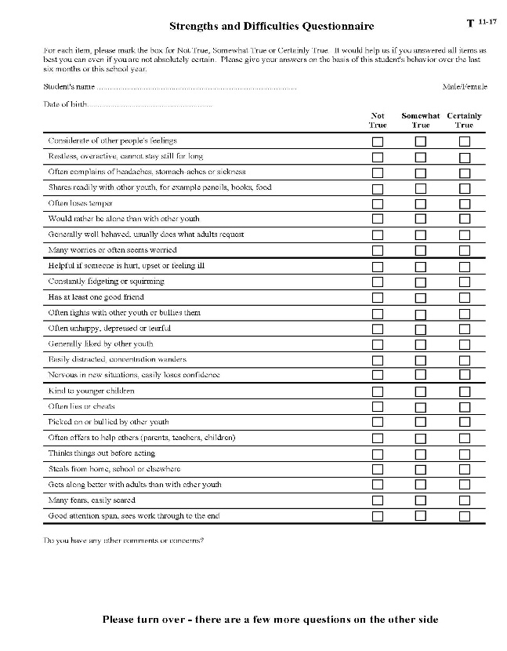


What screening tools are available?
See Lane, Menzies, Oakes, and Kalberg (2012)

Slide 31
Student Risk Screening Scale
(Drummond, 1994)
The SRSS is 7-item mass screener used to identify students who are at risk for antisocial behavior.
Uses 4-point Likert-type scale:
never = 0, occasionally = 1, sometimes = 2, frequently = 3
Teachers evaluate each student on the following items
  - Steal - Low Academic Achievement
  - Lie, Cheat, Sneak - Negative Attitude
  - Behavior Problems - Aggressive Behavior
  - Peer Rejection
Student Risk is divided into 3 categories
  Low 0 – 3
  Moderate 4 – 8
  High 9 - 21 (SRSS; Drummond, 1994)

Slide 32
Student Risk Screening Scale
(Drummond, 1994)
DATE
TEACHER NAME
0 = Never |  | Steal | Lie, Cheat, Sneak | Behavior Problem | Peer Rejection | Low Academic Achievement | Negative Attitude | Aggressive Behavior | SRSS Score: Sum Items 1-7 (Range 0 - 21)
1= Occasionally
2 = Sometimes
3 = Frequently
Use the above scale to rate each item for each student.
Student Name | Student ID
Smith, Sally | 11111 | 0 | 0 | 1 | 0 | 2 | 1 | 3 | 7
 |  |  |  |  |  |  |  |  | 0
 |  |  |  |  |  |  |  |  | 0
 |  |  |  |  |  |  |  |  | 0
 |  |  |  |  |  |  |  |  | 0
 |  |  |  |  |  |  |  |  | 0
 |  |  |  |  |  |  |  |  | 0
 |  |  |  |  |  |  |  |  | 0
 |  |  |  |  |  |  |  |  | 0
 |  |  |  |  |  |  |  |  | 0
 |  |  |  |  |  |  |  |  | 0
 |  |  |  |  |  |  |  |  | 0
 |  |  |  |  |  |  |  |  | 0
 |  |  |  |  |  |  |  |  | 0
 |  |  |  |  |  |  |  |  | 0

Slide 33
Student Risk Screening Scale
Middle School Fall 2004 - Fall 2011
n = 12
n = 20
n = 507
Percentage of Students
N=534
N=502
N=454
N=470
N=477
N=476
N=524
N= 539
Fall Screeners
Lane, K. L., Oakes, W. P., & Magill, L. (2014). Primary prevention efforts: How do we implemented and monitor the Tier 1 component of our Comprehensive, Integrated, Three-Tiered (CI3T) Model? Preventing School Failure. 58, 143-158.

Slide 34
sample data: SRSS
Middle School Study 1: Behavioral & Academic Characteristics of SRSS Risk Groups
Variable |  | Risk
 | Low (n = 422) M (SD) | Moderate (n = 51) M (SD) | High (n = 12) M (SD) | Significance Testing
ODR | 1.50 (2.85) | 5.02 (5.32) | 8.42 (7.01) | L<M<H
In-School Suspensions | 0.08 (0.38) | 0.35 (1.04) | 1.71 (2.26) | L<M<H
GPA | 3.35 (0.52) | 2.63 (0.65) | 2.32 (0.59) | L>M, H M=H
Course Failures | 0.68 (1.50) | 2.78 (3.46) | 4.17 (3.49) | L<M, H M=H
(Lane, Parks, Kalberg, & Carter, 2007)

Slide 35
Student Risk Screening Scale
High School: Behavioral & Academic Characteristics of SRSS Risk Groups
Non-Instructional Raters
Variable |  | Risk
 | Low (n = 328) M (SD) | Moderate (n = 52) M (SD) | High (n = 35) M (SD) | Significance Testing
ODR | 3.53 (5.53) | 8.27 (7.72) | 8.97 (9.39) | L < M, H M = H
GPA | 3.10 (0.82) | 2.45 (0.84) | 2.38 (0.88) | L > M, H M = H
(Lane, Kalberg, Parks, & Carter, 2008)

Slide 36
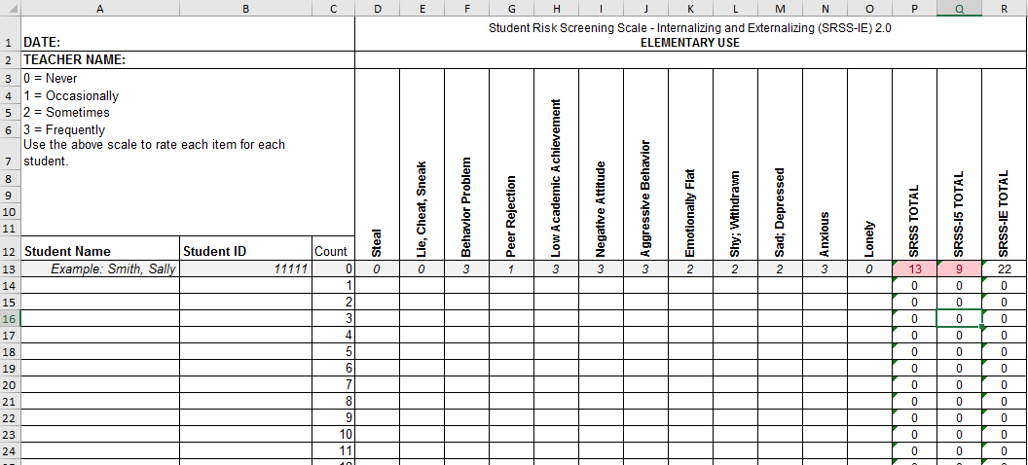
SRSS-IE for Elementary Schools

Slide 37
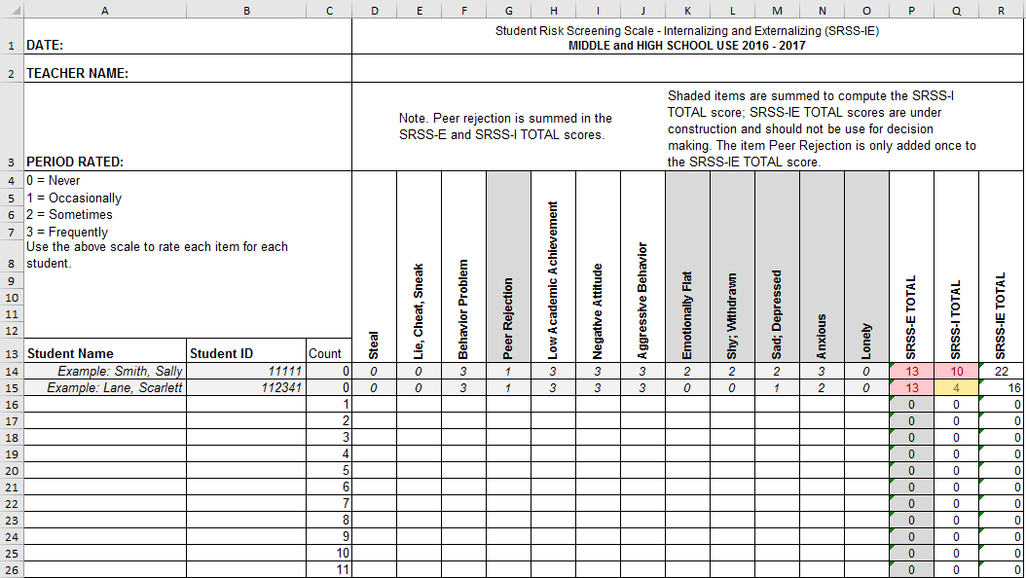
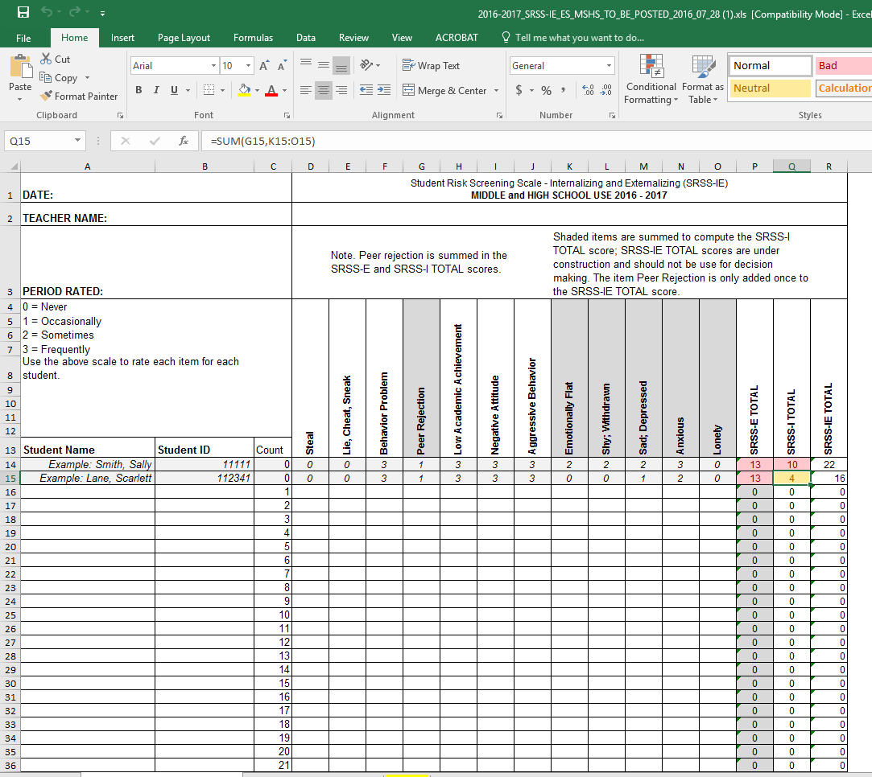
SRSS-IE for Middle and High Schools

Slide 38
SRSS-IE: Cut Scores
Elementary School |  | Middle and High School
SRSS-E7 | SRSS-I5 | SRSS-E7 | SRSS-I6
Items 1-7 | Items 8-12 | Items 1-7 | Items 4, 8-12
0-3 = low risk 4-8 = moderate risk 9-21 = high risk | 0-1 = low risk 2-3 = moderate risk 4-15 = high risk | 0-3 = low risk 4-8 = moderate risk 9-21 = high risk | 0-3 = low risk 4-5 = moderate risk 6-18 = high risk
Elementary School Level:
Lane, K. L., Oakes, W. P., Swogger, E. D., Schatschneider, C., Menzies, H., M., & Sanchez, J. (2015). Student risk screening scale for internalizing and externalizing behaviors: Preliminary cut scores to support data-informed decision making. Behavioral Disorders, 40, 159-170.
Middle and High School Levels:
Lane, K. L., Oakes, W. P., Cantwell, E. D., Schatschneider, C., Menzies, H., Crittenden, M., & Messenger, M. (in press). Student Risk Screening Scale for Internalizing and Externalizing Behaviors: Preliminary cut scores to support data-informed decision making in middle and high schools. Behavioral Disorders.

Slide 39
ES Fall
SRSS-E7 Results – All Students
N = 34
N = 29
N = 20
N = 99
N = 78
N = 56
N = 371
N = 407
N = 358
Notes:
DES

Slide 40
ES Fall
SRSS-I5 Results – All Students
N = 55
N = 46
N = 35
N = 90
N = 77
N = 64
N = 359
N = 391
N = 335
Notes:
DES

Slide 41
HS Fall
SRSS-E7 Results – All Students
N = 29
N = 39
N = 96
N = 95
N = 1072
N = 1404
Notes:
LHS

Slide 42
SRSS-E7 Comparison by Grade Level
HS Fall 2016
Grade Level | N Screened | Low (0-3) | Moderate (4-8) | High (9-21)
9th | 397 | 361 (90.93%) | 29 (7.30%) | 7 (1.76%)
10th | 428 | 381 (89.02%) | 32 (7.48%) | 15 (3.50%)
11th | 396 | 363 (91.67%) | 24 (6.06%) | 9 (2.27%)
12th | 317 | 299 (94.32%) | 10 (3.15%) | 8 (2.52%)
Notes:
LHS N = 1498

Slide 43
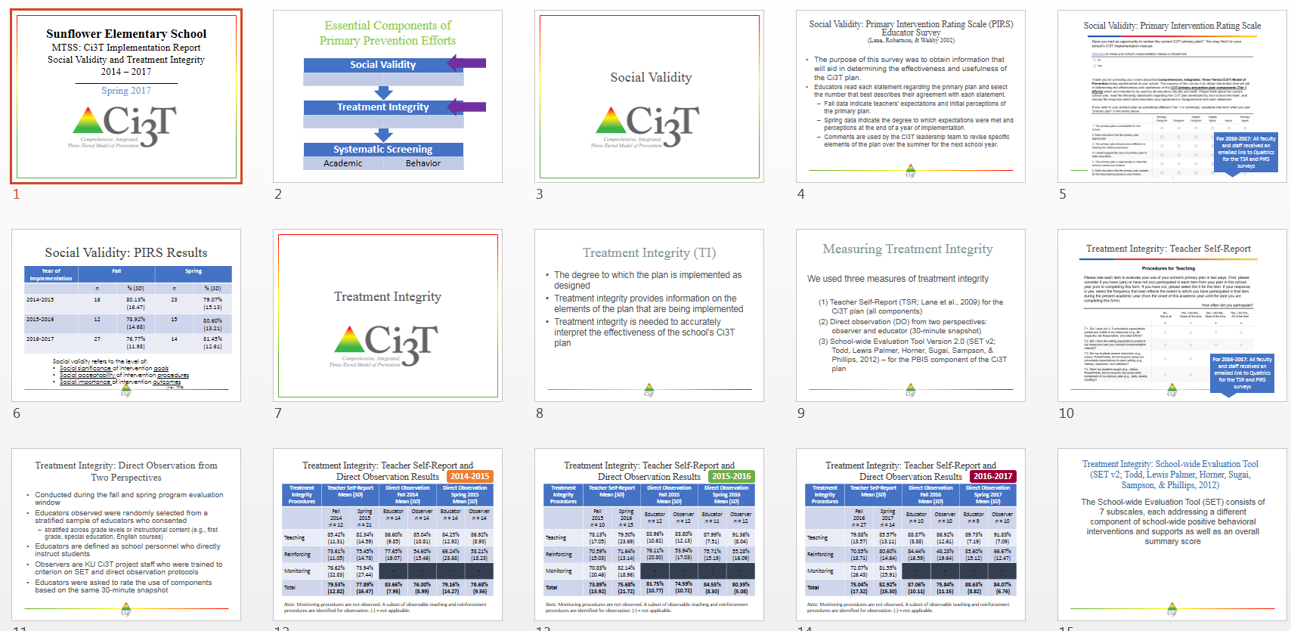
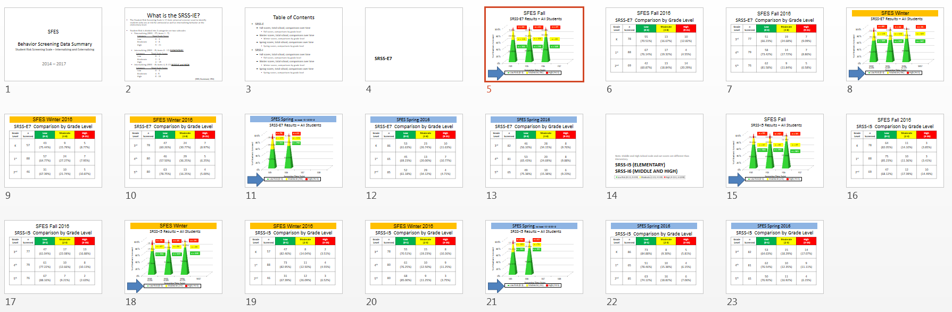
Implementation …
Data-Informed Decision Making

Slide 44
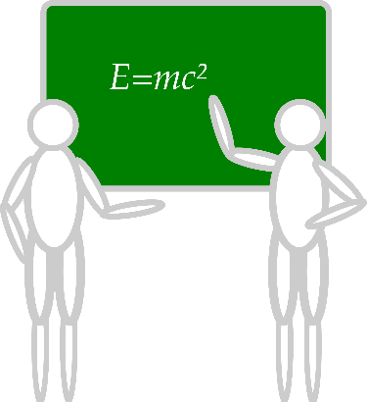





Communication and Continuous Improvement
Effective
Teams
Ci3T District Leadership Team
College & Career
Ci3T School Leadership Team
Ci3T School Leadership Team
Ci3T School Leadership Team
Ci3T School Leadership Team
Ci3T School Leadership Team
Ci3T School Leadership Team
Ci3T School Leadership Team
Ci3T School Leadership Team
Ci3T School Leadership Team
Ci3T School Leadership Team
Ci3T School Leadership Team
Ci3T School Leadership Team
Ci3T School Leadership Team
Ci3T School Leadership Team
Ci3T School Leadership Team
High
Ci3T School Leadership Team
Ci3T School Leadership Team
Middle
Ci3T School Leadership Team
Ci3T School Leadership Team
Ci3T School Leadership Team
Ci3T School Leadership Team
Elementary
Notes:
Structure for positive, productive discussions
Data-informed professional development

Slide 45
Notes:
10 min Using this PowerPoint break timer
**Is timer set to correct time. Do we want 25 or 10? Same question for above slide.
This PowerPoint slide uses images, custom animation, and timing to provide a countdown timer that you can use in any presentation. When you open the template, you’ll notice that the timer is set at 00:00. However, when you start the slide show, the timer will start at the correct time and count down by 1-minute intervals until it gets to 1 minute. At that point, it will count down in two 30-seconds intervals to 00:00.
To insert this slide into your presentation
Save this template as a presentation (.ppt file) on your computer.
Open the presentation that will contain the timer.
On the Slides tab, place your insertion point after the slide that will precede the timer. (Make sure you don't select a slide. Your insertion point should be between the slides.)
On the Insert menu, click Slides from Files.
In the Slide Finder dialog box, click the Find Presentation tab.
Click Browse, locate and select the timer presentation, and then click Open.
In the Slides from Files dialog box, select the timer slide.
Select the Keep source formatting check box. If you do not select this check box, the copied slide will inherit the design of the slide that precedes it in the presentation.
Click Insert.
Click Close.

Slide 46
Examining your screening data …
… implications for primary prevention efforts
… implications for teachers
… implications for student-based interventions
See Lane, Menzies, Bruhn, and Crnobori (2011)

Slide 47
Social Skills Improvement System – Performance Screening Guide
Spring 2012 – Total School
N = 54
N = 22
N = 35
N = 31
N = 223
N = 233
N = 180
N = 187
N = 212
N = 235
N = 275
N = 271
n = 489 n = 490 n = 490 n = 489
Lane, K. L., Oakes, W. P., & Magill, L. (2013). Primary prevention efforts: How do we implemented and monitor the Tier 1 component of our Comprehensive, Integrated, Three-Tiered (CI3T) Model?

Slide 48
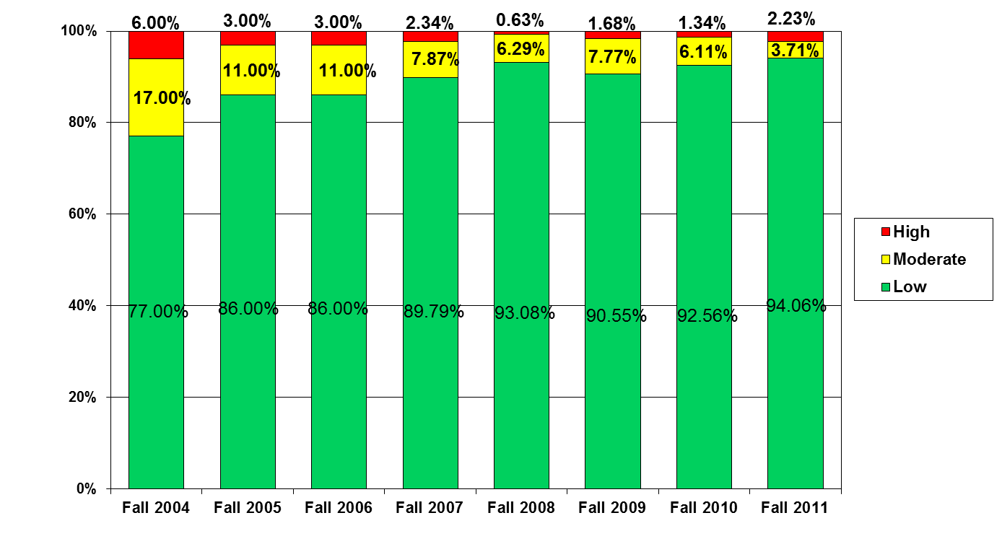
Student Risk Screening Scale
Middle School Fall 2004 - Fall 2011
n = 12
n = 20
n = 507
Percentage of Students
N=534
N=502
N=454
N=470
N=477
N=476
N=524
N= 539
Fall Screeners

Slide 49
Examining your screening data …
… implications for primary prevention efforts
… implications for teachers
… implications for student-based interventions
See Lane, Menzies, Bruhn, and Crnobori (2011)

Slide 50


Schoolwide Positive
Behavior Support
Comprehensive, Integrative,
Three-tiered (CI₃T)
Models of Support
Low Intensity Strategies
Basic Classroom Management
Effective Instruction
Low Intensity Strategies
Behavior Contracts
Self-Monitoring
- -
Functional Assessment-Based
Interventions
Higher Intensity
Strategies
Assess, Design, Implement,
and
Evaluate
Assessment

Slide 51
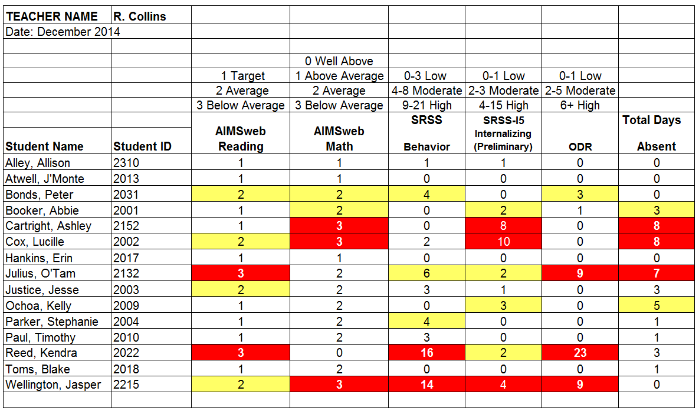
Examining Academic and Behavioral Data – Elementary Level
Notes:
Lane, K. L., Oakes, W. P., Ennis, R. P., & Hirsch, S. E. (2014). Identifying students for secondary and tertiary prevention efforts: How do we determine which students have Tier 2 and Tier 3 needs? Preventing School Failure, 58, 171-182, DOI: 10.1080/1045988X.2014.895573

Slide 52

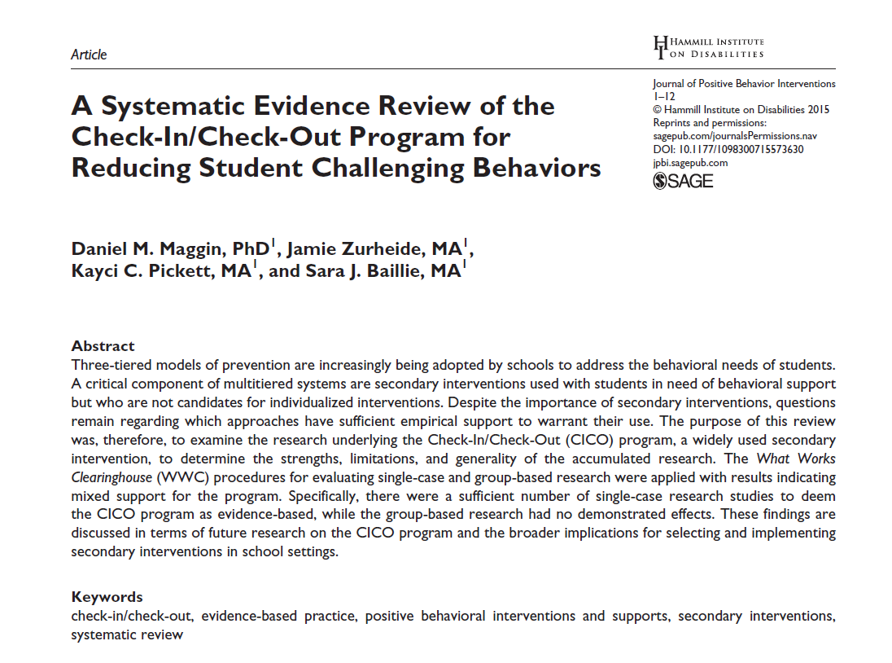

Low-Intensity Strategies: Building capacity through professional learning
Opportunities to Respond
Behavior Specific Praise
Active Supervision
Instructional Feedback
High p Requests
Self-monitoring
Precorrection
Behavior Contracts
Incorporating Choice
Notes:
Lane, K. L., Oakes, W. P., Ennis, R. P., & Hirsch, S. E. (2014). Identifying students for secondary and tertiary prevention efforts: How do we determine which students have Tier 2 and Tier 3 needs? Preventing School Failure, 58, 171-182, DOI: 10.1080/1045988X.2014.895573

Slide 53
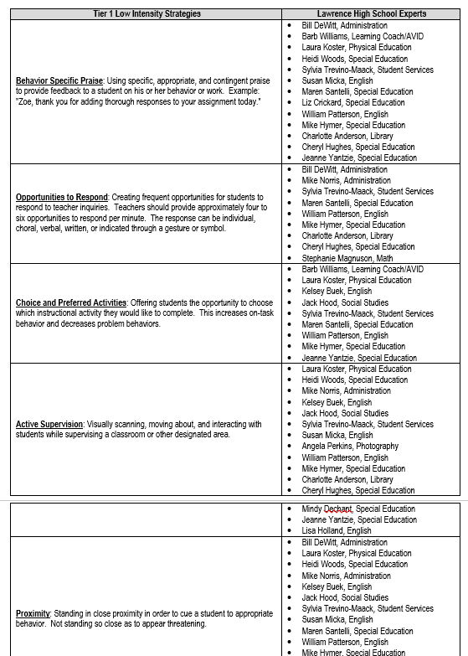
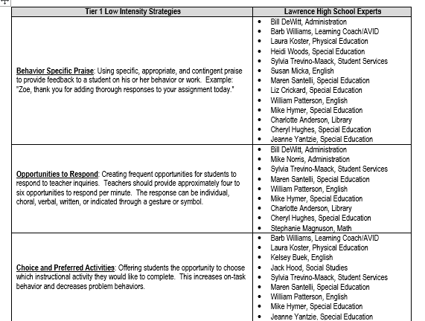

Slide 54

ci3t.org

Slide 55
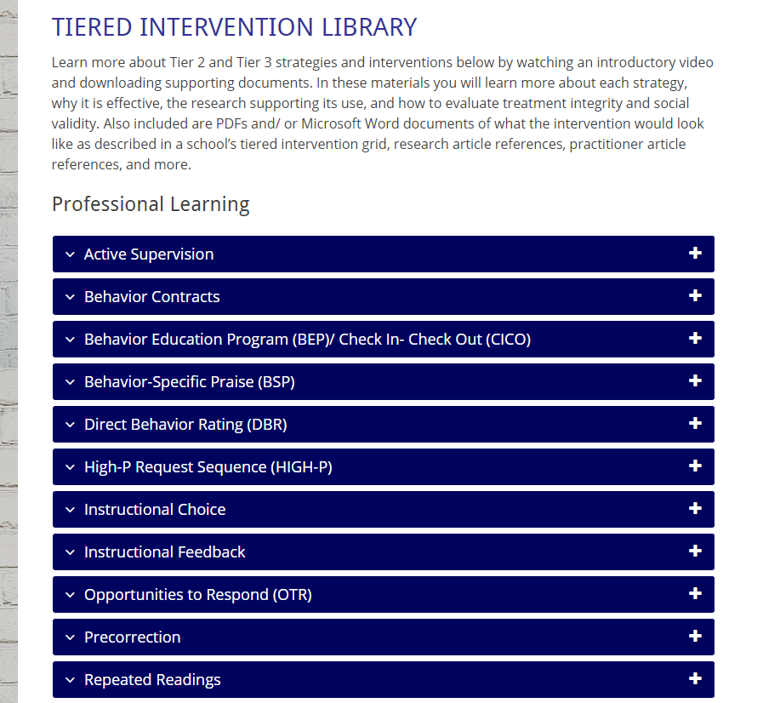
Professional Learning! www.ci3t.org/pl

Slide 56
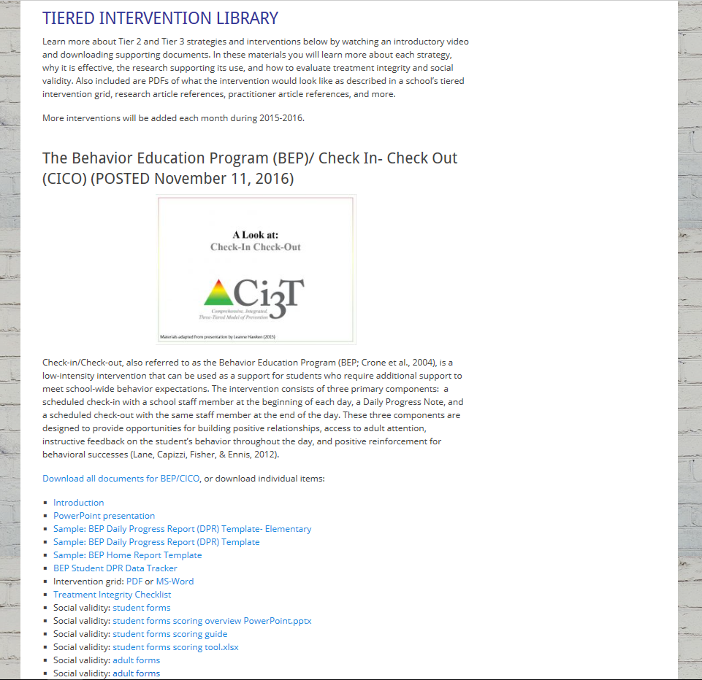

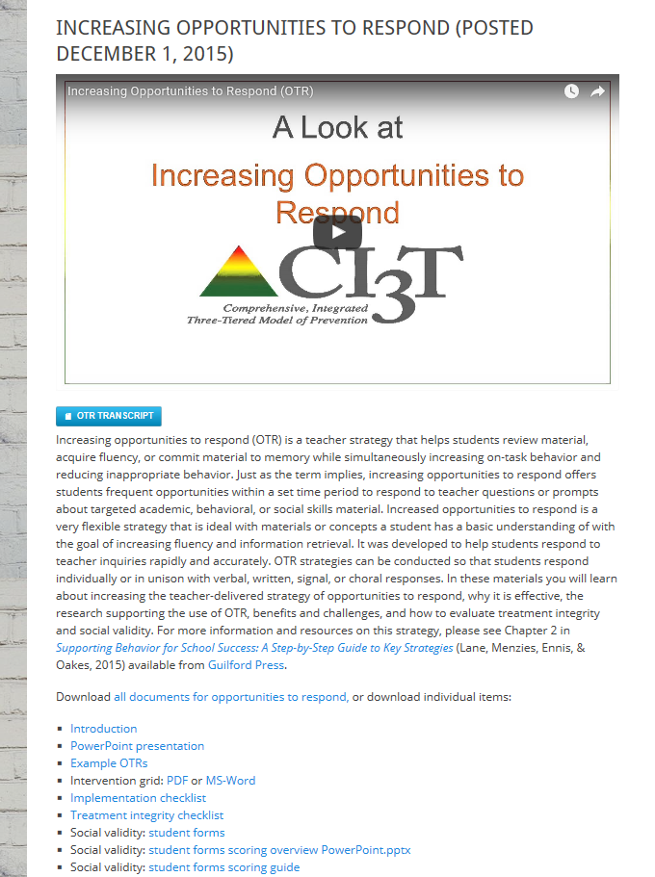
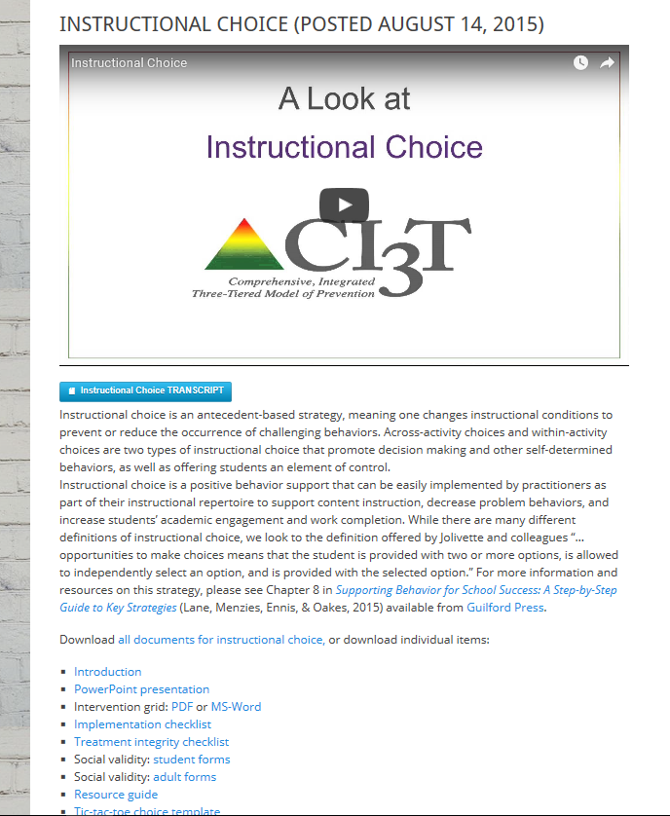
ci3t.org
Professional Learning tab

Slide 57
Examining your screening data …
… implications for primary prevention efforts
… implications for teachers
… implications for student-based interventions
See Lane, Menzies, Bruhn, and Crnobori (2011)

Slide 58
Secondary (Tier 2) Intervention Grids

Slide 59
BASC² – Behavior and Emotional Screening Scale
Spring 2012
N = 24
N = 67
N = 533
N = 624 n = 219 n = 202 n = 203

Slide 60
Schoolwide Positive Behavior
Support
Comprehensive, Integrative,
Three-tiered (CI3T)
Models of Support
Low Intensity Strategies
Basic Classroom Management
Effective Instruction
Low Intensity Strategies
Behavior Contracts
Self-Monitoring
- -
Functional Assessment-Based
Interventions
Higher Intensity Strategies
Assess, Design, Implement,
and
Evaluate
Assessment

Slide 61
Sample Secondary Intervention Grid
Sample Secondary Intervention Grid
Support | Description | Schoolwide Data: Entry Criteria | Data to Monitor Progress | Exit Criteria
Behavior Contract | A written agreement between two parties used to specify the contingent relationship between the completion of a behavior and access to or delivery of a specific reward. Contract may involve administrator, teacher, parent, and student. | Behavior: SRSS - mod to high risk Academic: 2 or more missing assignments with in a grading period | Work completion, or other behavior addressed in contract Treatment Integrity Social Validity | Successful Completion of behavior contract
Self-monitoring | Students will monitor and record their academic production (completion/ accuracy) and on-task behavior each day. | Students who score in the abnormal range for H and CP on the SDQ; course failure or at risk on CBM | Work completion and accuracy in the academic area of concern; passing grades Treatment Integrity Social Validity | Passing grade on the report card in the academic area of concern
Lane, Kalberg, & Menzies (2009). pp. 131 - 137, Boxes 6.1 - 6.4

Slide 62
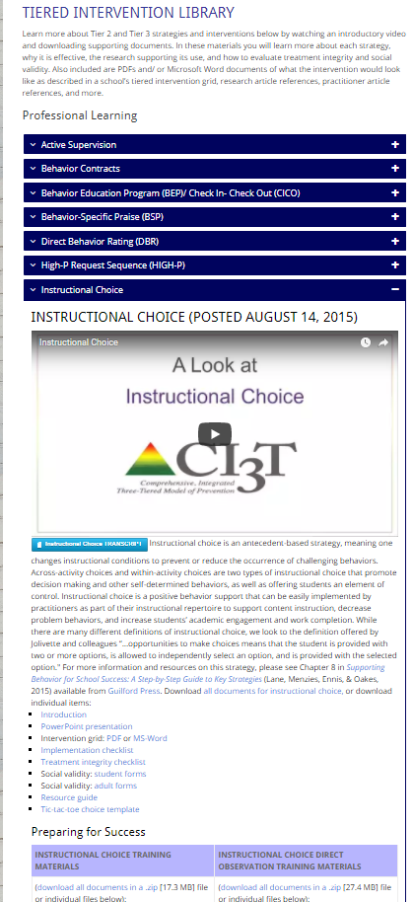

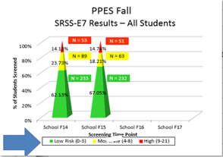
Instructional Choice
Ci3T Secondary (Tier 2) Intervention Grid
Support | Description | School-wide Data: Entry Criteria | Data to Monitor Progress | Exit Criteria
Instructional Choice | Within and across task choices offered during reading instruction. During independent language arts assignments. Choices offered by teacher in general education classroom. | SRSS moderate risk and Report card work completed and independent work habits Progressing or Limited Improvement | Academic engaged time % work completed Treatment Integrity (component checklist) Social Validity (student & teacher completed) | 5 consecutive weeks of daily: academic engagement ≥80% And work completion ≥ 90%
(Lane, Menzies, Ennis, & Oakes, 2015)
http://www.ci3t.org/pl

Slide 63

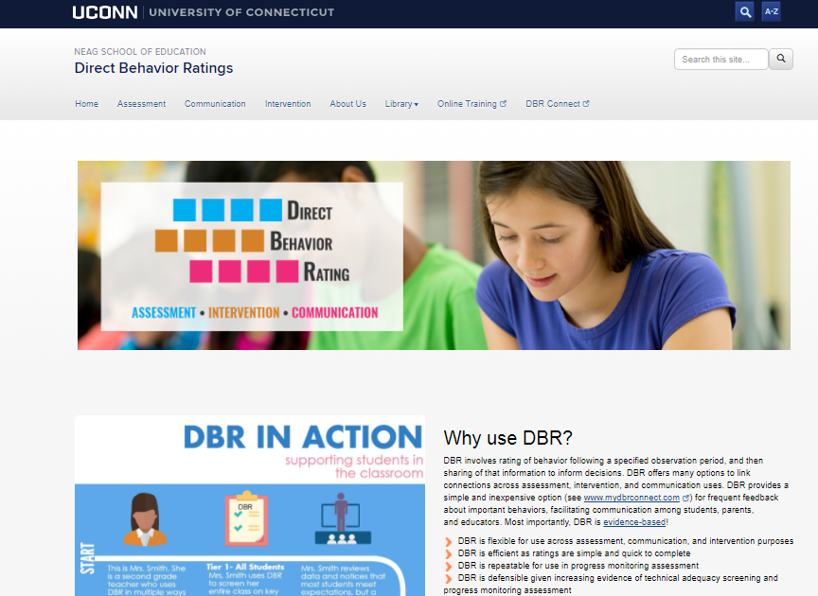
Daily Behavior Report Cards
Support | Description | School-wide Data: Entry Criteria | Data to Monitor Progress | Exit Criteria
Daily Behavior Report (DBR) Card | DBR will be completed by the classroom teacher during daily observation periods (e.g., core instruction during English Language Arts) and parents will sign the form each day. DBR will be used to rate academic engagement, respect, and disruption. At the conclusion of each observation period, the teacher will indicate the degree to which the student displayed each behavior. The teacher will meet briefly with the student to share the teacher’s DBR rating and home-school communication procedures will be established for student to bring a paper copy or email to parent or caregiver each day DBR was implemented for a parent/caregiver to sign. | Behavior SRSS-E7 score: Moderate (4-8) and/or SRSS-I5 score: Moderate (2-3) AND Evidence of teacher implementation of Ci3T primary (Tier 1) plan [treatment integrity: direct observation] AND Parent permission AND Academic Student is in grade 2 or 3 | Student measures Daily behavior report (DBR; daily) Attendance and tardies Social validity Teacher: IRP-15 Student: CIRP Treatment integrity Tier 2 treatment integrity measures Ci3T TI: Direct observation (30 min if needed) | Review student progress at end of 24 sessions Team agrees goals have been met or no further Positive Action small group sessions are warranted SRSS-E7 and I5 scores are in the low risk category
http://dbr.education.uconn.edu/

Slide 64

Positive Action: Tier 2 Groups
Support | Description | School-wide Data: Entry Criteria | Data to Monitor Progress | Exit Criteria
Positive Action (PA) – counselor-led small group | Counselors and/or social workers will lead small group Positive Action sessions for approximately 30-40 min 2-3 days per week. Students will acquire new skills, learn how to engage more fully in instructional experiences, and learn how to meet more school-wide expectations. Small groups will run for up to 24 sessions (8 to 12 weeks depending on the number of sessions conducted per week) using a subset of Positive Action lessons appropriate for student skillsets as identified using Skills For Greatness (teacher, counselor, parent versions) and SSiS-Rating Scale (teacher and parent version). | Behavior SRSS-E7 score: Moderate (4-8) and/or SRSS-I5 score: Moderate (2-3) AND 2 or fewer absences in first 3 months of school AND Evidence of teacher implementation of Ci3T primary (Tier 1) plan [treatment integrity: direct observation] AND Parent permission AND Academic Student is in grade 2 or 3 | Student measures SSiS-Rating Scale (Pre/Post) Skills for Greatness (Pre/Post) Daily behavior report (DBR; daily) Attendance and tardies Social validity Teacher: IRP-15 Student: CIRP Treatment integrity Tier 2 treatment integrity measures Ci3T TI: Direct observation (30 min if needed) | Review student progress at end of 24 sessions Team agrees goals have been met or no further Positive Action small group sessions are warranted SRSS-E7 and I5 scores are in the low risk category

Slide 65


Schoolwide Positive Behavior
Support
Comprehensive, Integrative,
Three-tiered (CI3T)
Models of Support
Low Intensity Strategies
Basic Classroom Management
Effective Instruction
Low Intensity Strategies
Behavior Contracts
Self-Monitoring
- -
Functional Assessment-Based
Interventions
Higher Intensity Strategies
Assess, Design, Implement, and
Evaluate
Assessment

Slide 66
Tertiary (Tier 3) Intervention Grids

Slide 67

Changes in Harry’s Behavior
Cox, M., Griffin, M. M., Hall, R., Oakes, W. P., & Lane, K. L. (2012). Using a functional assessment-based intervention to increase academic engaged time in an inclusive middle school setting. Beyond Behavior, 2, 44 – 54.

Slide 68

Recommendations to Consider
Recommendation #1: Build Stakeholders’ Expertise
Recommendation #2: Develop the Structures to Sustain and Improve Practices
Recommendation #3: Conduct Screenings in a Responsible Fashion
Recommendation #4: Consider Legal Implications- know your state laws

Slide 70
Ci3T Training Series
Ci3T: Primary Prevention
Session 1:
Overview of Ci3T Prevention Models
Setting a Purpose
Establish team meetings and roles
Session 2:
Mission and Purpose
Establish Roles and Responsibilities
Procedures for Teaching
Procedures for Reinforcing
Reactive Plan
Session 3:
Procedures for Monitoring
Session 4:
Revise Primary Plan using Stakeholder feedback
Prepare presentation
Ci3T: Secondary Prevention
Session 5:
Overview of Teacher focused Strategies
Overview of Student Focused Strategies
Using data to determine
Draft the Secondary Intervention Grid based on existing supports
Ci3T: Tertiary Prevention
Session 6:
Final revisions of Ci3T Plan based on stakeholder feedback
Draft Tertiary Prevention Intervention Grids
Design Implementation Manual and Plan for roll out to faculty, students, and parents
Ci3T Team Training Sequence
Implementation Stages of Tier 2 and 3 within Ci3T
Additional Professional Development on Specific Topics
Core Content Curriculum
Check In - Check Out
Functional Assessment-based Interventions
Reading, Math, Writing Benchmarking and Progress Monitoring Tools
Student Driven Interventions, Strategies, & Practices
Additional Tier 3 Supports
Teacher Driven Supports: Instructional Techniques to Improve Students’ Motivation; General Classroom Management Practices; Low-Intensity Behavior Supports
Notes:
Lane and Oakes 2014.

Slide 71
Upcoming Professional Development
Sep | Oct | Nov | Dec | Jan | Feb | Mar | Apr | May
 |  | KU Ci3T Day 1 11/13/18 5:00-7:00PM | KU Ci3T Day 2 12/05/18 8:00AM-4:00PM | KU Ci3T Day 3 01/15/19 5:00-7:00PM | KU Ci3T Day 4 02/12/19 8:00AM-4:00PM |  | KU Ci3T Day 5 04/03/19 5:00-7:00PM | KU Ci3T Day 6 05/09/19 8:00AM-4:00PM
KU Ci3T IMP Day 1 09/19/18 |  | KU Ci3T IMP Day 2 11/14/18 |  | KU Ci3T IMP Day 3 01/16/19 |  | KU Ci3T IMP Day 4 03/19/19 | KU Ci3T IMP Day 5 04/02/19
Technology Training Day 1 09/20/18 9:00AM-12:00PM |  | Technology Training Day 2 11/28/18 5:00-7:00PM
TOT Coaching Call Session 1 09/20/18 |  | TOT Coaching Call Session 2 11/16/18 | TOT Coaching Call Session 3 12/07/18 | TOT Coaching Call Session 4 01/17/19 | TOT Coaching Call Session 5 02/13/19 | TOT Coaching Call Session 6 03/21/19 | TOT Coaching Call Session 7 04/04/19 | TOT Coaching Call Session 8 05/03/19
 | KU Ci3T EMPOWER Session 1 10/03/18 | KU Ci3T EMPOWER Session 2 11/15/18 |  | KU Ci3T EMPOWER Session 3 01/24/19 |  | KU Ci3T EMPOWER Session 4 03/20/19 | KU Ci3T EMPOWER Session 5 04/17/19
KU Ci3T TRAINING
KU Ci3T IMPLEMENTATION
5:00-7:00 PM
Trainer of Trainers Coaching Calls
4:00-5:30 PM
Register 2-3 colleagues today!
KU Project EMPOWER
5:00-7:00 PM

Slide 72
Ci3T Team Implementation Support
9/19/18
5:00-7:00 PM
Supporting Success: A Look at Tier 1
11/14/18
5:00-7:00 PM
Planning for Success: Monitoring and Communication
1/16/19
5:00-7:00 PM
Using Your Data to Inform Instruction
3/19/19
5:00-7:00 PM
Supporting Students Across the Tiers
4/2/19
5:00-7:00 PM
Planning for the Year Ahead

Slide 73
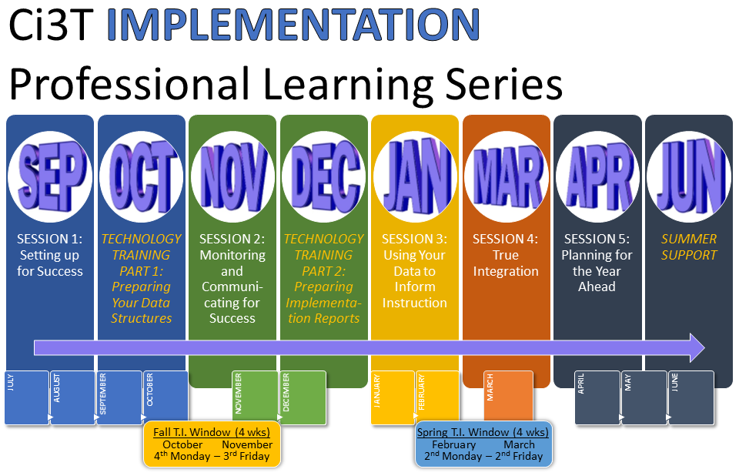

Slide 74
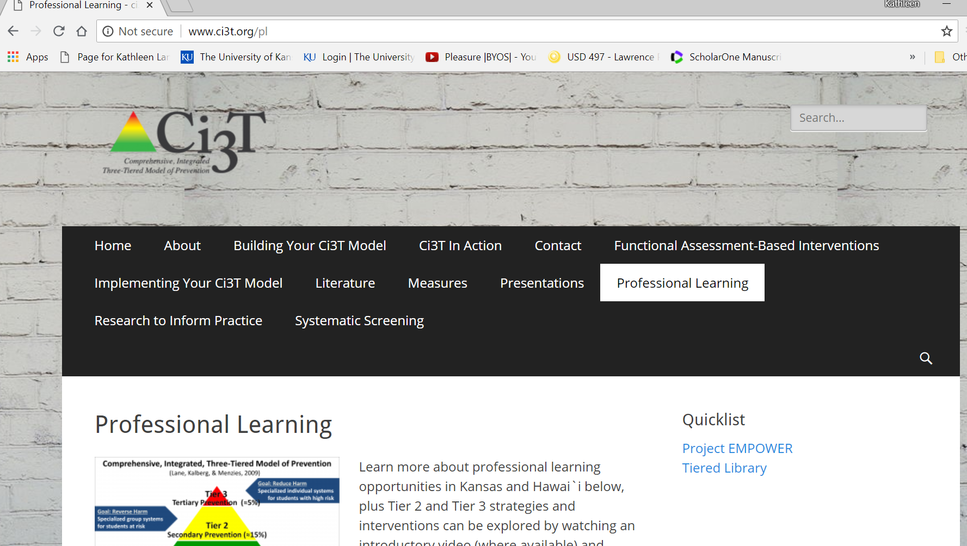
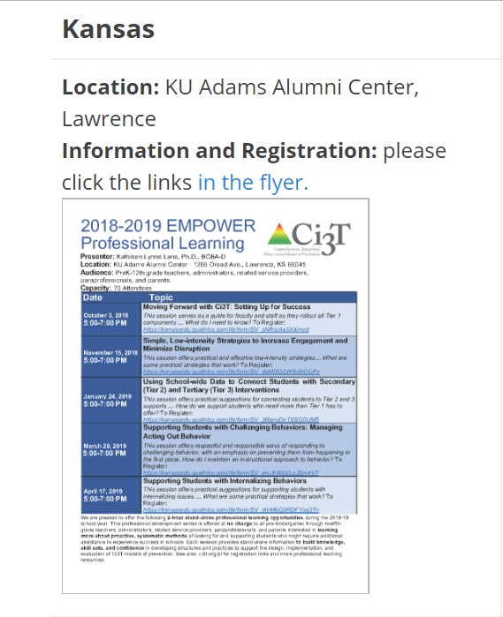


Slide 75

www.ci3t.org
Kathleen.Lane@ku.edu
615.545.5634
Notes:
Add website info here (e.g., new tab)

