Slide 1
Tier 2 Strategies:
A Look at Self-Monitoring
Wendy Peia Oakes, Ph.D. Arizona State University
Kathleen Lynne Lane, Ph.D., BCBA-D University of Kansas

Slide 2


Agenda
Comprehensive, Integrated, Three-Tiered (Ci3T) Models of Prevention
A look at Self-Monitoring
  What is self-monitoring?
  Why is self-monitoring effective?
  What does the supporting research for self-monitoring say?
  What are the benefits and challenges?
  How do I implement self-monitoring in my classroom?
  Implementation Checklist
  How well is it working? Examining the Effects

Slide 3
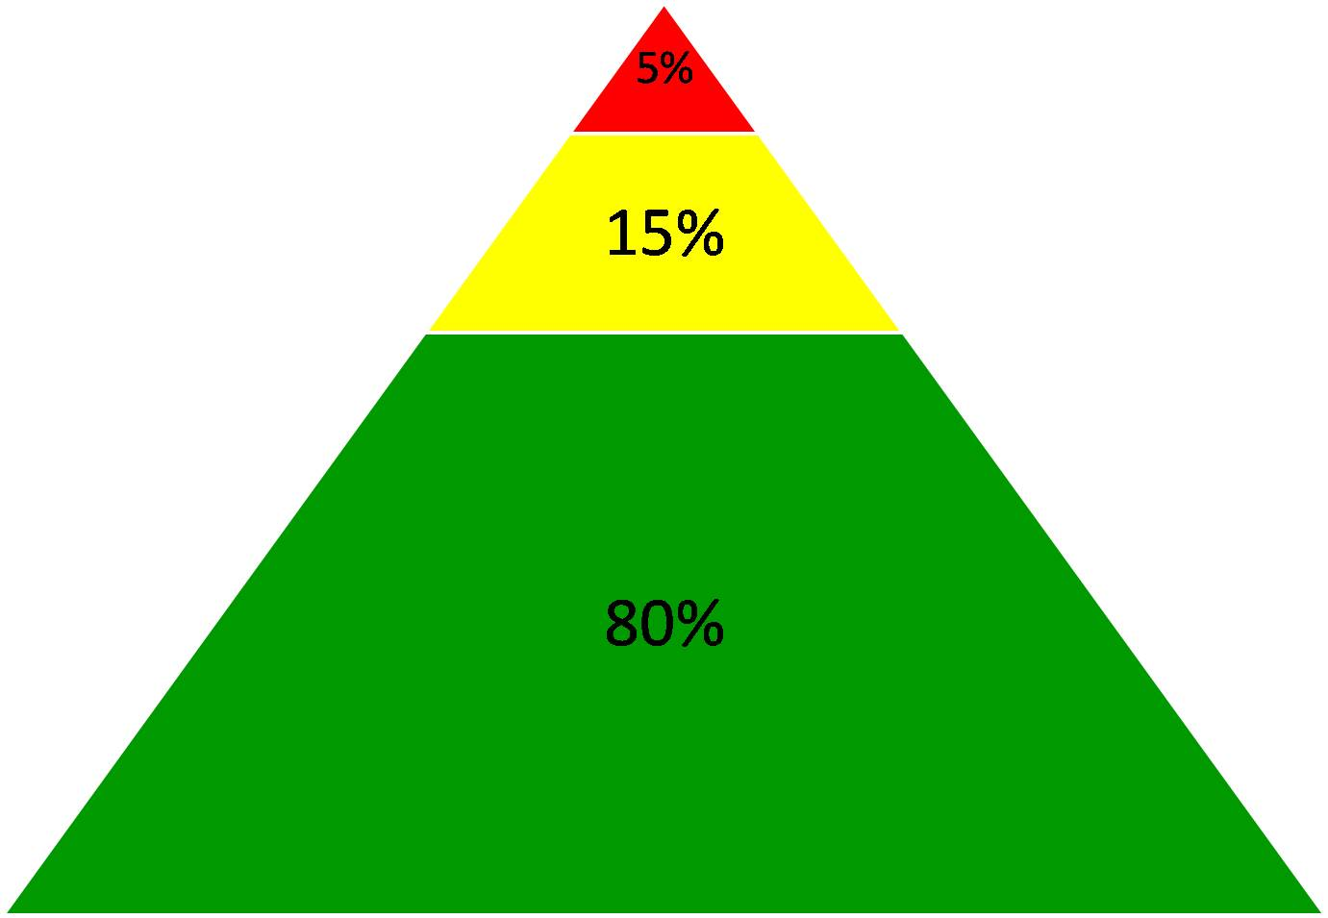
Comprehensive, Integrated, Three-Tiered Model of Prevention (Lane, Kalberg, & Menzies, 2009)
Goal: Reduce Harm
Specialized Individual Systems
for Students with High-Risk
≈
Tertiary Prevention (Tier 3)
Goal: Reverse Harm
Specialized Group Systems
for Students At-Risk
≈
Secondary Prevention (Tier 2)
PBIS Framework
Goal: Prevent Harm
School/Classroom-Wide Systems for All Students, Staff, & Settings
≈
Validated Curricula
Primary Prevention (Tier 1)
Academic
Behavioral
Social
Notes:
Lane, K. L., Oakes, W. P., Ennis, R. P., & Hirsch, S. E. (2014). Identifying students for secondary and tertiary prevention efforts: How do we determine which students have Tier 2 and Tier 3 needs? Preventing School Failure, 58, 171-182, DOI: 10.1080/1045988X.2014.895573

Slide 4
Monitoring Progress
Treatment Integrity
Is it happening?
Social Validity
What do stakeholders think about the goals, procedures, and outcomes?
Experimental Design
How well did this support work for this student?
Notes:
Lane, K. L., Oakes, W. P., Ennis, R. P., & Hirsch, S. E. (2014). Identifying students for secondary and tertiary prevention efforts: How do we determine which students have Tier 2 and Tier 3 needs? Preventing School Failure, 58, 171-182, DOI: 10.1080/1045988X.2014.895573

Slide 5

A Look at:
Self-Monitoring
Chapter 6

Slide 6
What is self-monitoring?
One commonly used self-management strategy
Involves teaching students to:
  Observe, or determine if a behavior occurred using an operational definition
  Record whether or not the behavior occurred

Slide 7
Why is self-monitoring effective?
Easy
Convenient
High social validity (students like it)
Promotes independency and self-determined behaviors
Impacts behavior and academic components

Slide 8
An Overview of Supporting Research on Self-Monitoring
Self-management strategies are empirically supported across general education, self-contained special education, and resource classrooms
(Briesch & Chafouleas, 2009)
Most commonly used self-management strategy for supporting students with emotional and behavioral disorders (Mooney et al., 2005)
  Generally favorable outcomes in improving academic skills
  Students with emotional and behavioral disorders showed improvements in specific, targeted academic skills
  Gains generalized and maintained
  (Mooney et al., 2005)

Slide 9
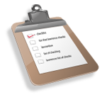
What does the supporting research for self-monitoring say?
Self-management interventions are an evidence-based practice for improving the classroom conduct of students with challenging behaviors (Maggin, Briesch, & Chafouleas, 2012)
  Elementary (Levendoski & Cartledge, 2000)
  Increased on-task behavior and academic productivity
  High social validity for students
  Middle School (Carr & Punzo, 1993)
  Improved academic accuracy, productivity, and engagement for middle school students with EBD
  High social validity for students

Slide 10
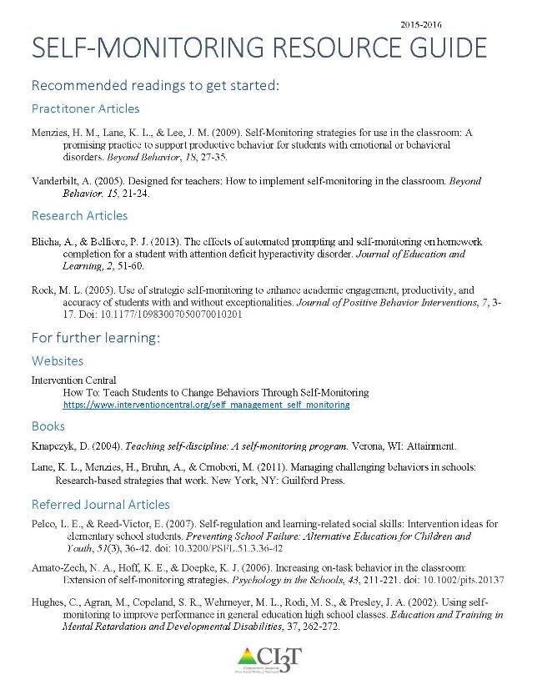
Supporting Research
See “Self-Monitoring Resource Guide” in the Resources folder for additional
supporting research and information.

Slide 11
What are the benefits and challenges?
Benefits
Challenges
Can positively impact behavior, productivity, and accuracy
Empower students to become more independent and self-sufficient in their ability to regulate their environment
Not appropriate for acquisition deficits, self-injurious, or aggressive behaviors

Slide 12

How do I implement self-monitoring in my classroom?
Step 1
Establish prerequisite conditions
Step 2
Identify and operationally define the behaviors
Step 3
Design the self-monitoring procedures, including a monitoring form

Slide 13
How do I implement self-monitoring in my classroom?
Step 4
Teach the self-monitoring procedures
Step 5
Monitor student progress
Step 6
Consider maintenance and follow-up

Slide 14
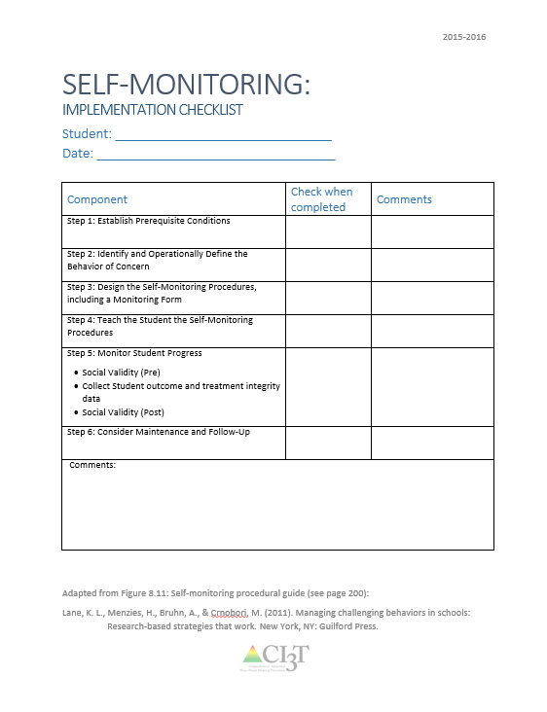
Implementing Self-Monitoring in Your Classroom: Implementation Checklist
Step 1: Establish Prerequisite Conditions
Step 2: Identify and Operationally Define the Behaviors
Step 3: Design the Self-Monitoring Procedures, Including a Monitoring Form
Step 4: Teach the Self-Monitoring Procedures
Step 5: Monitor Student Progress
Step 6: Consider Maintenance and Follow-Up
See Implementation folder for
“Self-Monitoring Implementation Checklist”

Slide 15
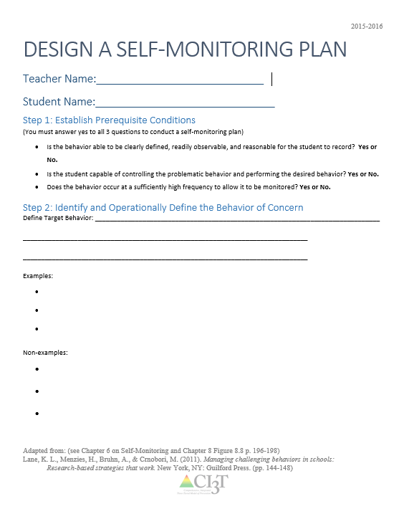
Self-Monitoring Procedures
Step 1: Establish Prerequisite Conditions
  Target and replacement (i.e., desired) behaviors are readily observable and easy for the student to record
  The student is capable of performing the replacement behavior
    If the student has an acquisition deficit, instead teach the replacement behavior
  The student can control the behavior
    If the behavior is out of control, a higher intensity intervention should be implemented first
  The problem behavior occurs frequently
See Resources folder:
Design A Self-Monitoring Plan

Slide 16
Self-Monitoring Procedures
Step 2: Identify and Operationally Define the Behaviors
  Operationally define the behavior you want to change
  Provide examples of the behavior
  Provide non-examples of the behavior

Slide 17
Self-Monitoring Procedures
Sample Operational definition
Academic engagement during silent reading
  The amount of time spent actively engaged in silently reading appropriate material
    Examples include: looking at the book or other reading materials, looking away to think about material for a duration of less than 15 s, appropriately asking the teacher about a word.
    Non-examples include: any activity other than reading the appropriate material, such as disruptive (e.g., audible vocalizations inappropriate to the assigned task, stomping feet) and off task (e.g., walking around the classroom, looking away from book for more than 15 s, reading an unapproved video game manual) behaviors.

Slide 18




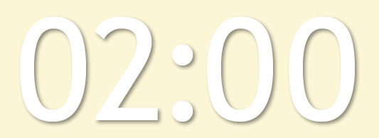

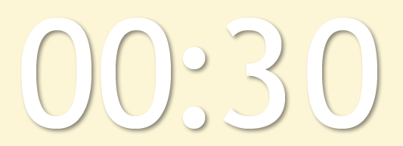

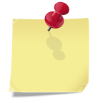
Will you please ….
Choose a behavior you want to change
  Label the behavior
  Operationally define the behavior
  Provide examples of the behavior
  Provide non-examples
Let’s talk …
Notes:
Using this PowerPoint break timer
This PowerPoint slide uses images, custom animation, and timing to provide a countdown timer that you can use in any presentation. When you open the template, you’ll notice that the timer is set at 00:00. However, when you start the slide show, the timer will start at the correct time and count down by 1-minute intervals until it gets to 1 minute. At that point, it will count down in two 30-seconds intervals to 00:00.
To insert this slide into your presentation
Save this template as a presentation (.ppt file) on your computer.
Open the presentation that will contain the timer.
On the Slides tab, place your insertion point after the slide that will precede the timer. (Make sure you don't select a slide. Your insertion point should be between the slides.)
On the Insert menu, click Slides from Files.
In the Slide Finder dialog box, click the Find Presentation tab.
Click Browse, locate and select the timer presentation, and then click Open.
In the Slides from Files dialog box, select the timer slide.
Select the Keep source formatting check box. If you do not select this check box, the copied slide will inherit the design of the slide that precedes it in the presentation.
Click Insert.
Click Close.

Slide 19
Self-Monitoring Procedures
Step 3: Design the Self-Monitoring Procedures, Including a Monitoring Form
  Create an implementation checklist of procedures
  Create a student self-monitoring checklist
    age appropriate
    explicitly states behavioral goals
    divided into appropriate times and situations
    simple
  Consider including a reinforcement contingency (i.e., If you do “X”, then you get “Y”) to set students up for success

Slide 20
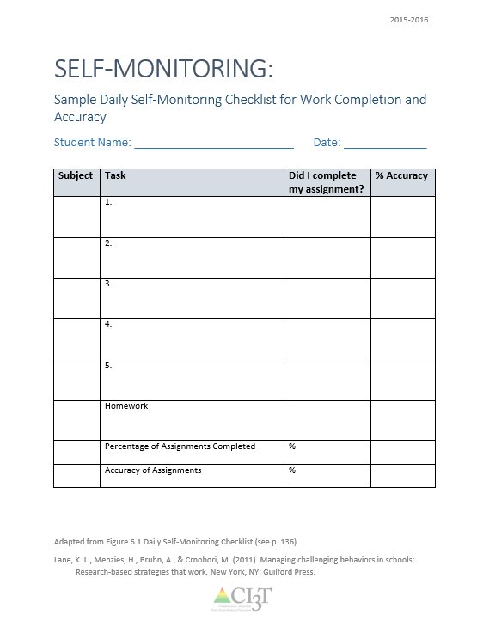
Example:
Daily Self-Monitoring Checklist for Work Completion and Accuracy
See Implementation folder for
“Self-Monitoring Secondary Sample Checklist”

Slide 21
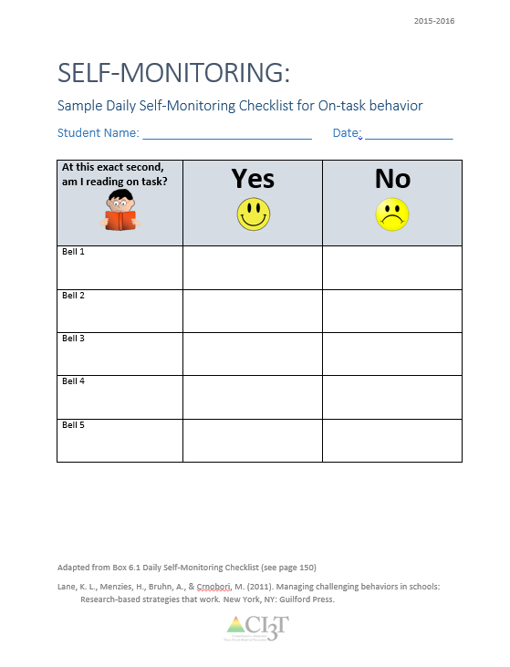
Example: Daily Self-Monitoring Checklist
See Implementation folder for
“Self-Monitoring Secondary Sample Checklist”
See Implementation folder for
“Self-Monitoring Elementary Sample Checklist”

Slide 22






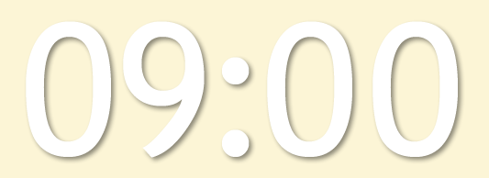
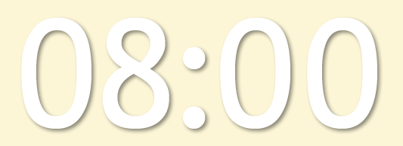


Will you please ….
Design the Self-Monitoring Procedures
  Daily procedures checklist
  Self-monitoring form
  Data collection sheet
  Reinforcement contingency
Let’s talk …
Notes:
Using this PowerPoint break timer
This PowerPoint slide uses images, custom animation, and timing to provide a countdown timer that you can use in any presentation. When you open the template, you’ll notice that the timer is set at 00:00. However, when you start the slide show, the timer will start at the correct time and count down by 1-minute intervals until it gets to 1 minute. At that point, it will count down in two 30-seconds intervals to 00:00.
To insert this slide into your presentation
Save this template as a presentation (.ppt file) on your computer.
Open the presentation that will contain the timer.
On the Slides tab, place your insertion point after the slide that will precede the timer. (Make sure you don't select a slide. Your insertion point should be between the slides.)
On the Insert menu, click Slides from Files.
In the Slide Finder dialog box, click the Find Presentation tab.
Click Browse, locate and select the timer presentation, and then click Open.
In the Slides from Files dialog box, select the timer slide.
Select the Keep source formatting check box. If you do not select this check box, the copied slide will inherit the design of the slide that precedes it in the presentation.
Click Insert.
Click Close.

Slide 23
Self-Monitoring Procedures
Step 4: Teach the Self-Monitoring Procedures
  Teach the student how to use the data-collection sheet
    Discussion
    Modeling
    Coaching
    Role play
  Gradually fade adult/teacher support as the student is more comfortable self-monitoring independently
  Make it clear this is not punishment, but a tool to achieve success
Notes:
Fading: increase intervals between checkpoints, matching to teacher less frequently, self-monitoring during fewer periods of time each day

Slide 24
Self-Monitoring Procedures
Step 5: Monitor Student Progress
  Take data on current performance (before the intervention is put into place; baseline data) if you are taking data on the target behavior
  Implement the intervention and compare intervention data to baseline data
  Monitor and reward accuracy of student’s self- recording by filling out the same form for the same time period
  Have the student graph their own data to visually see progress

Slide 25
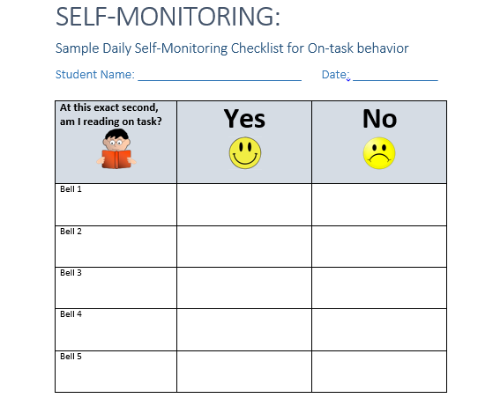
Example: Student Self-monitoring Checklist
See Implementation folder for
“Self-Monitoring Elementary Sample Checklist”

Slide 26
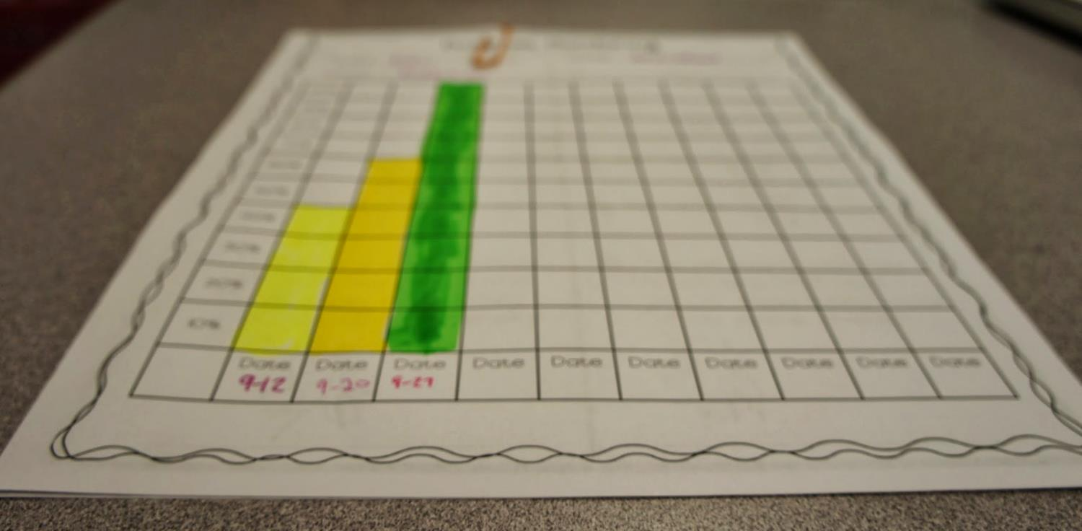
On-task Reading
Student Outcomes
Percentage

Slide 27
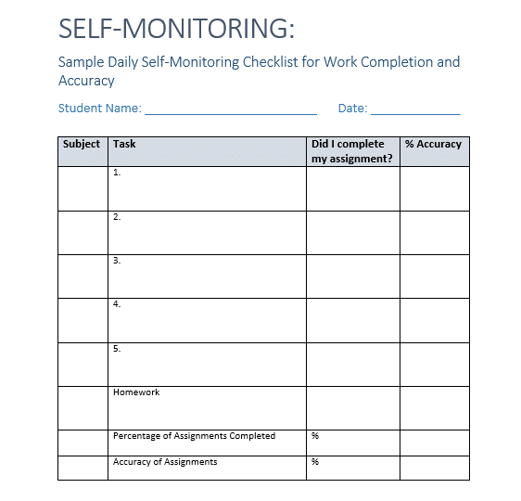
Example: Daily Self-Monitoring Checklist for Work Completion
See Implementation folder for
“Self-Monitoring Secondary Sample Checklist”

Slide 28
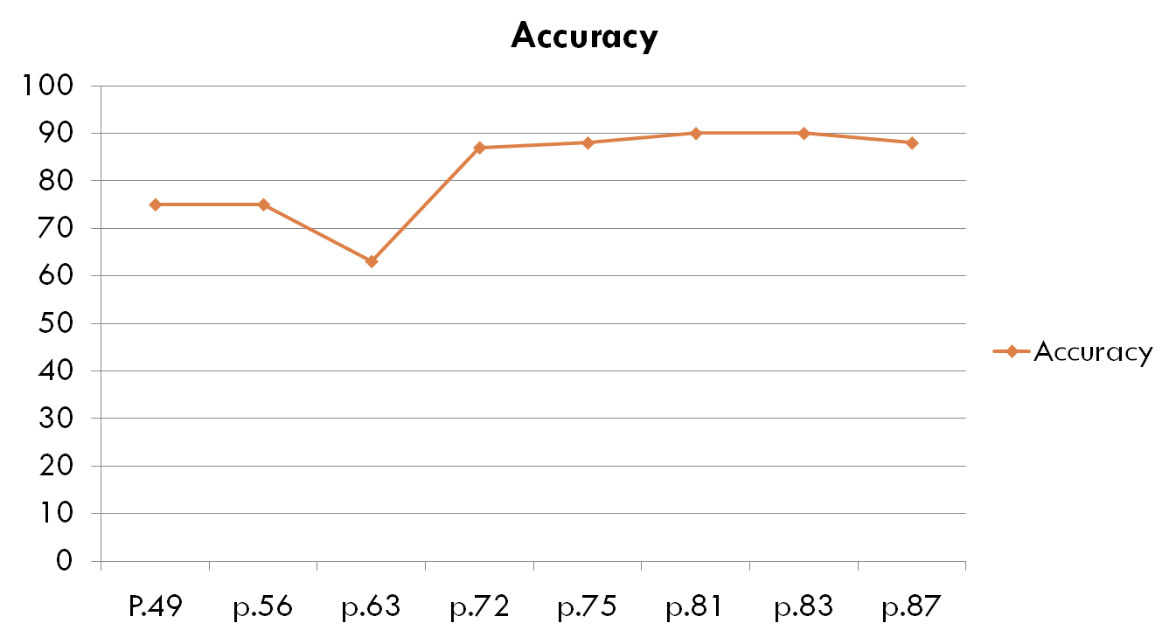
Accuracy of Math Homework Completion
Percentage

Slide 29
Self-Monitoring Procedures
Step 6: Consider Maintenance and Follow-Up
  Gradually fade self-monitoring support and data collection once student has consistently improved behavior
    Options: increase intervals between checkpoints, matching to teacher less frequently, self-monitoring during fewer periods of time each day
    Note: the student may elect to use the self-monitoring independently as a continued support
  Ultimate goal is for students to no longer exhibit the problem behavior and maintain the replacement behavior across all settings
  Once faded, continue to use intermittent behavior-specific praise and reinforcement

Slide 30
How well is it working?
Examining the Effects
Treatment Integrity
Is it happening?
Social Validity
What do stakeholders think about the goals, procedures, and outcomes?
Experimental Design
How well did this support work for this student?

Slide 31
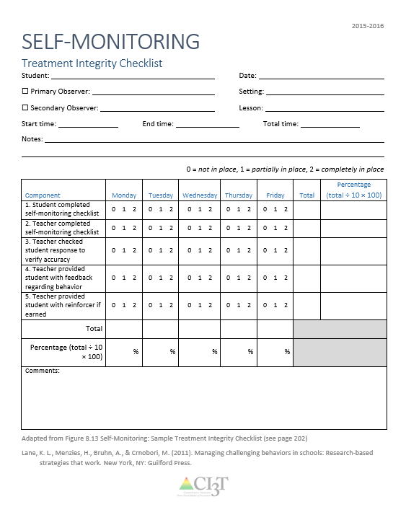
Treatment Integrity
Have structures in place to monitor whether self-monitoring is carried out as intended
Treatment integrity checklist
Example questions:
  1. Student completed self-monitoring checklist
  2. Teacher completed self-monitoring checklist
  3. Teacher checked student response to verify accuracy
  4. Teacher provided student with feedback regarding behavior
  5. Teacher provided student with reinforcer if earned
See Implementation folder for
“Self-Monitoring Treatment Integrity Checklist”

Slide 32
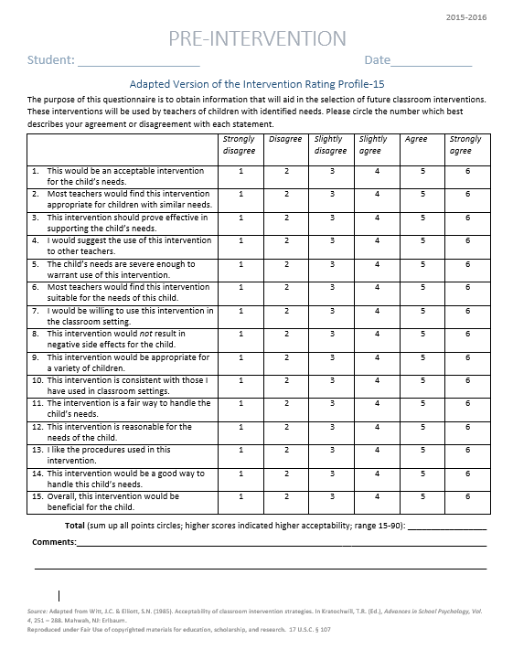
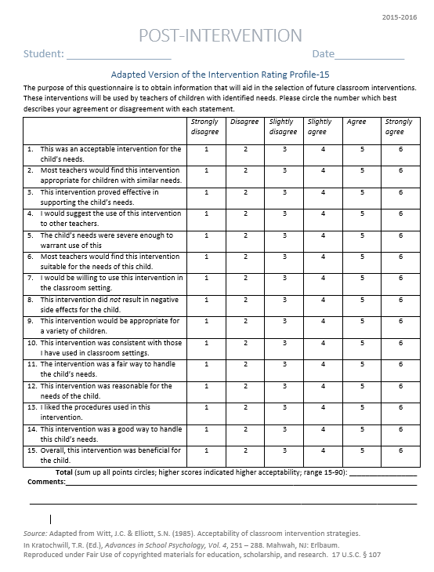
What do they think about it?
Intervention Rating Profile (IRP-15)
Completed by the teacher and/or parent participating in the intervention at two time points: Pre and post intervention
See Implementation folder for
“Social Validity Adapted IRP15_Pre/ Post_ Teacher”

Slide 33
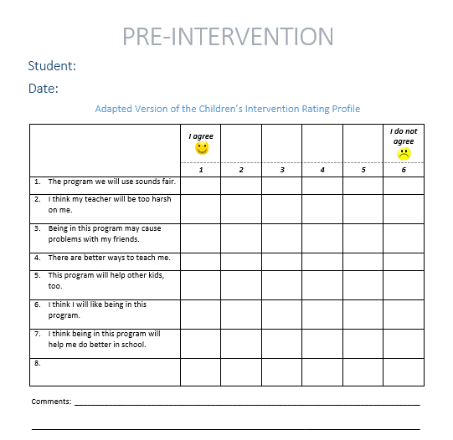
What do they think about it?
Children’s Intervention Rating Profile (CIRP)
Completed by the student participating in the intervention at two time points: Pre and Post Intervention
See Implementation folder for
“Social Validity Adapted CIRP_Pre/Post_Student”
Pre and Post Versions

Slide 34
Sample Elementary Intervention Grid
Support | Description | School-wide Data: Entry Criteria | Data to Monitor Progress | Exit Criteria
Self-monitoring | Strategy implemented by student and teacher to improve academic performance (completion/ accuracy), academic behavior, or other target behavior. | Behavior: SRSS-E7 score: Moderate (4-8) SRSS-I5 score: Moderate (2-3) or SRSS-E7 score: High (9-21) SRSS-I5 score: High (4-15) or 2 or more office discipline referrals (ODR) AND/OR Academic: Progress report: 1 or more course failures or AIMSweb: intensive or strategic level (math or reading) or Progress report: Targeted for Growth for academic learning behaviors | Work completion and accuracy of the academic area of concern (or target behavior named in the self-monitoring plan) Grades on progress reports Social Validity: Teacher: IRP-15 Student: CIRP Treatment Integrity: Implementation & treatment integrity checklist | SRSS-E7 score: Low (1-3) SRSS-I5 score: Low (1-2) Passing grade on progress report or report card in the academic area of concern (or target behavior named in the self-monitoring plan)
Notes:
Sample

Slide 35
Sample Secondary Intervention Grid
Support | Description | School-wide Data: Entry Criteria | Data to Monitor Progress | Exit Criteria
Self-monitoring | Strategy implemented by student and teacher to improve academic performance (completion/ accuracy), academic behavior, or other target behavior. | Behavior: SRSS-E7 score: Moderate (4-8) or SRSS-E7 score: High (9-21) or 2 or more office discipline referrals (ODR) or Skyward: 2 or more missing assignments AND/ OR Academic: Report card: 1 or more course failures or AIMSweb: intensive or strategic level (math or reading) or Below 2.5 GPA | Work completion and accuracy of the academic area of concern (or target behavior named in the self-monitoring plan) Passing grades on progress reports Social Validity: Teacher: IRP-15 Student: CIRP Treatment Integrity: Implementation & treatment integrity checklist | SRSS-E7 score: Low (1-3) Passing grade on progress report or report card in the academic area of concern (or target behavior named in the self-monitoring plan)
Notes:
Sample

Slide 36
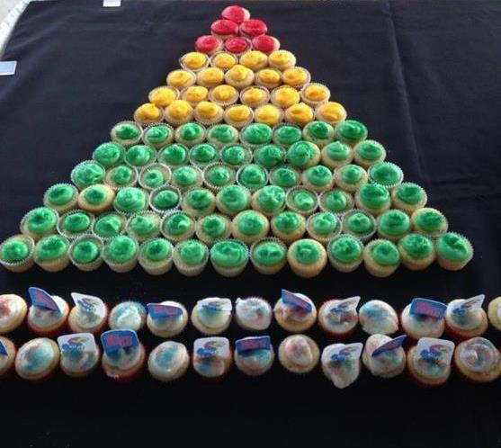
Expanding Your Tool Kit

Slide 37

Recommended Resources
Thank you!
Questions:
wendy.oakes@asu.edu
kathleen.lane@ku.edu
Lane, K. L., Menzies, H. M., Bruhn, A.L., & Crnobori, M. (2011). Managing Challenging Behaviors in Schools: Research-Based Strategies That Work. New York, NY: Guilford Press.
Lane, K. L., Menzies, H. M., Ennis, R. P., & Oakes, W. P. (2015). Supporting behavior for school success: A step-by-step guide to key strategies. New York, NY: Guilford Press.

Slide 38


Recommended Resources
Designing, Implementing, and Evaluating Comprehensive, Integrated, Three-Tiered (Ci3T) Models of Prevention: Step by Step Guide (2014). A special issue of Preventing School Failure, volume 58, issue 3 www.tandfonline.com/toc/vpsf20/58/3
Umbreit, J., Ferro, J. B., Liaupsin, C. J., & Lane, K. L. (2007). Functional behavioral assessment and function-based intervention: An effective, practical approach. New York, NY: Pearson.

