Slide 1
Implementing Comprehensive, Integrated, Three-Tiered (Ci3T) Models: Planning for Success: Monitoring and Communication
Ci3T Implementation: Session 2

Slide 2
Welcome, School Teams!
_________ Schools
We are excited to welcome you to the second session of the Ci3T implementation professional learning series.
Your dedication to systems change for helping all students succeed academically, behaviorally, and socially is appreciated!
Notes:
Instructions: Insert the name of the participating schools and districts.
Participating school district(s) logos can be added as well.

Slide 3
Agenda
Welcome
Preparing to Collect Social Validity & Treatment Integrity Data
Using Screening Data to Inform Instruction
Facilitating Clear Communication with Stakeholders
Preparing Implementation Reports to Support Data-informed Decision Making: Technology Training Part 2 – A sneak preview!
Wrapping Up and Moving Forward

Slide 4
Upcoming Professional Development
Sep | Oct | Nov | Dec | Jan | Feb | Mar | Apr | May
 |  | KU Ci3T Day 1 11/14/17 5:00-7:00PM | KU Ci3T Day 2 12/06/17 8:00AM-4:00PM | KU Ci3T Day 3 01/16/18 5:00-7:00PM | KU Ci3T Day 4 02/13/18 8:00AM-4:00PM |  | KU Ci3T Day 5 04/04/18 5:00-7:00PM | KU Ci3T Day 6 05/03/18 8:00AM-4:00PM
KU Ci3T IMP Day 1 09/20/17 |  | KU Ci3T IMP Day 2 11/15/17 |  | KU Ci3T IMP Day 3 01/17/18 |  | KU Ci3T IMP Day 4 03/13/18 | KU Ci3T IMP Day 5 04/03/18
 | Technology Training Day 1 10/02/17 9:00AM-12:00PM | Technology Training Day 2 11/29/17 5:00-7:00PM
TOT Coaching Call Session 1 09/21/17 |  | TOT Coaching Call Session 2 11/16/17 | TOT Coaching Call Session 3 12/08/17 | TOT Coaching Call Session 4 01/18/18 | TOT Coaching Call Session 5 02/15/18 | TOT Coaching Call Session 6 03/15/18 | TOT Coaching Call Session 7 04/05/18 | TOT Coaching Call Session 8 05/04/18
KU Ci3T EMPOWER Session 1 09/25/17 |  | KU Ci3T EMPOWER Session 2 11/08/17 |  | KU Ci3T EMPOWER Session 3 01/24/18 |  | KU Ci3T EMPOWER Session 4 03/14/18 | KU Ci3T EMPOWER Session 5 04/17/18
KU Ci3T TRAINING
KU Ci3T IMPLEMENTATION
5:00-7:00 PM
Trainer of Trainers Coaching Calls
4:00-5:30 PM
KU Project EMPOWER
5:00-7:00 PM

Slide 5
Wrap Up and Preview
Last Session Review
Today’s Preview
Gained an understanding of
long-range planning
conducting effective meetings
communicating with stakeholders
Reviewed rollout of and implementation procedures for
teaching, reinforcing, and monitoring the academic, behavior, and social skills components of your Ci3T model of prevention
Prepare to collect social validity and treatment integrity data
Use screening data to inform instruction at Tier 1, Tier 2, and Tier 3
Communication with all stakeholders:
District
Ci3T Leadership Team
Faculty and staff
Students, parents, community

Slide 6
Log on to dropbox.com
OPEN:
IM18 Ci3T Leadership Team Meeting Agenda TEMPLATE
Click the file to start a preview
Click “Open” in the top right corner, which allows multiple people to edit together online
Notes:
When ready to present, consider moving a copy of this slide to the first slide position so participants can be ready to access Dropbox as they settle in.

Slide 7
Using Dropbox
As you work on documents from Dropbox today:
Edit files in Word Online for simultaneous collaboration with your team
Copy and rename files so your school initials are at the beginning and today’s date is at the end of the file name.
XXES IM18 Ci3T Leadership Team Meeting Agenda YYYY MM DD.docx

Slide 8
Welcome

Slide 9
IM18 Ci3T Leadership Team Meeting Agenda TEMPLATE
Predictability

Slide 11
Secondary (Tier 2) Intervention Grids

Slide 12
Tertiary (Tier 3) Intervention Grids

Slide 13
Preparing to Collect Social Validity & Treatment Integrity Data

Slide 14
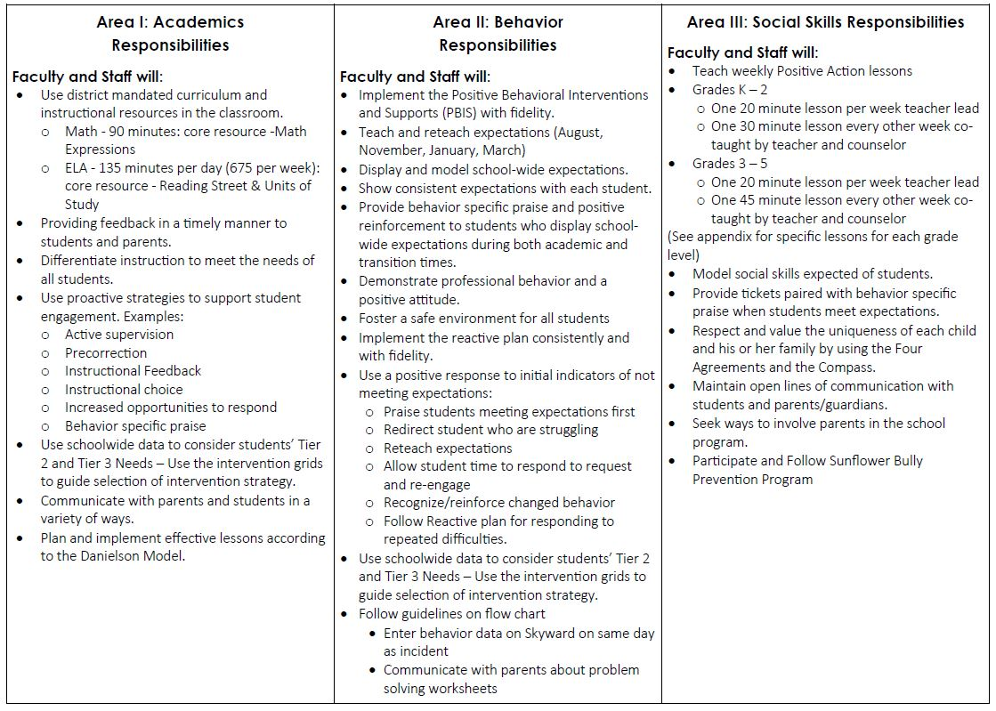
Ci3T Primary (Tier 1) Plan: Procedures for
Teaching
Ci3T Primary (Tier 1) Plan: Procedures for Reinforcing
Ci3T Primary (Tier 1) Plan: Procedures for Monitoring

Slide 15
Essential Components of Primary Prevention Efforts
Social Validity
Treatment Integrity
Systematic Screening
Academic
Behavior
Notes:
Add slides to the end of the presentation to report Year End Summaries of screening measures. These should be screening measures you collect and use for determining which students need Secondary and Tertiary levels of support. For example, you might list Office Discipline Referrals (ODRs), the Student Risk Screening Scale (SRSS), AIMSweb, DIBELS, and/or Benchmarks.

Slide 16
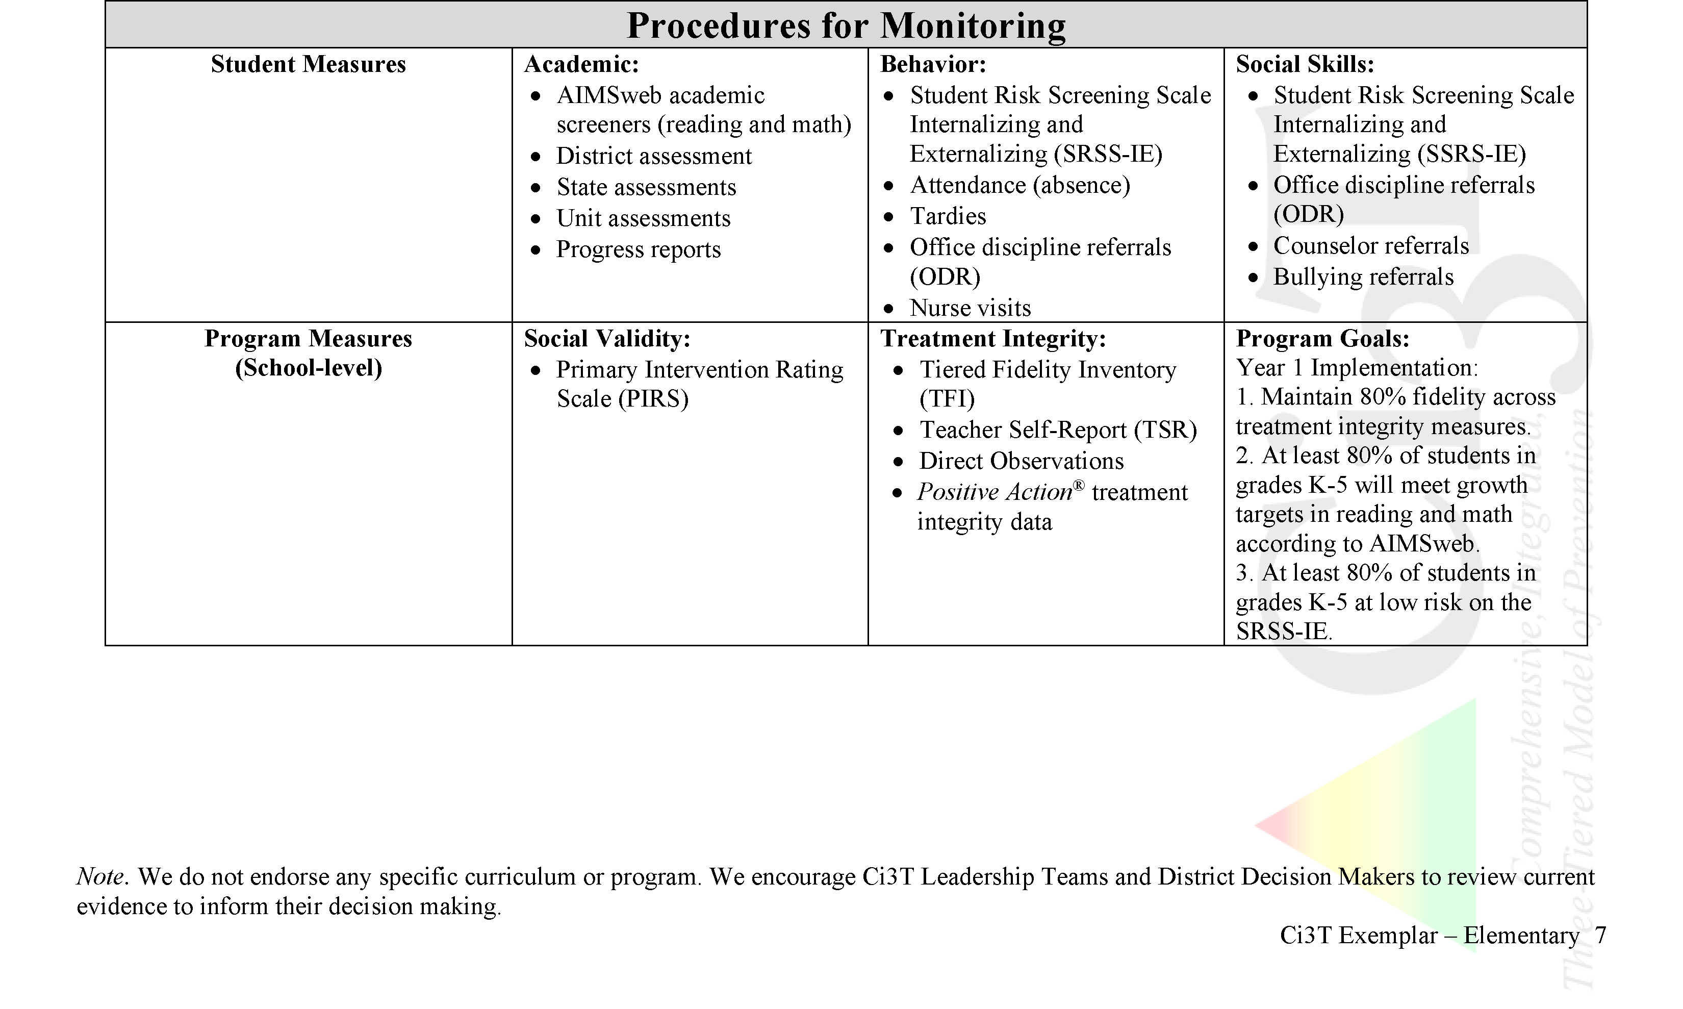
Ci3T Primary Plan Procedures for Monitoring: Elementary
Reduce time out of instruction for students (ODR)
Decrease reading gap between diverse populations
(MAP, AIMSweb)

Slide 17
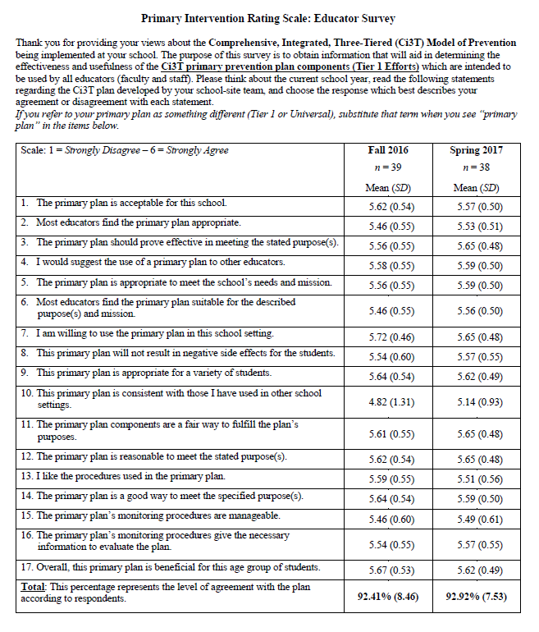
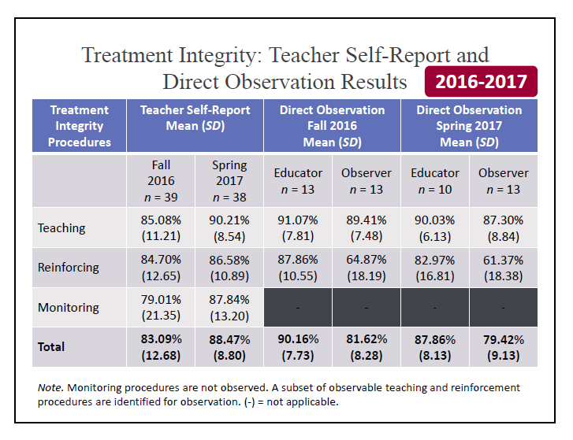
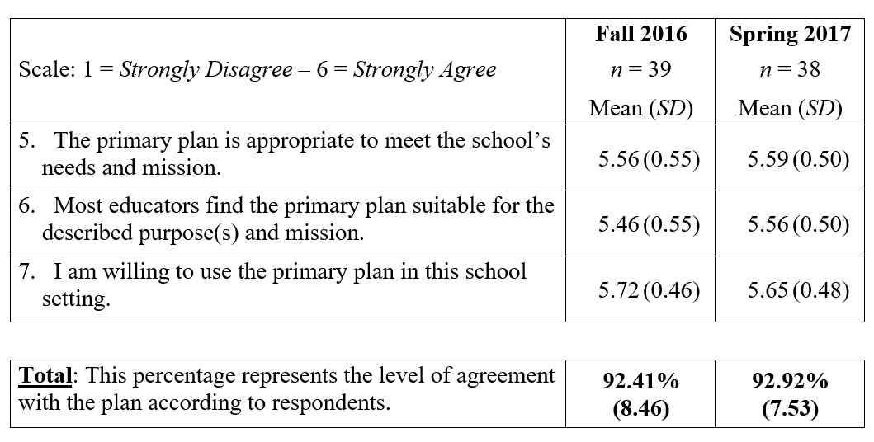
Why monitor implementation?
Do our students have access to Tier 1?
What are our strengths and areas for growth?
What professional learning opportunities can we give our staff?
How can we improve our plan?

Slide 18
Social Validity

Slide 19
Social Validity: Primary Intervention Rating Scale (PIRS) Educator Survey (Lane, Robertson, & Wehby 2002)
Purpose: To obtain information that will aid in determining the effectiveness and usefulness of the Ci3T plan.
Directions: Read each statement regarding the Ci3T primary plan and select the number that best describes their agreement.
Fall data indicate teachers’ expectations and initial perceptions.
Spring data indicate the degree to which expectations were met and perceptions at the end of the implementation year.
Ci3T Leadership Team considers all feedback as they revise specific elements of the Ci3T plan over the summer for the next school year.

Slide 20
What is the Primary Intervention Rating Scale (PIRS)?
A social validity measure adapted from the Intervention Rating Profile-15 (Witt & Elliott, 1985)
17 statements regarding the Ci3T primary plan
Items are rated using a Likert-type scale ranging from 1 = strongly disagree to 6 = strongly agree
There are 2 versions:
Training: collected between sessions 4 and 5
Implementation: collected during fall and spring treatment integrity/social validity windows

Slide 21
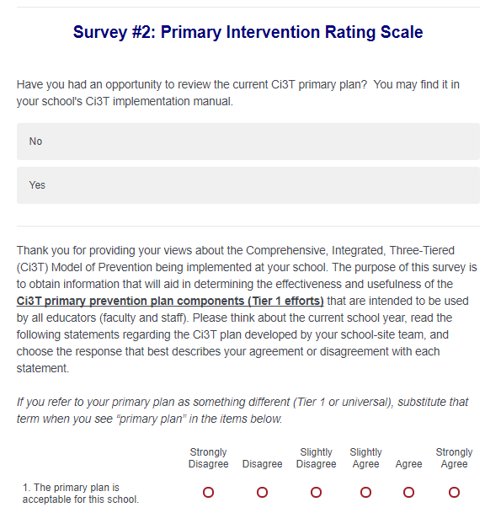
Social Validity: Primary Intervention Rating Scale
Ensure all faculty and staff receive an emailed link to Qualtrics for the PIRS and TSR surveys

Slide 22
Social Validity: PIRS Results
Year of Implementation | Fall |  | Spring
 | n | % (SD) | n | % (SD)
2016-2017 | 39 | 92.41 (8.46) | 37 | 92.92 (7.53)
Social validity refers to the level of:
Social significance of intervention goals
Social acceptability of intervention procedures
Social importance of intervention outcomes
(Wolf, 1978)

Slide 23
Treatment Integrity

Slide 24
Treatment Integrity (TI)
The degree to which the plan is implemented as designed.
Treatment integrity provides information on the elements of the plan that are and are not being implemented.
Treatment integrity data are used for accurate interpretation the effectiveness of the school’s Ci3T plan.
☑
☑
☑

Slide 25
Measuring Treatment Integrity
Three measures:
Ci3T Treatment Integrity: Teacher Self-Report (Ci3T TI: TSR)
For all components of the Ci3T plan (Lane et al., 2009)
Ci3T Treatment Integrity: Direct Observation (Ci3T TI: DO)
From two perspectives: observer and educator (30-min snapshot; Lane et al., 2009)
School-wide Evaluation Tool version 2.0 (SET v2)
For the PBIS component of the Ci3T plan (Todd et al., 2012)

Slide 26
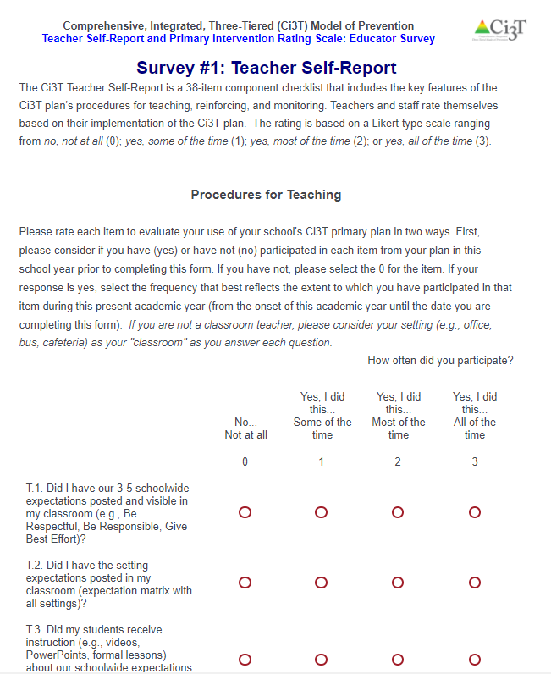
Ci3T Treatment Integrity: Teacher Self-Report
Ensure all faculty and staff receive an emailed link to Qualtrics for the PIRS and TSR surveys

Slide 27
Ci3T Treatment Integrity: Teacher Self-Report
38-item component checklist
Three constructs:
procedures for teaching
procedures for reinforcing
procedures for monitoring
Faculty and staff rate their implementation of the Ci3T plan from the beginning of the current school year to the date the Ci3T TI: TSR is completed
Likert-type scale ranging from
0 = no, not at all
1 = yes, some of the time
2 = yes, most of the time
3 = yes, all of the time
Comments may be provided at the end of the form

Slide 28
Ci3T Treatment Integrity: Direct Observation
Conducted during the fall and spring program evaluation window
Educators are selected for observation through random selection
stratified across grade levels or instructional content (e.g., first grade, special education, English department)
Educators are defined as school personnel who directly instruct students
Observers trained to criterion on direct observation procedures
Educators are asked to rate their use of Ci3T plan components during the 30-min observation

Slide 29
Treatment Integrity: Teacher Self-Report and Direct Observation Results
2016-2017
Treatment Integrity Procedures | Teacher Self-Report Mean (SD) |  | Direct Observation Fall 2016 Mean (SD) |  | Direct Observation Spring 2017 Mean (SD)
 | Fall 2016 n = 39 | Spring 2017 n = 38 | Educator n = 13 | Observer n = 13 | Educator n = 10 | Observer n = 13
Teaching | 85.08% (11.21) | 90.21% (8.54) | 91.07% (7.81) | 89.41% (7.48) | 90.03% (6.13) | 87.30% (8.84)
Reinforcing | 84.70% (12.65) | 86.58% (10.89) | 87.86% (10.55) | 64.87% (18.19) | 82.97% (16.81) | 61.37% (18.38)
Monitoring | 79.01% (21.35) | 87.84% (13.20) | - | - | - | -
Total | 83.09% (12.68) | 88.47% (8.80) | 90.16% (7.73) | 81.62% (8.28) | 87.86% (8.13) | 79.42% (9.13)
Note. Monitoring procedures are not observed. A subset of observable teaching and reinforcement procedures are identified for observation. (-) = not applicable.

Slide 30
Treatment Integrity: School-wide Evaluation Tool (SET; Version 2.0) (Todd, Lewis-Palmer, Horner, Sugai, Sampson, & Phillips, 2012)
Measures 7 subscales representing core components of school-wide positive behavioral interventions and supports (PBIS)
Scores reported in each subscale and an overall total score.
Includes the collection of products as well as brief interviews with administrator, faculty & staff, and students.

Slide 31
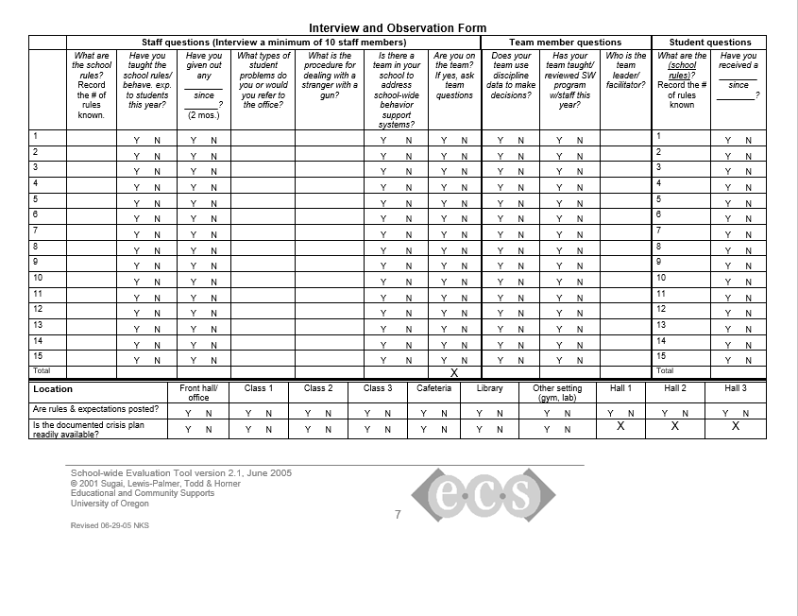
Administering the SET
Interviews
Administrator
10-15 randomly selected staff
A minimum of 3 Ci3T Leadership Team members
15 Randomly selected students
Observations/Walk-through
School rules posted in 10 locations
Crisis procedure posted in 7 locations
Permanent products

Slide 32
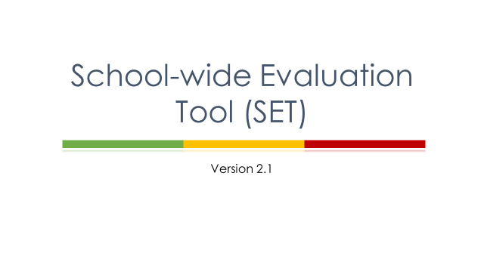
Download SET Manual and SET training at pbis.org
(http://www.pbis.org/evaluation/evaluation-tools)

Slide 33
Treatment Integrity: SET Results – Lincoln Elementary School
Category | Total Points Earned |  | Total Points Possible | % Earned
 | Fall 2016 | Spring 2017 |  | Fall 2016 | Spring 2017
Expectations Defined | 3 | 4 | 4 | 75 | 100
Behavioral Expectations Taught | 8 | 10 | 10 | 80 | 100
On-going System for Rewarding Behavioral Expectations | 5 | 6 | 6 | 83.33 | 100
System for Responding to Behavioral Violations | 5 | 6 | 8 | 62.50 | 75
Monitoring & Decision-Making | 8 | 8 | 8 | 100 | 100
Management | 15 | 14 | 16 | 93.75 | 87.50
District-Level Support | 4 | 4 | 4 | 100 | 100
TOTAL SCORE | Goal: 80% on Behavioral Expectations Taught and Overall Scores |  |  | 84.94 | 94.64
Notes:
Category
Total Points Earned
Total Points Possible
% Earned
Total Points Earned
Total Points Possible
% Earned

Slide 34
Treatment Integrity: SET Results
Percentage of Points Earned

Slide 35
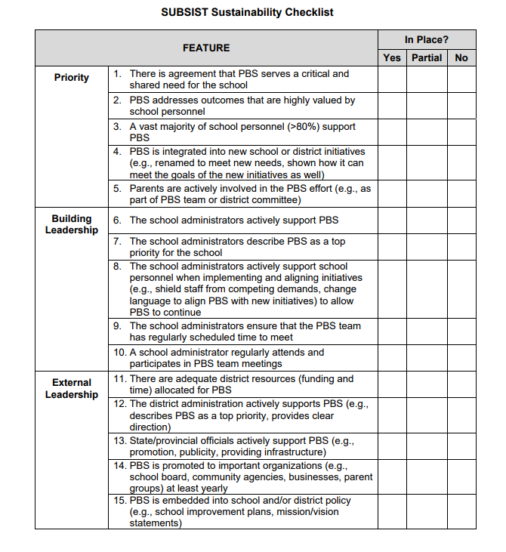
Schoolwide Universal Behavior Sustainability Index: School Teams (SUBSIST)
50 item self-report
Ci3T Leadership Team members complete the measure 2x per year (during treatment integrity window)
Scores predict fidelity and sustainability of implementation of tiered models
Available from pbis.org
Data to support sustainability of system change

Slide 36
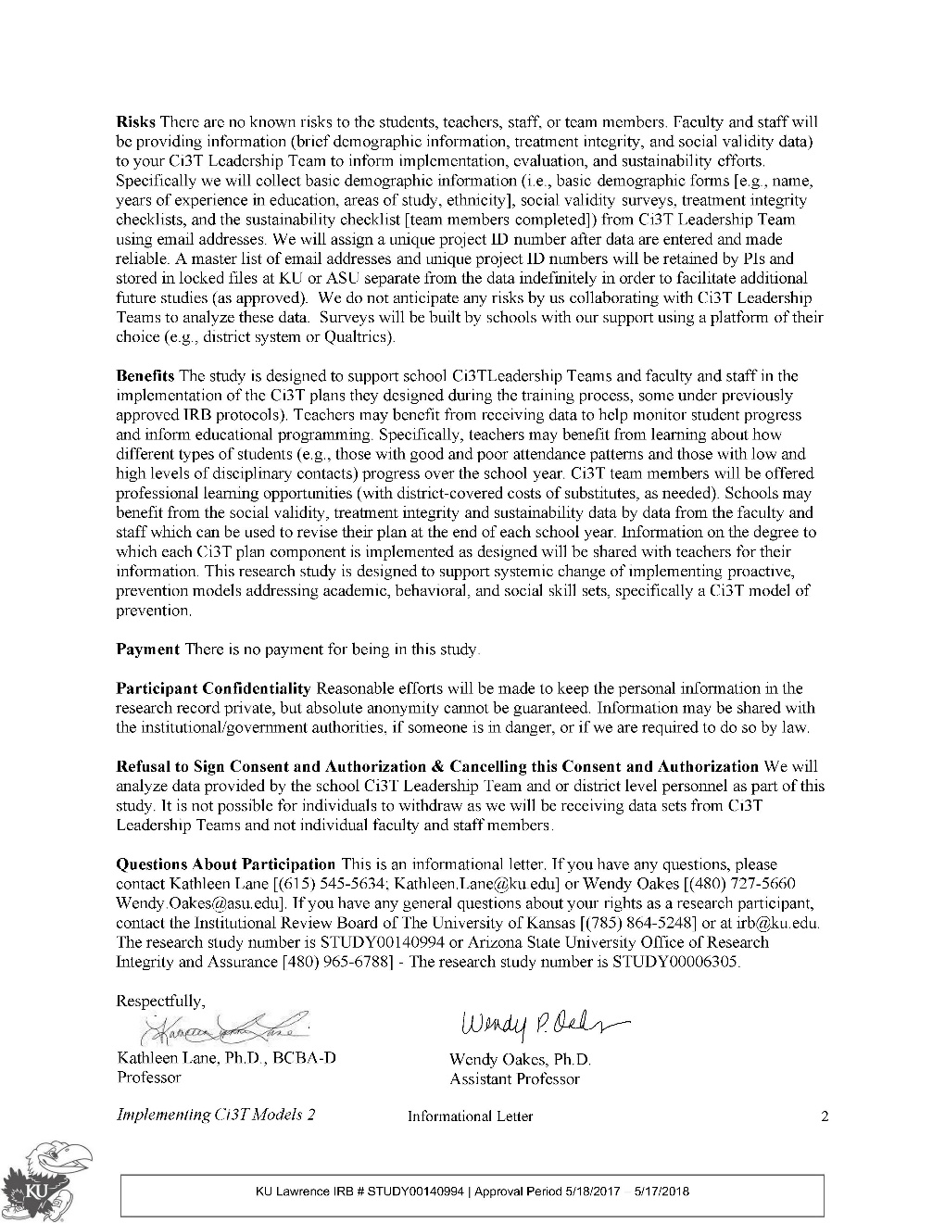
With District Approval…
Informational letter available for all partnering schools
Informs educators about how information will be used for research purposes

Slide 37
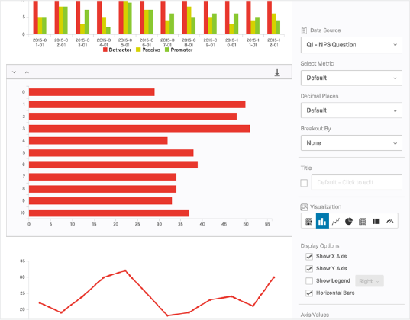
Qualtrics

Slide 40
= Anticipated Treatment Integrity visits for 2nd year implementers
= Available to support 1st year implementers!

Slide 41
Let’s talk… And make plans!
How you will use these data?
How and when you will share these data with your full faculty and staff?
Notes:
Using this PowerPoint break timer 10 MIN
This PowerPoint slide uses images, custom animation, and timing to provide a countdown timer that you can use in any presentation. When you open the template, you’ll notice that the timer is set at 00:00. However, when you start the slide show, the timer will start at the correct time and count down by 1-minute intervals until it gets to 1 minute. At that point, it will count down in two 30-seconds intervals to 00:00.
To insert this slide into your presentation
Save this template as a presentation (.ppt file) on your computer.
Open the presentation that will contain the timer.
On the Slides tab, place your insertion point after the slide that will precede the timer. (Make sure you don't select a slide. Your insertion point should be between the slides.)
On the Insert menu, click Slides from Files.
In the Slide Finder dialog box, click the Find Presentation tab.
Click Browse, locate and select the timer presentation, and then click Open.
In the Slides from Files dialog box, select the timer slide.
Select the Keep source formatting check box. If you do not select this check box, the copied slide will inherit the design of the slide that precedes it in the presentation.
Click Insert.
Click Close.

Slide 42
Using Screening Data to Inform Instruction
Considerations for
Primary (Tier 1) Prevention Efforts
Teacher-Delivered, Low-Intensity Supports
Secondary (Tier 2) and Tertiary (Tier 3) Supports

Slide 43
First … a Look at Logistics for Screening
Before Screening
Preparing
During Screening
Screening
After Screening
Interpreting

Slide 44
Essential Components of Primary Prevention Efforts
Social Validity
Treatment Integrity
Systematic Screening
Academic
Behavior
Urgent!
Notes:
Add slides to the end of the presentation to report Year End Summaries of screening measures. These should be screening measures you collect and use for determining which students need Secondary and Tertiary levels of support. For example, you might list Office Discipline Referrals (ODRs), the Student Risk Screening Scale (SRSS), AIMSweb, DIBELS, and/or Benchmarks.

Slide 45
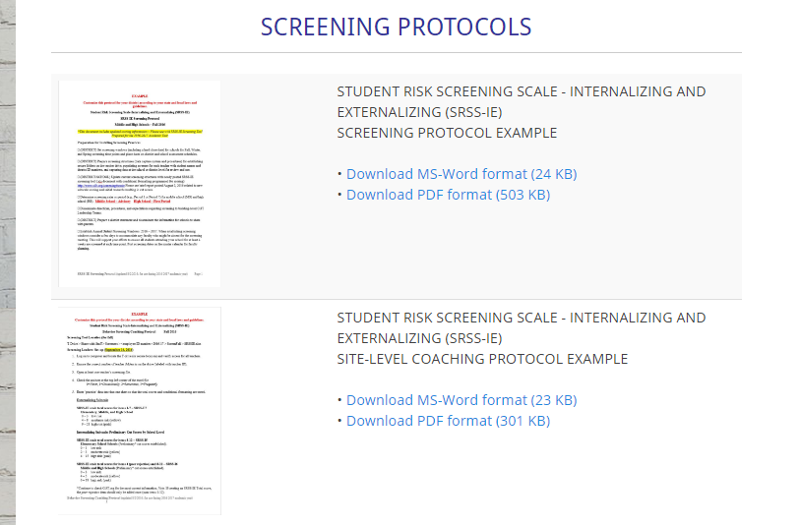
Before Screening
Preparing
District support
Examine and select tool(s)
Professional development
Share information with parents

Slide 46
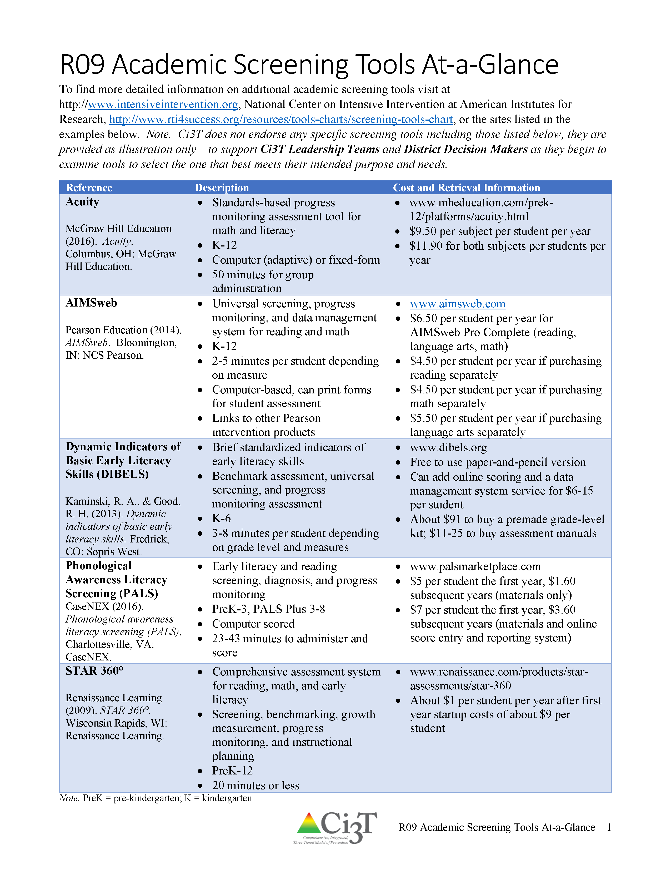
Selecting the best academic screening tool(s) for our school

Slide 47
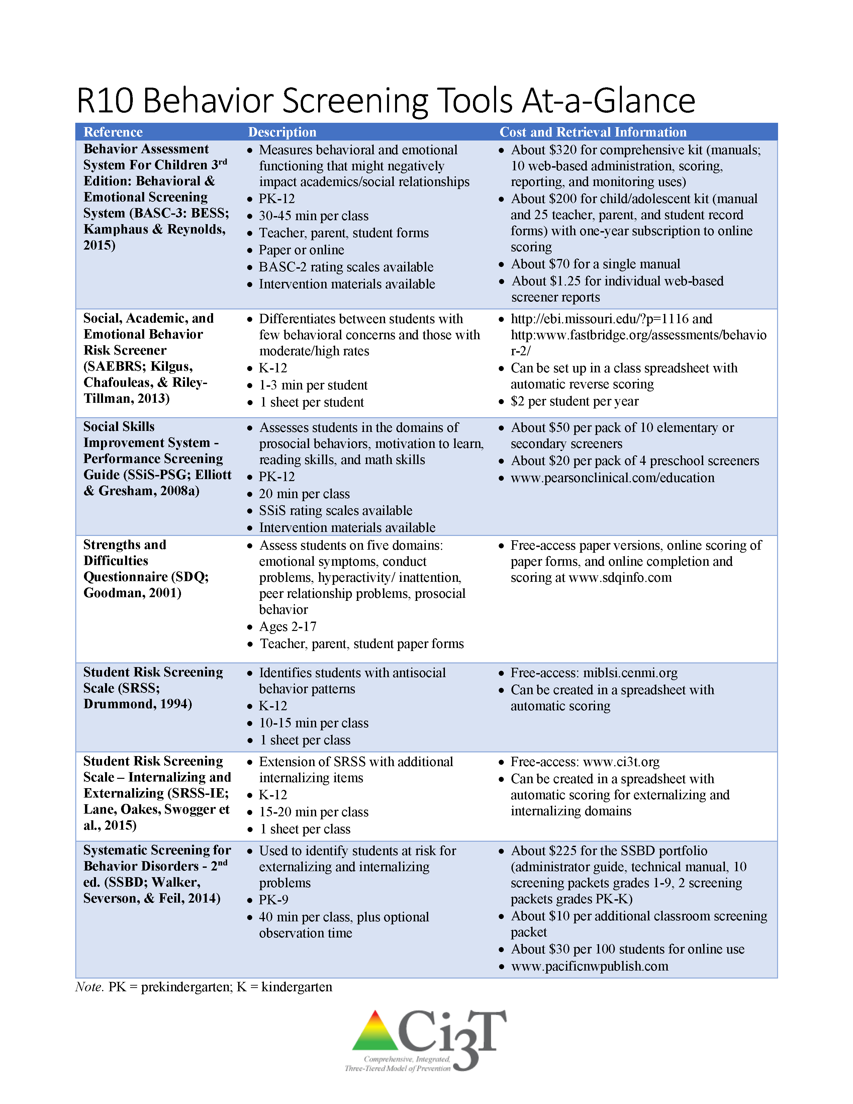
Selecting the best behavior screening tool(s) for our school

Slide 48
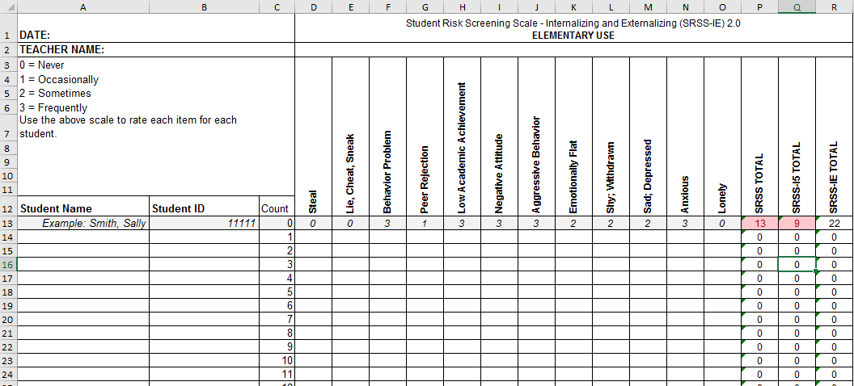
SRSS-IE for Elementary Schools

Slide 49
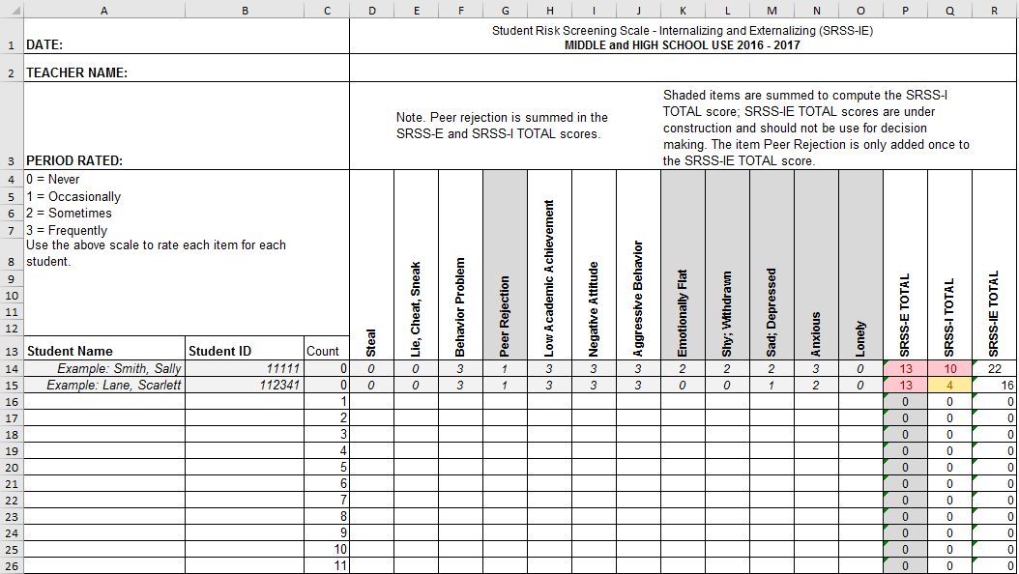
SRSS-IE for Middle and High Schools

Slide 50
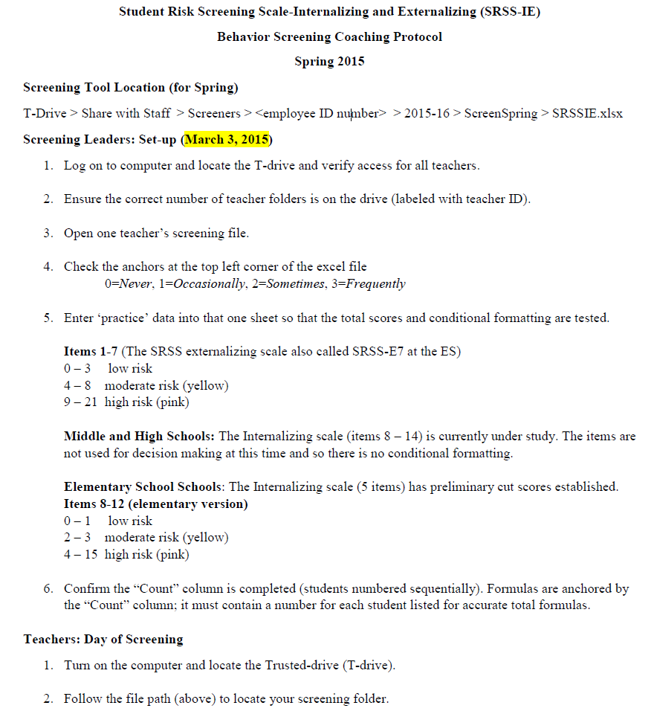
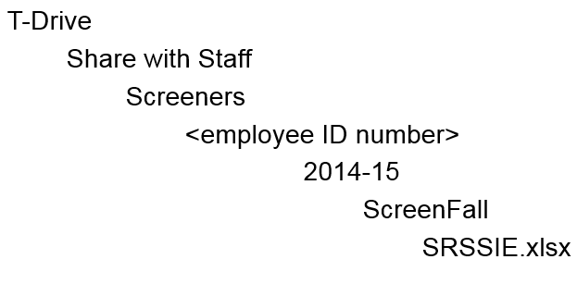
During Screening
Screening
Gather teachers together
Review procedures
Conduct screening

Slide 51
Ensure faculty and staff administering, entering, and managing academic screening data have sufficient professional learning
Add all screening windows to the master assessment calendar

Slide 52
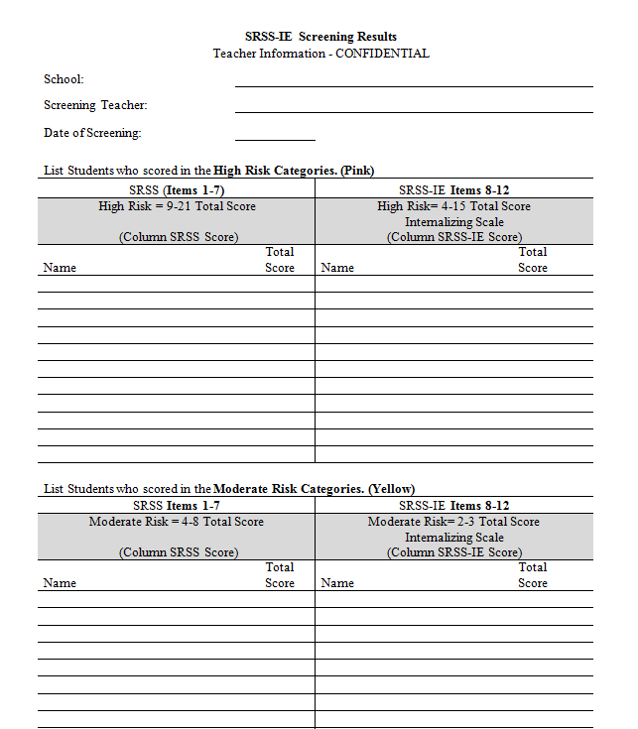
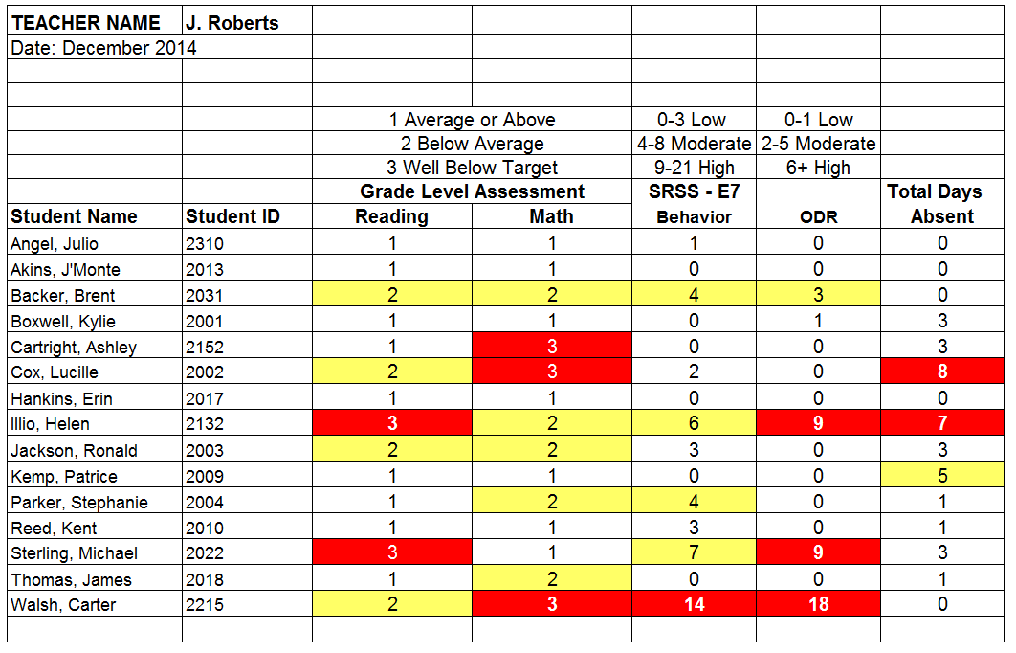
After Screening
Interpreting
School level
Grade level
Student level
Elementary

Slide 53
Academic Screening: Reading and Math Benchmarks
READING
Grade: | % (n) of Students
Teacher: | Benchmark | Strategic | Intensive
Fall | x% (n = x) | x% (n = x) | x% (n = x)
Winter | x% (n = x) | x% (n = x) | x% (n = x)
Spring | x% (n = x) | x% (n = x) | x% (n = x)
Set Goal
By spring, % will be at benchmark on reading screening measures.
MATH
Grade: | % (n) of Students
Teacher: | Benchmark | Strategic | Intensive
Fall | x% (n = x) | x% (n = x) | x% (n = x)
Winter | x% (n = x) | x% (n = x) | x% (n = x)
Spring | x% (n = x) | x% (n = x) | x% (n = x)
Set Goal
By spring, % will be at benchmark on math screening measures.

Slide 54
Academic Screening Data
n = 700, 713, 768
n = 723, 723, 721

Slide 55
SRSS-IE: Cut Scores
Enter ‘practice’ data into that one sheet so that the total scores and conditional formatting are tested.
Confirm the “Count” column is completed (students’ numbered sequentially). Formulas are anchored by the “Count” column; it must contain a number for each student listed for accurate total formulas.
Elementary School |  | Middle and High School
SRSS-E7 | SRSS-I5 | SRSS-E7 | SRSS-I6
Items 1-7 | Items 8-12 | Items 1-7 | Items 4, 8-12
0-3 = low risk 4-8 = moderate risk 9-21 = high risk | 0-1 = low risk 2-3 = moderate risk 4-15 = high risk | 0-3 = low risk 4-8 = moderate risk 9-21 = high risk | 0-3 = low risk 4-5 = moderate risk 6-18 = high risk
Elementary School Level:
Lane, K. L., Oakes, W. P., Swogger, E. D., Schatschneider, C., Menzies, H., M., & Sanchez, J. (2015). Student risk screening scale for internalizing and externalizing behaviors: Preliminary cut scores to support data-informed decision making. Behavioral Disorders, 40, 159-170.
Middle and High School Levels:
Lane, K. L., Oakes, W. P., Cantwell, E. D., Schatschneider, C., Menzies, H., Crittenden, M., & Messenger, M. (in press). Student Risk Screening Scale for Internalizing and Externalizing Behaviors: Preliminary cut scores to support data-informed decision making in middle and high schools. Behavioral Disorders.

Slide 56
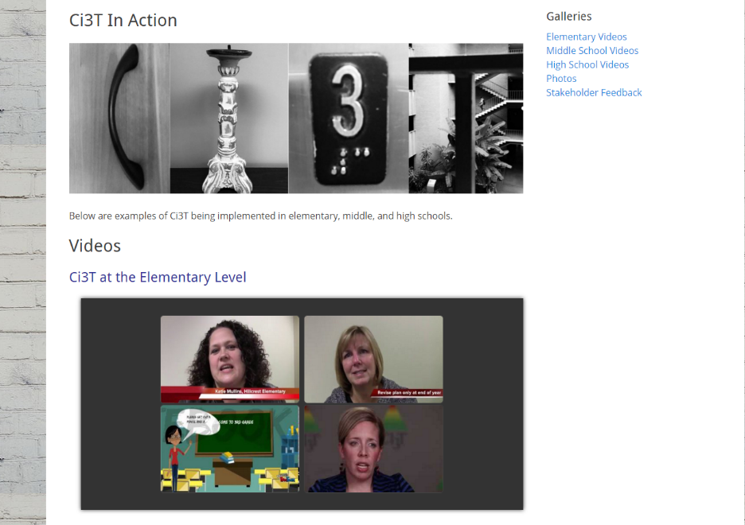
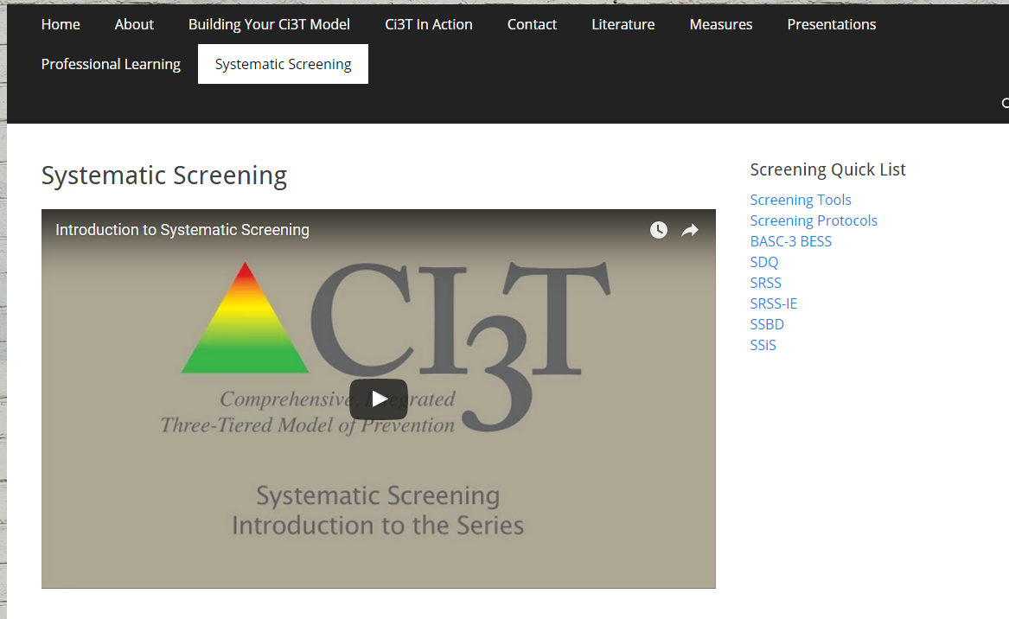
Screening … Considering the Logistics & Ci3T in Action

Slide 57
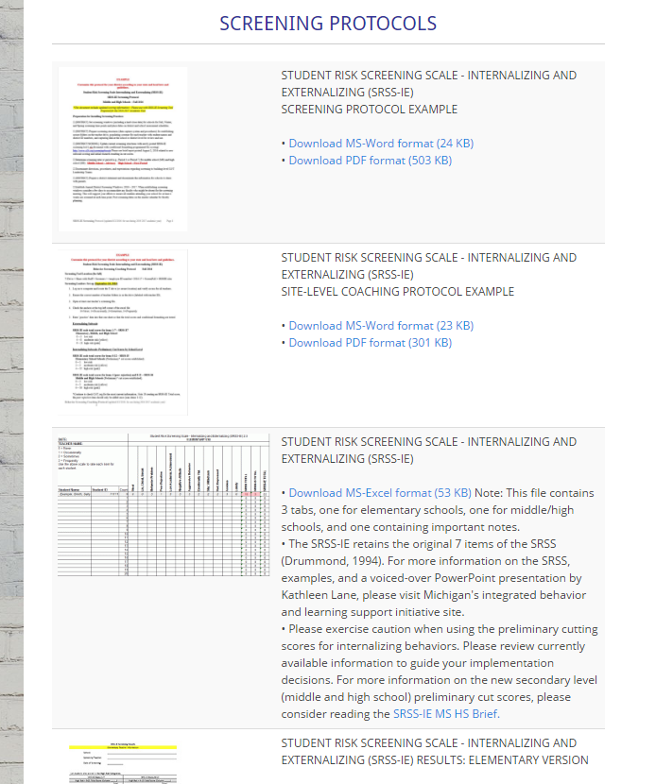
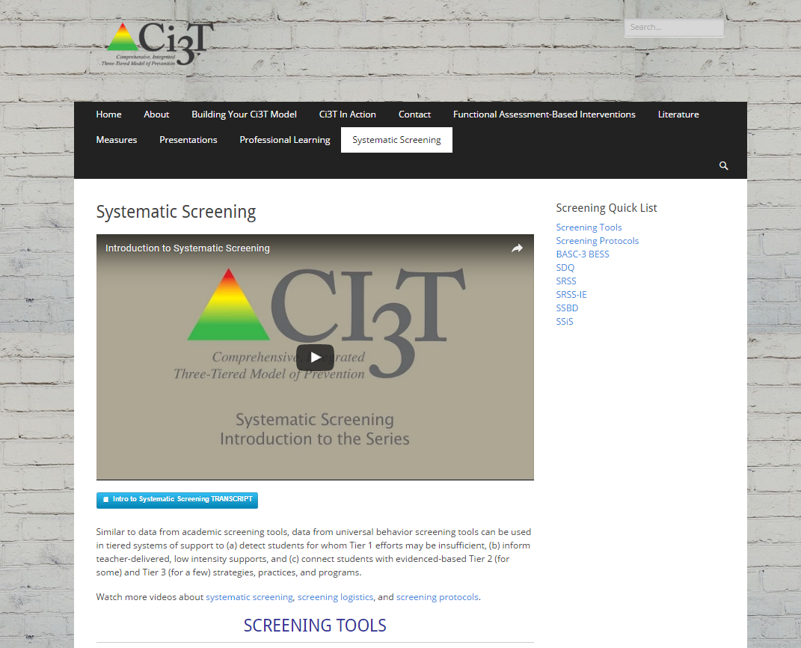
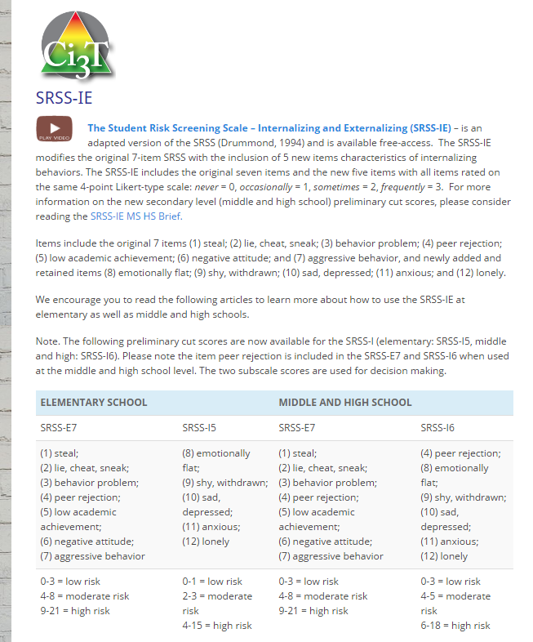
ci3t.org/screening
Systematic Screening

Slide 58
Protocols
Screening Protocol Example
Site-level Coaching Protocol Example

Slide 59
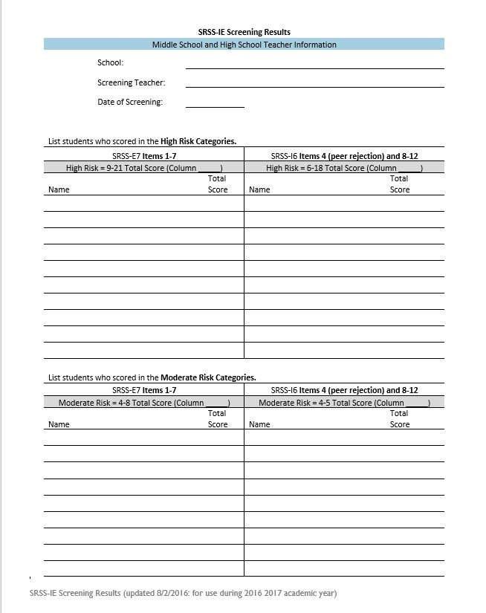
Screening Results
Elementary Screening
Middle and High School

Slide 60
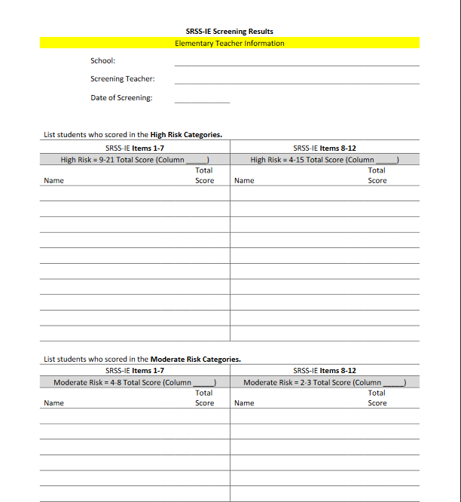
SRSS-IE Screening Results at the Elementary Level Enter students with: SRSS Items 1-7: 9-21 SRSS-IE Items 8-12: 4-15 SRSS Items 1-7: 4-8 SRSS-IE Items 8-12: 2-3

Slide 61
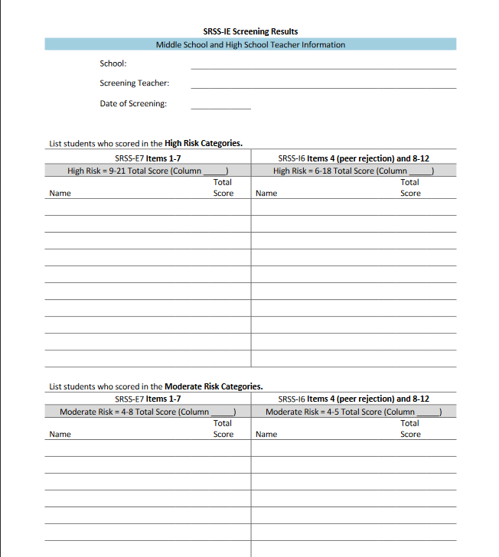
SRSS-IE Screening Results at the Middle School and High School Level Enter students with: SRSS Items 1-7: 9-21 SRSS-IE Items 4, 8-12: 6-18 SRSS Items 1-7: 0-3 SRSS-IE Items 8-12: 0-3

Slide 62
Using Screening Data to Inform Instruction
Considerations for
Primary (Tier 1) Prevention Efforts
Teacher-Delivered, Low-Intensity Supports
Secondary (Tier 2) and Tertiary (Tier 3) Supports
see Lane, Menzies, Bruhn, and Crnobori (2011)

Slide 63
Academic Screening Measures
Use the selected tool’s technical manual(s) or online systems to apply cut scores for decision making

Slide 64
Social Skills Improvement System – Performance Screening Guide Spring 2012 – Total School
N = 54
N = 22
N = 35
N = 31
N = 223
N = 233
N = 180
N = 187
N = 212
N = 235
N = 275
N = 271
n = 489 n = 490 n = 490 n = 489

Slide 65
Student Risk Screening Scale Middle School Fall 2004 - Fall 2011
n = 12
n = 20
n = 507
Percentage of Students
N=534
N=502
N=454
N=470
N=477
N=476
N=524
N= 539
Fall Screeners

Slide 66
Example Middle School: Spring
SRSS Results – All Students
N = 59
N = 32
N = 114
N = 89
N = 431
N = 532
*102 students not screened
Notes:
N = 706

Slide 67
SRSS Comparison by Grade Level
Example Middle School: Spring 2015
Grade Level | N = 604 Screened | Low (0-3) | Moderate (4-8) | High (9-21)
6th | 214 | 156 (72.90%) | 39 (18.22%) | 19 (8.88%)
7th | 195 | 146 (74.87%) | 34 (17.44%) | 15 (7.69%)
8th | 195 | 129 (66.15%) | 41 (21.03%) | 25 (12.82%)
*102 students not screened
Notes:
N=443

Slide 68
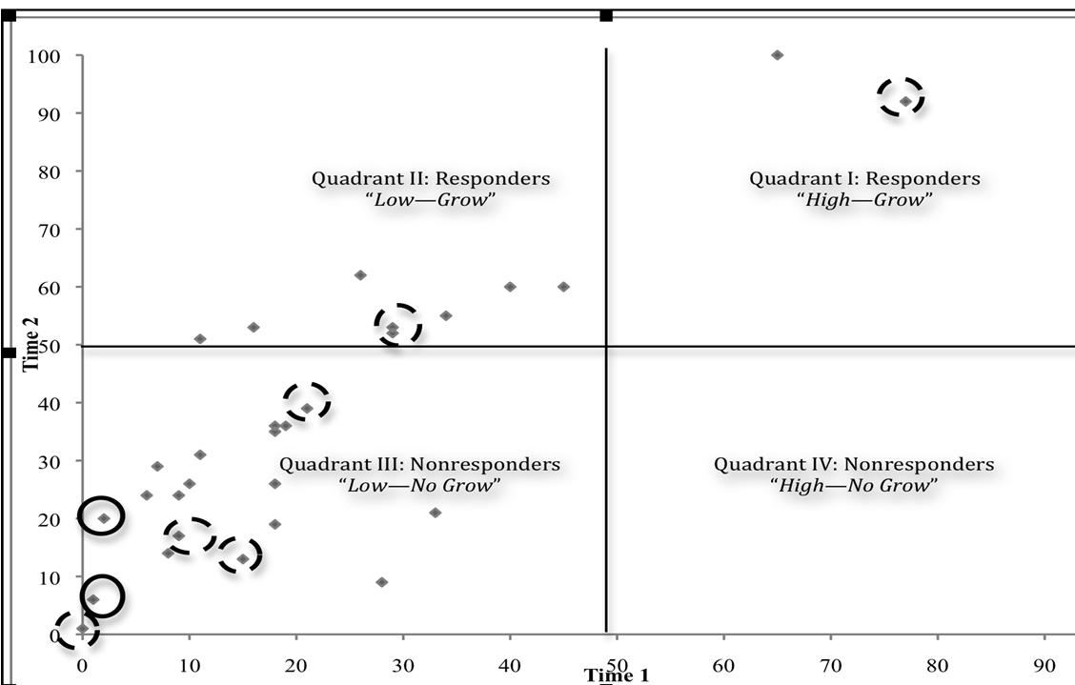
First Grade Illustration: Academic (Curriculum-Based Measurement) and Behavior (Student Risk Screening Scale) Screeners
Kalberg, J. R., Lane, K. L., & Menzies, H. M. (2010). Using systematic screening procedures to identify students who are nonresponsive to primary prevention efforts: Integrating academic and behavioral measures. Education and Treatment of Children, 33(4), 561-584.
Notes:
Note. Diamonds refer to an individual student’s combined Time 1 (fall) and Time 2 (Winter) curriculum-based measures (CBM) score. Solid circles indicate a student that scored in the high risk range (9-21) on the Student Risk Screening Scale (SRSS; Drummond, 1994) during Time 2 (Winter) administration. Dashed circles indicate a student that scored in the moderate risk range (4-8) on the SRSS during Time 2 administration.
68

Slide 69
Second Grade Illustration: Academic (Curriculum-Based Measurement) and Behavior (Student Risk Screening Scale & Systematic Screening for Behavior Disorder) Screeners
Kalberg, J. R., Lane, K. L., & Menzies, H. M. (2010). Using systematic screening procedures to identify students who are nonresponsive to primary prevention efforts: Integrating academic and behavioral measures. Education and Treatment of Children, 33(4), 561-584.
Notes:
Note. Diamonds refer to an individual student’s combined Time 1 (fall) and Time 2 (Winter) curriculum-based measures (CBM) score. Solid circles indicate a student that scored in the high risk range (9-21) on the Student Risk Screening Scale (SRSS; Drummond, 1994) during Time 2 (Winter) administration. Dashed circles indicate a student that scored in the moderate risk range (4-8) on the SRSS during Time 2 administration. Solid squares indicated a student who exceeded normative criteria on Stage 2 of the Systematic Screening for Behavior Disorders (SSBD; Walker & Severson, 1992) on the externalizing dimension during Time 2 administration.
69

Slide 70
Let’s talk… And make plans!
Discuss and list questions on screening procedures.
Notes:
Using this PowerPoint 10-min break timer
This PowerPoint slide uses images, custom animation, and timing to provide a countdown timer that you can use in any presentation. When you open the template, you’ll notice that the timer is set at 00:00. However, when you start the slide show, the timer will start at the correct time and count down by 1-minute intervals until it gets to 1 minute. At that point, it will count down in two 30-seconds intervals to 00:00.
To insert this slide into your presentation
Save this template as a presentation (.ppt file) on your computer.
Open the presentation that will contain the timer.
On the Slides tab, place your insertion point after the slide that will precede the timer. (Make sure you don't select a slide. Your insertion point should be between the slides.)
On the Insert menu, click Slides from Files.
In the Slide Finder dialog box, click the Find Presentation tab.
Click Browse, locate and select the timer presentation, and then click Open.
In the Slides from Files dialog box, select the timer slide.
Select the Keep source formatting check box. If you do not select this check box, the copied slide will inherit the design of the slide that precedes it in the presentation.
Click Insert.
Click Close.

Slide 71
Using Screening Data to Inform Instruction
Considerations for
Primary (Tier 1) Prevention Efforts
Teacher-Delivered, Low-Intensity Supports
Secondary (Tier 2) and Tertiary (Tier 3) Supports
see Lane, Menzies, Bruhn, and Crnobori (2011)

Slide 72
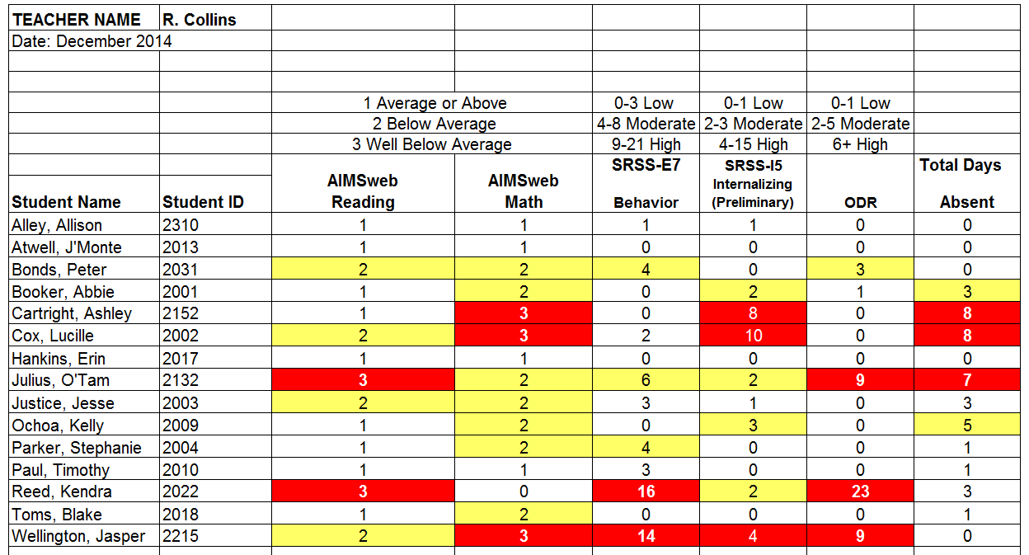
Consider this class….
Low-Intensity Strategies
Classroom Management
Practices
Classroom Climate
Physical Room Arrangement
Routines and Procedures
Managing Paper Work
Opportunities to Respond
Behavior-Specific Praise
Active Supervision
Instructional Feedback
High p Requests
Precorrection
Incorporating Choice

Slide 73
Schoolwide Positive
Behavior Support
Comprehensive, Integrative,
Three-Tiered (Ci₃T)
Models of Support
Low-Intensity Strategies
Basic Classroom Management
Effective Instruction
Low-Intensity Strategies
Behavior Contracts
Self-Monitoring
- -
Functional Assessment-Based
Interventions
Higher-Intensity
Strategies
Assess, Design, Implement,
and
Evaluate
Assessment

Slide 74
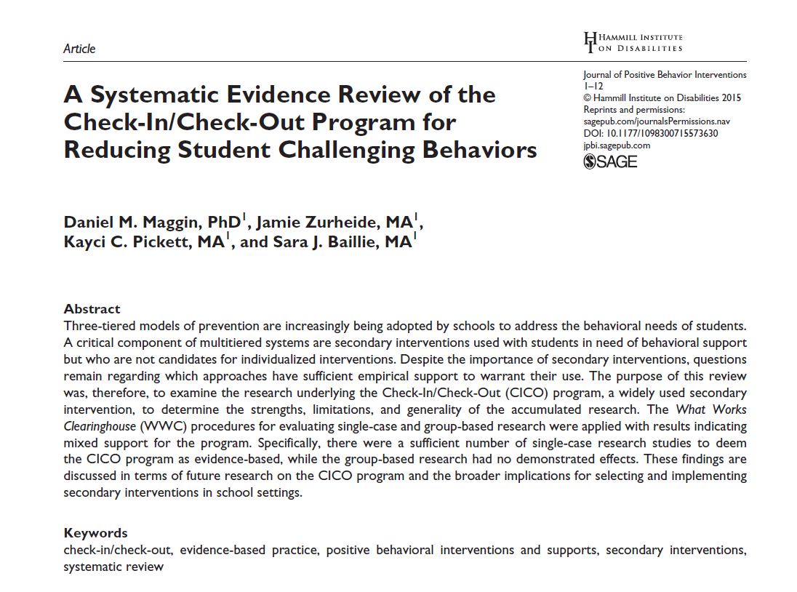
Low-Intensity Strategies: Building capacity through professional learning
Opportunities to Respond
Behavior Specific Praise
Active Supervision
Instructional Feedback
Self-Monitoring
High p Requests
Behavior Contracts
Precorrection
Incorporating Choice
Notes:
Lane, K. L., Oakes, W. P., Ennis, R. P., & Hirsch, S. E. (2014). Identifying students for secondary and tertiary prevention efforts: How do we determine which students have Tier 2 and Tier 3 needs? Preventing School Failure, 58, 171-182, DOI: 10.1080/1045988X.2014.895573

Slide 75
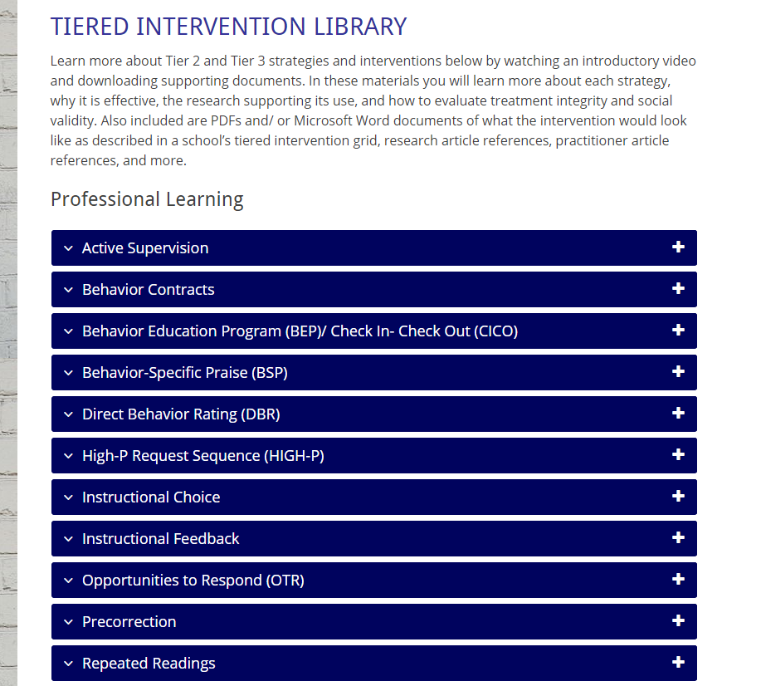
Professional Learning! www.ci3t.org/pl

Slide 76
Low-Intensity Strategy | Lincoln Elementary On-Site Expert
Behavior-Specific Praise: Identifying the specific expectation the student met. “Niama, great job using your graphic organizer to draft your essay.” “Justice, thank you for pushing in your chair to keep the walkway safe.” | Eric Common, Behavior Specialist Mark Buckman, Special Education Grant Allen, Parent Volunteer
Opportunities to Respond: Providing 4-6 opportunities per minute for students to respond individually, choral, verbal, written, gesture, or symbol. “Show me thumbs or thumbs down if...” “Show me on your white board what…” “Turn to your elbow partner and say…” “All together now, what is…” | David Royer, Administration Emily Cantwell, 5th Grade Scarlett Lane, 3rd Grade Mallory Messenger, Counselor
Instructional Choice: Providing within-task or between task choices to increase academic engaged time and motivation. “Ronaldo, of these 3 tasks today, which would you like to work on first?” “Suzy, do you want to work with colored pencils, crayons, or sparkly markers?” | Abbie Jenkins, 2nd Grade Scarlett Lane, 3rd Grade Bryan Simmons, PE Liane Johl, Kindergarten
Notes:
Identify on-site experts!

Slide 77
Using Screening Data to Inform Instruction
Considerations for
Primary (Tier 1) Prevention Efforts
Teacher-Delivered, Low-Intensity Supports
Secondary (Tier 2) and Tertiary (Tier 3) Supports
see Lane, Menzies, Bruhn, and Crnobori (2011)

Slide 78
Secondary (Tier 2) Intervention Grids

Slide 79
Schoolwide Positive
Behavior Support
Comprehensive, Integrative,
Three-Tiered (Ci₃T)
Models of Support
Low-Intensity Strategies
Basic Classroom Management
Effective Instruction
Low-Intensity Strategies
Behavior Contracts
Self-Monitoring
- -
Functional Assessment-Based
Interventions
Higher-Intensity
Strategies
Assess, Design, Implement,
and
Evaluate
Assessment

Slide 80
Building a Ci3T Tier Library
Teacher-Delivered Strategies (T1 T2)
Tier 1
Tier 2
Tier 3

Slide 81
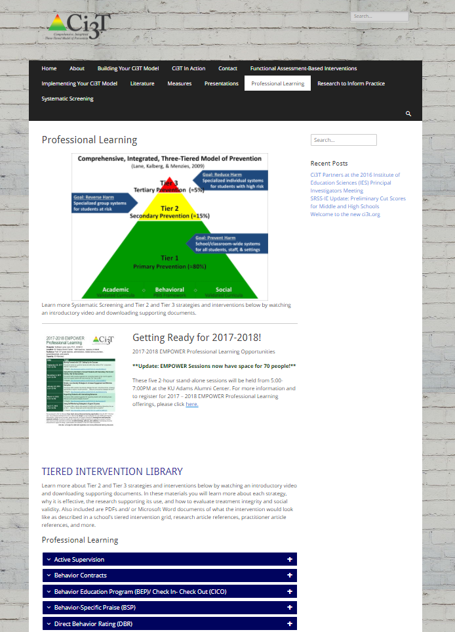

Slide 82
Sample Secondary Intervention Grid
Sample Secondary Intervention Grid
Support | Description | Schoolwide Data: Entry Criteria | Data to Monitor Progress | Exit Criteria
Behavior Contract | A written agreement between two parties used to specify the contingent relationship between the completion of a behavior and access to or delivery of a specific reward. Contract may involve administrator, teacher, parent, and student. | Behavior: SRSS - mod to high risk Academic: 2 or more missing assignments with in a grading period | Work completion, or other behavior addressed in contract Treatment Integrity Social Validity | Successful Completion of behavior contract
Self-monitoring | Students will monitor and record their academic production (completion/ accuracy) and on-task behavior each day. | Students who score in the abnormal range for H and CP on the SDQ; course failure or at risk on CBM | Work completion and accuracy in the academic area of concern; passing grades Treatment Integrity Social Validity | Passing grade on the report card in the academic area of concern
Lane, Kalberg, & Menzies (2009). pp. 131 - 137, Boxes 6.1 - 6.4

Slide 83
An illustration
Support | Description | Schoolwide Data: Entry Criteria | Data to Monitor Progress: | Exit Criteria
Small group reading instruction with self-monitoring | Small group reading instruction (30 min, 3 days per week). Students monitored their participation in the reading instructional tasks. Students used checklists of reading lesson components each day to complete and compare to teachers’ rating. K – 1. | Students who: Behavior: Fall SRSS at moderate (4-8) or high (9-21) risk Academic: Fall AIMSweb LNF at the strategic or intensive level | AIMSweb reading PSF and NWF progress monitoring probes (weekly). Daily self-monitoring checklists Treatment Integrity Social Validity | Meet AIMSweb reading benchmark at next screening time point. Low Risk on SRSS at next screening time point.
Notes:
Add more description

Slide 84
Small group Reading Instruction with Self-Monitoring
Lane, K.L., & Oakes, W. P. (2012). Identifying Students for Secondary and Tertiary Prevention Efforts: How do we determine which students have Tier 2 and Tier 3 needs? In preparation.
Notes:
Citation: Lane, K.L., & Oakes, W. P. (2012). Identifying Students for Secondary and Tertiary Prevention Efforts: How do we determine which students have Tier 2 and Tier 3 needs? In preparation.

Slide 85
First Grade Students’ Self Monitoring Form
Altmann, S. A. (2010). Project support and include: the additive benefits of self-monitoring on students’ reading acquisition. Unpublished master’s thesis, Vanderbilt University.

Slide 86
Treatment Integrity Social Validity Monitor student progress
Altmann, S. A. (2010). Project support and include: the additive benefits of self-monitoring on students’ reading acquisition. Unpublished master’s thesis, Vanderbilt University.

Slide 87
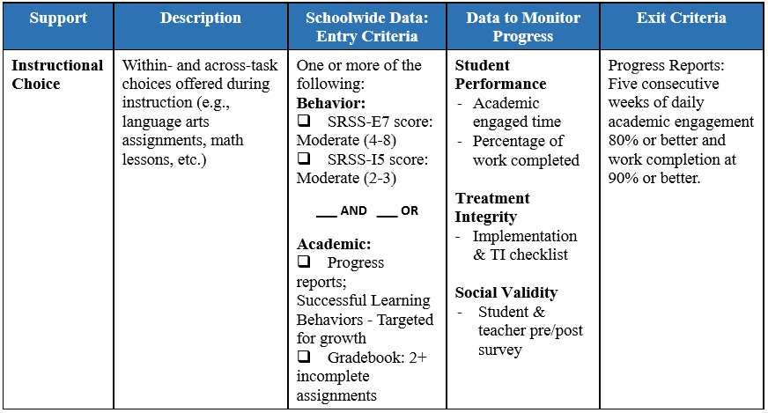
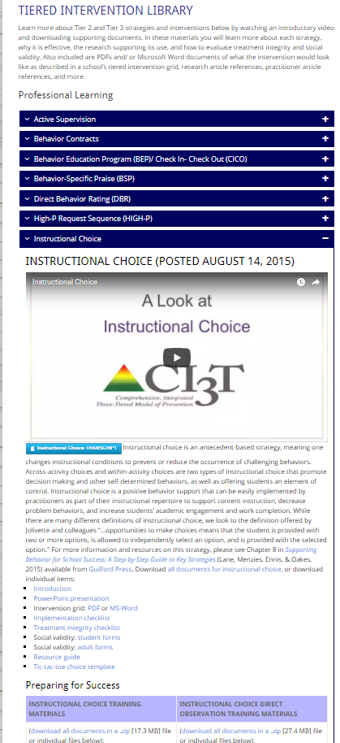
Instructional Choice
ci3t.org/pl

Slide 88
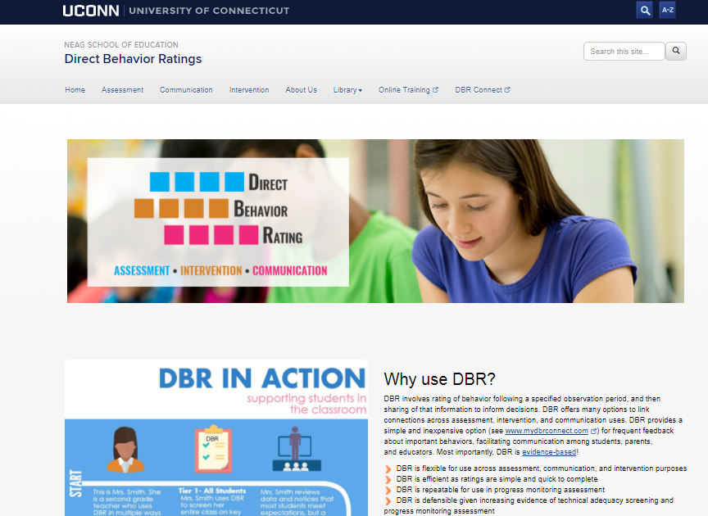
Daily Behavior Report Cards
Support | Description | School-wide Data: Entry Criteria | Data to Monitor Progress | Exit Criteria
Daily Behavior Report (DBR) Card | DBR will be completed by the classroom teacher during daily observation periods (e.g., core instruction during English Language Arts) and parents will sign the form each day. DBR will be used to rate academic engagement, respect, and disruption. At the conclusion of each observation period, the teacher will indicate the degree to which the student displayed each behavior. The teacher will meet briefly with the student to share the teacher’s DBR rating and home-school communication procedures will be established for student to bring a paper copy or email to parent or caregiver each day DBR was implemented for a parent/caregiver to sign. | Behavior SRSS-E7 score: Moderate (4-8) and/or SRSS-I5 score: Moderate (2-3) AND Evidence of teacher implementation of Ci3T primary (Tier 1) plan [treatment integrity: direct observation] AND Parent permission AND Academic Student is in grade 2 or 3 | Student measures Daily behavior report (DBR; daily) Attendance and tardies Social validity Teacher: IRP-15 Student: CIRP Treatment integrity Tier 2 treatment integrity measures Ci3T TI: Direct observation (30 min if needed) | Review student progress at end of 24 sessions Team agrees goals have been met or no further Positive Action small group sessions are warranted SRSS-E7 and I5 scores are in the low risk category
http://dbr.education.uconn.edu/

Slide 89
Positive Action: Tier 2 Groups
Support | Description | School-wide Data: Entry Criteria | Data to Monitor Progress | Exit Criteria
Positive Action (PA) – counselor-led small group | Counselors and/or social workers will lead small group Positive Action sessions for approximately 30-40 min 2-3 days per week. Students will acquire new skills, learn how to engage more fully in instructional experiences, and learn how to meet more school-wide expectations. Small groups will run for up to 24 sessions (8 to 12 weeks depending on the number of sessions conducted per week) using a subset of Positive Action lessons appropriate for student skillsets as identified using Skills For Greatness (teacher, counselor, parent versions) and SSiS-Rating Scale (teacher and parent version). | Behavior SRSS-E7 score: Moderate (4-8) and/or SRSS-I5 score: Moderate (2-3) AND 2 or fewer absences in first 3 months of school AND Evidence of teacher implementation of Ci3T primary (Tier 1) plan [treatment integrity: direct observation] AND Parent permission AND Academic Student is in grade 2 or 3 | Student measures SSiS-Rating Scale (Pre/Post) Skills for Greatness (Pre/Post) Daily behavior report (DBR; daily) Attendance and tardies Social validity Teacher: IRP-15 Student: CIRP Treatment integrity Tier 2 treatment integrity measures Ci3T TI: Direct observation (30 min if needed) | Review student progress at end of 24 sessions Team agrees goals have been met or no further Positive Action small group sessions are warranted SRSS-E7 and I5 scores are in the low risk category

Slide 90
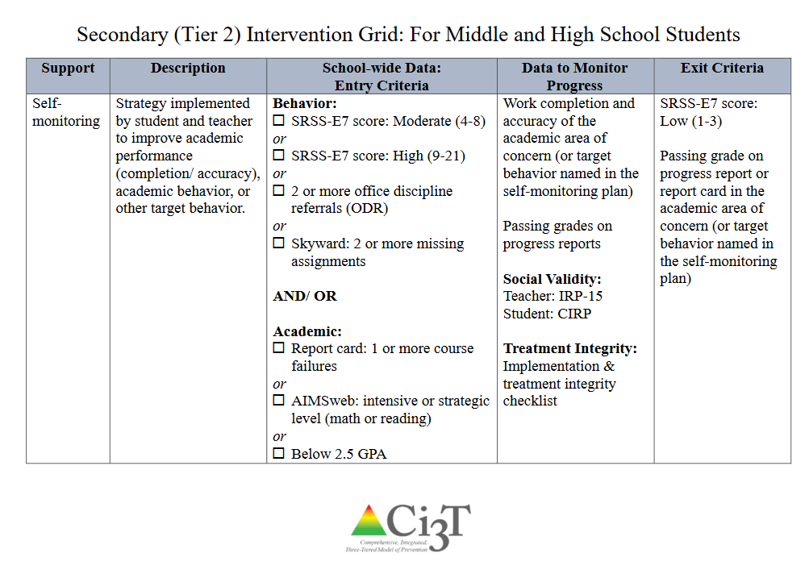

Slide 91
Schoolwide Positive
Behavior Support
Comprehensive, Integrative,
Three-Tiered (Ci₃T)
Models of Support
Low-Intensity Strategies
Basic Classroom Management
Effective Instruction
Low-Intensity Strategies
Behavior Contracts
Self-Monitoring
- -
Functional Assessment-Based
Interventions
Higher-Intensity
Strategies
Assess, Design, Implement,
and
Evaluate
Assessment

Slide 92
Tertiary (Tier 3) Intervention Grids

Slide 93
Schoolwide Positive Behavior
Support
Comprehensive, Integrative,
Three-tiered (CI3T)
Models of Support
Low Intensity Strategies
Basic Classroom Management
Effective Instruction
Low Intensity Strategies
Behavior Contracts
Self-Monitoring
- -
Functional Assessment-Based
Interventions
Higher Intensity Strategies
Assess, Design, Implement, and
Evaluate
Assessment

Slide 94
Schoolwide Positive
Behavior Support
Comprehensive, Integrative,
Three-Tiered (Ci₃T)
Models of Support
Low-Intensity Strategies
Basic Classroom Management
Effective Instruction
Low-Intensity Strategies
Behavior Contracts
Self-Monitoring
- -
Functional Assessment-Based
Interventions
Higher-Intensity
Strategies
Assess, Design, Implement,
and
Evaluate
Assessment

Slide 95
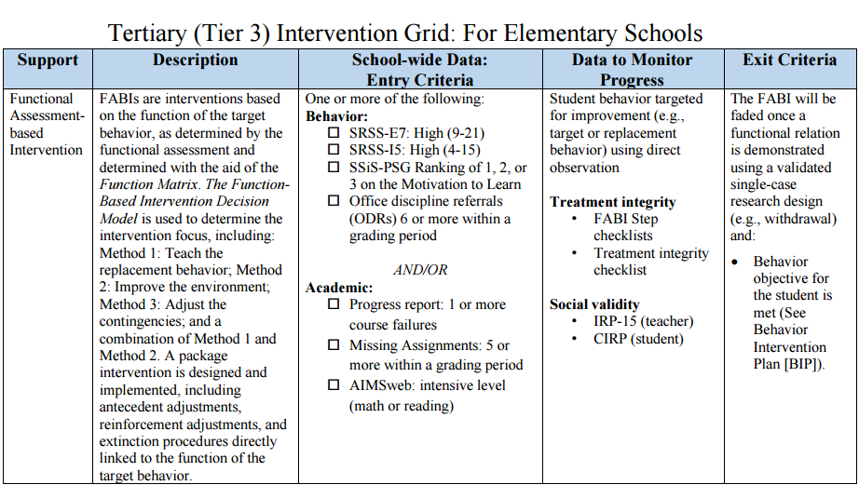

Slide 96
Let’s talk… And make plans!
Discuss and list questions on using screening data to inform instruction.
Notes:
10-min timer

Slide 97
Facilitating Clear Communication with Stakeholders
Communicating and Collaborating with your
District
Ci3T Leadership Team
Faculty and Staff
Students, Parents, and Community

Slide 98
Monitoring Implementation: Develop Action Items for Communication with Stakeholders
District
Ci3T Leadership Team
Faculty and Staff
Students, Parents, & Community
Notes:
Honor those who are on time
Starting the meeting on time
Start with sharing successes
Respect everyone’s time
End the meeting on time, one hour maximum
Assign tasks to individuals or temporary subcommittees as needed to keep the meeting on track
Schedule a follow-up meeting as needed or make plans to conduct final business by email
Be efficient with time
Be solution-based, spending time on action plans instead of “admiring the problem

Slide 99
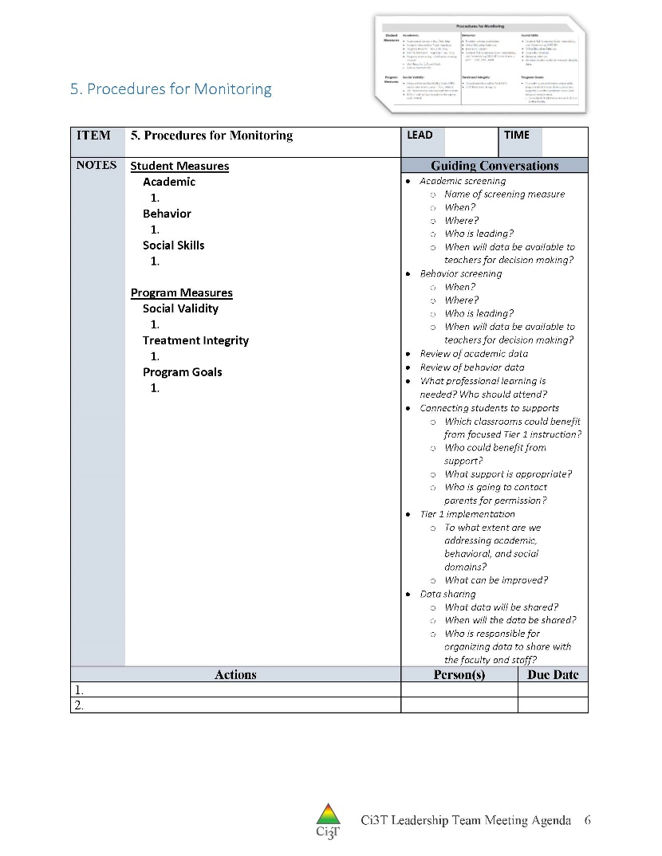
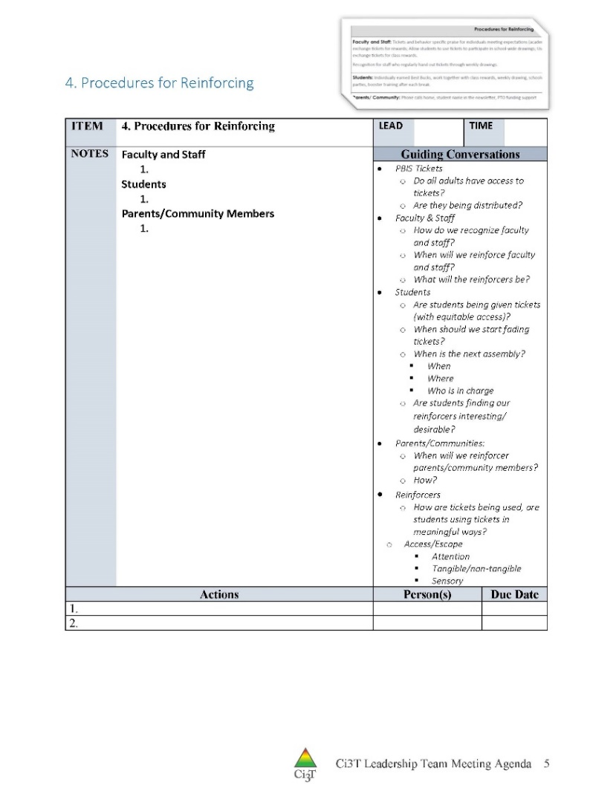
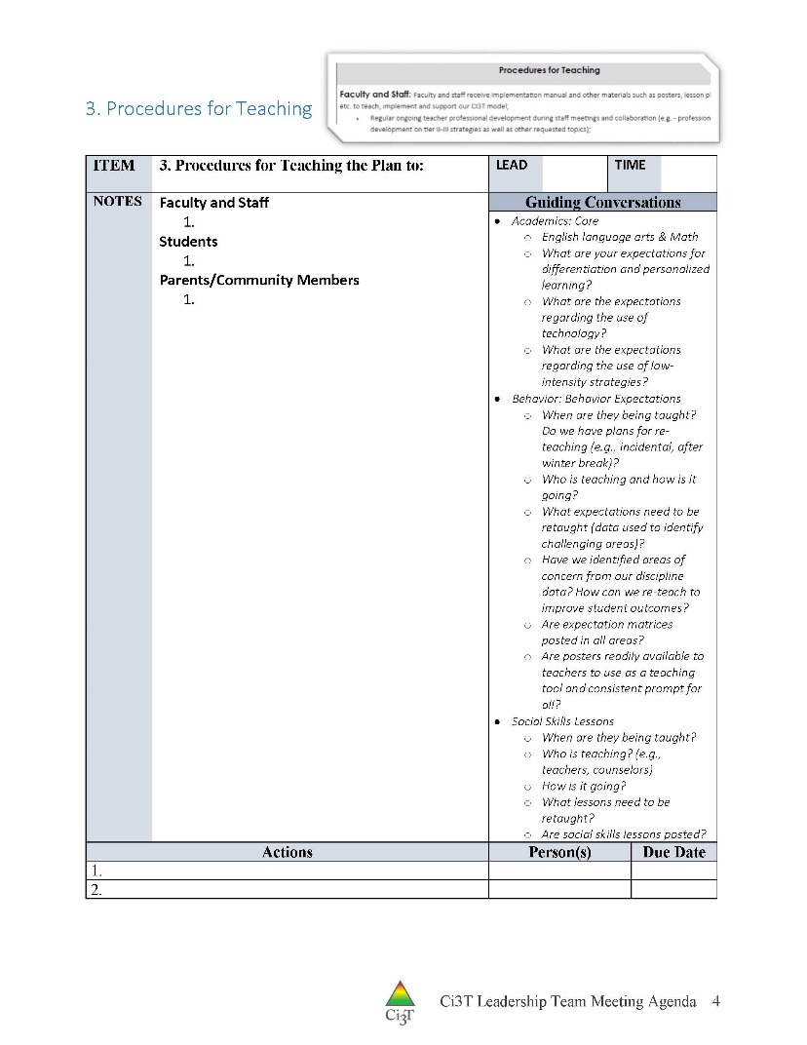
Procedures for Teaching, Reinforcing, and Monitoring

Slide 100
Where are you in the implementation process? Adapted from Fixsen & Blase, 2005
Exploration & Adoption
Installation
Initial Implementation
We think we know what we need so we are planning to move forward (evidence-based)
Let’s make sure we’re ready to implement (capacity infrastructure)
Let’s give it a try and evaluate (demonstration)
Full Implementation
Let’s make it our way of doing business (institutionalized use)
Sustainability & Continuous Regeneration
That worked, let’s do it for real (investment)

Slide 101
Building Capacity and Sustainability
of Tiered Prevention Models
For Academic Achievement, Behavior, and Social Competencies
OUTCOMES
Communication Structures
Communication Content
SYSTEMS
DATA
PRACTICES
Communication Content
pbis.org

Slide 102
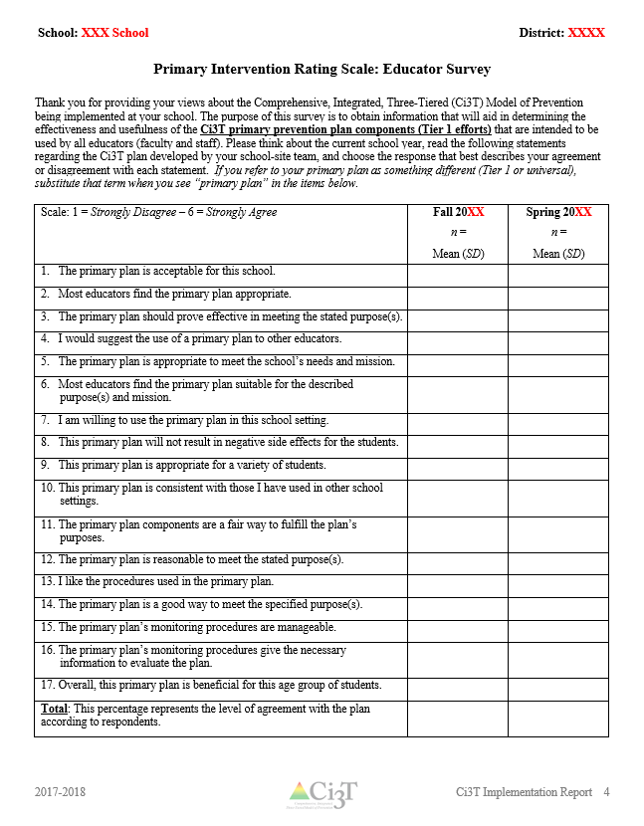
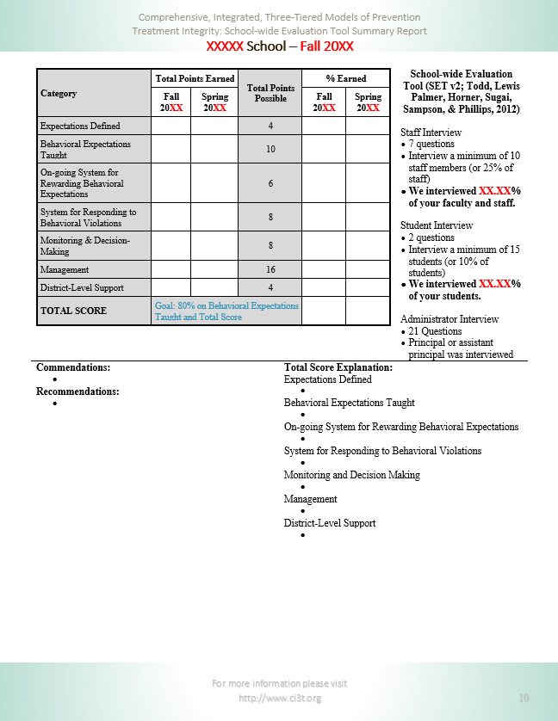
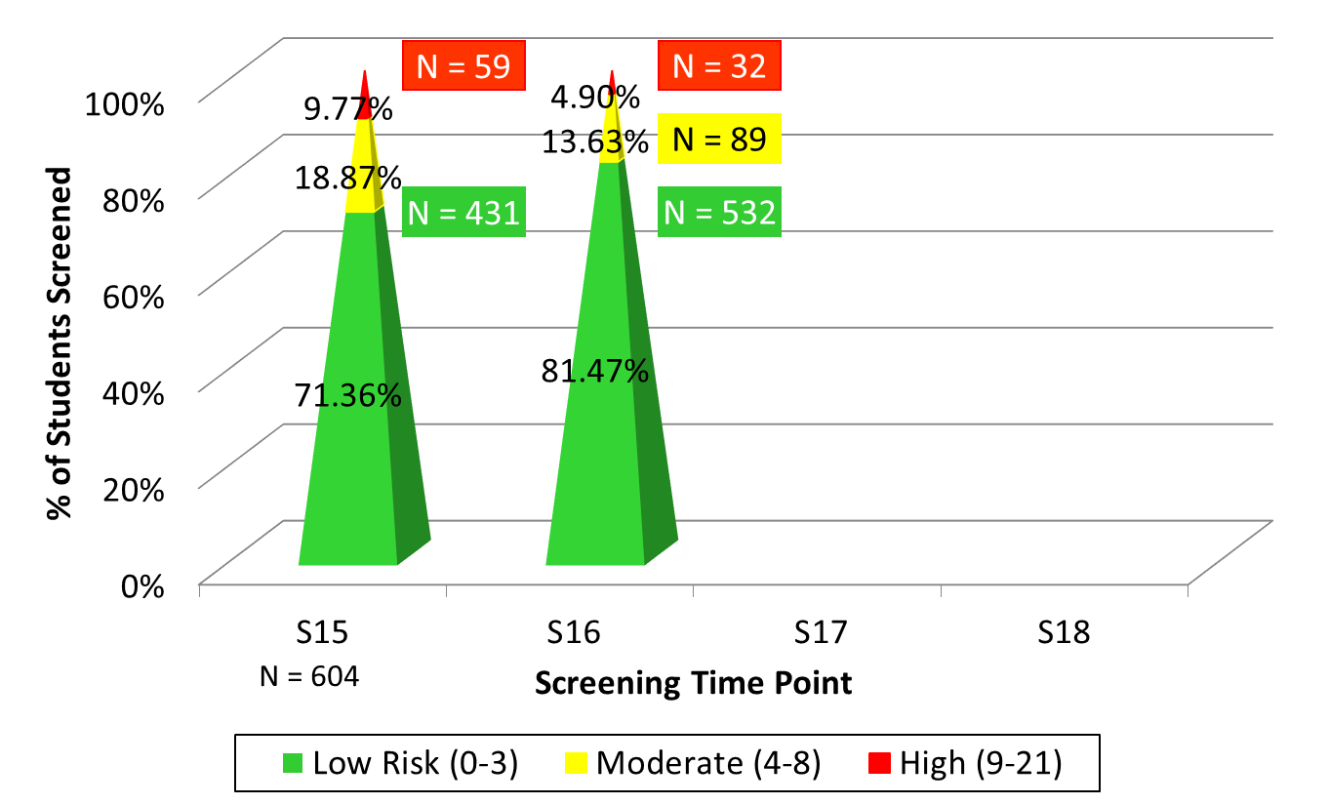
Ci3T Communication Tools

Slide 103
District Communication with Stakeholders

Slide 104
Communicating with Students
Have students be the teachers!
https://vimeo.com/groups/pbisvideos/videos/189663105
https://youtu.be/FuBR6EH6UOM
https://youtu.be/Qgj7fdH7_MU
Notes:
APBS film festival videos. View slideshow, then each video should have a play button. Click the fullscreen button to make video larger while playing.

Slide 105
Communication through School Webpages
Use a recognizable graphic
Clear and consistent messaging
Are all Ci3T domains presented – academic, social, and behavioral components?
Keep your website current and active:
Upcoming academic activities
Updates on weekly Ci3T challenges
Success sharing
Expectation focus for the week
Upcoming Ci3T assemblies
Social skills curriculum monthly topics

Slide 106
Let’s talk… Communication with Stakeholders
How will you use these multiple sources of data to inform professional learning for developing school capacity for low intensity strategies and tiered supports?
How will you use your Ci3T Team meeting time effectively and plan to communicate with all stakeholders?
How will share program level data (TI and SV) as well as student progress?
Notes:
10 min Using this PowerPoint break timer
**Is timer set to correct time. Do we want 25 or 10? Same question for above slide.
This PowerPoint slide uses images, custom animation, and timing to provide a countdown timer that you can use in any presentation. When you open the template, you’ll notice that the timer is set at 00:00. However, when you start the slide show, the timer will start at the correct time and count down by 1-minute intervals until it gets to 1 minute. At that point, it will count down in two 30-seconds intervals to 00:00.
To insert this slide into your presentation
Save this template as a presentation (.ppt file) on your computer.
Open the presentation that will contain the timer.
On the Slides tab, place your insertion point after the slide that will precede the timer. (Make sure you don't select a slide. Your insertion point should be between the slides.)
On the Insert menu, click Slides from Files.
In the Slide Finder dialog box, click the Find Presentation tab.
Click Browse, locate and select the timer presentation, and then click Open.
In the Slides from Files dialog box, select the timer slide.
Select the Keep source formatting check box. If you do not select this check box, the copied slide will inherit the design of the slide that precedes it in the presentation.
Click Insert.
Click Close.

Slide 107
Preparing Your Data Structures to Support Data-informed Decision Making:
Technology Training Part 2 A sneak preview!

Slide 109
Wrapping Up and Moving Forward

Slide 110
Ci3T Training Series
Ci3T: Primary Prevention
Session 1:
Overview of Ci3T Prevention Models
Setting a Purpose
Establish team meetings and roles
Session 2:
Mission and Purpose
Establish Roles and Responsibilities
Procedures for Teaching
Procedures for Reinforcing
Reactive Plan
Session 3:
Procedures for Monitoring
Session 4:
Revise Primary Plan using Stakeholder feedback
Prepare presentation
Ci3T: Secondary Prevention
Session 5:
Overview of Teacher focused Strategies
Overview of Student Focused Strategies
Using data to determine
Draft the Secondary Intervention Grid based on existing supports
Ci3T: Tertiary Prevention
Session 6:
Final revisions of Ci3T Plan based on stakeholder feedback
Draft Tertiary Prevention Intervention Grids
Design Implementation Manual and Plan for roll out to faculty, students, and parents
Ci3T Team Training Sequence
Implementation Stages of Tier 2 and 3 within Ci3T
Additional Professional Development on Specific Topics
Core Content Curriculum
Check In - Check Out
Functional Assessment-based Interventions
Reading, Math, Writing Benchmarking and Progress Monitoring Tools
Student Driven Interventions, Strategies, & Practices
Additional Tier 3 Supports
Teacher Driven Supports: Instructional Techniques to Improve Students’ Motivation; General Classroom Management Practices; Low-Intensity Behavior Supports
Notes:
Lane and Oakes 2014

Slide 111
Upcoming Professional Development
Sep | Oct | Nov | Dec | Jan | Feb | Mar | Apr | May
 |  | KU Ci3T Day 1 11/14/17 5:00-7:00PM | KU Ci3T Day 2 12/06/17 8:00AM-4:00PM | KU Ci3T Day 3 01/16/18 5:00-7:00PM | KU Ci3T Day 4 02/13/18 8:00AM-4:00PM |  | KU Ci3T Day 5 04/04/18 5:00-7:00PM | KU Ci3T Day 6 05/03/18 8:00AM-4:00PM
KU Ci3T IMP Day 1 09/20/17 |  | KU Ci3T IMP Day 2 11/15/17 |  | KU Ci3T IMP Day 3 01/17/18 |  | KU Ci3T IMP Day 4 03/13/18 | KU Ci3T IMP Day 5 04/03/18
 | Technology Training Day 1 10/02/17 9:00AM-12:00PM | Technology Training Day 2 11/29/17 5:00-7:00PM
TOT Coaching Call Session 1 09/21/17 |  | TOT Coaching Call Session 2 11/16/17 | TOT Coaching Call Session 3 12/08/17 | TOT Coaching Call Session 4 01/18/18 | TOT Coaching Call Session 5 02/15/18 | TOT Coaching Call Session 6 03/15/18 | TOT Coaching Call Session 7 04/05/18 | TOT Coaching Call Session 8 05/04/18
KU Ci3T EMPOWER Session 1 09/25/17 |  | KU Ci3T EMPOWER Session 2 11/08/17 |  | KU Ci3T EMPOWER Session 3 01/24/18 |  | KU Ci3T EMPOWER Session 4 03/14/18 | KU Ci3T EMPOWER Session 5 04/17/18
KU Ci3T TRAINING
KU Ci3T IMPLEMENTATION
5:00-7:00 PM
Register 2-3 colleagues today!
Trainer of Trainers Coaching Calls
4:00-5:30 PM
KU Project EMPOWER
5:00-7:00 PM

Slide 112
Ci3T Team Implementation Support
9/20/17
5:00-7:00 PM
Supporting Success: A Look at Tier 1
11/15/17
5:00-7:00 PM
Planning for Success: Monitoring and Communication
1/17/18
5:00-7:00 PM
Using Your Data to Inform Instruction
3/13/18
5:00-7:00 PM
Supporting Students Across the Tiers
4/3/18
5:00-7:00 PM
Planning for the Year Ahead

Slide 114
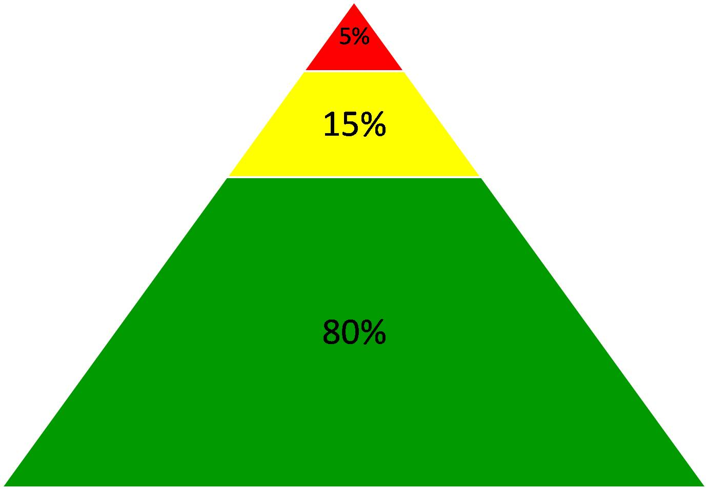

Slide 115
Goals for this Implementation Year
Establish effective Ci3T Leadership Team structures
Gain a deeper understanding of Ci3T models of prevention
Implement your school’s plan with high fidelity
Collect and use social validity and treatment integrity data to monitor Ci3T plan implementation
Collect student academic and behavioral screening and outcome data to inform Ci3T implementation efforts
Share data and communicated Ci3T practices with all stakeholders regularly (e.g., monthly, quarterly)
Identify areas of additional professional learning for faculty and staff and support faculty and staff access to professional learning
Address any barriers to implementing your Ci3T model

Slide 116
Let’s talk… And make plans!
What did I learn?
How will I take this information back to my faculty, staff, and parents?
Notes:
10 min: Using this PowerPoint break timer
This PowerPoint slide uses images, custom animation, and timing to provide a countdown timer that you can use in any presentation. When you open the template, you’ll notice that the timer is set at 00:00. However, when you start the slide show, the timer will start at the correct time and count down by 1-minute intervals until it gets to 1 minute. At that point, it will count down in two 30-seconds intervals to 00:00.
To insert this slide into your presentation
Save this template as a presentation (.ppt file) on your computer.
Open the presentation that will contain the timer.
On the Slides tab, place your insertion point after the slide that will precede the timer. (Make sure you don't select a slide. Your insertion point should be between the slides.)
On the Insert menu, click Slides from Files.
In the Slide Finder dialog box, click the Find Presentation tab.
Click Browse, locate and select the timer presentation, and then click Open.
In the Slides from Files dialog box, select the timer slide.
Select the Keep source formatting check box. If you do not select this check box, the copied slide will inherit the design of the slide that precedes it in the presentation.
Click Insert.
Click Close.

Slide 117
Please Take a Minute to Get Organized
Please stay until all materials are organized.
Team Materials:
Save all documents with your school initials at the beginning and the date at the end of the file name.
XXS IM18 Ci3T Leadership Team Meeting Agenda YYYY MM DD.docx
Save to your school’s Dropbox folder
Clearly identify the person(s) on your team in charge of each action item listed on the agenda.
Thank you!

Slide 118
Wrap Up and Preview
Today’s Review
Next Session Preview
Prepare to collect social validity and treatment integrity data
Use screening data to inform instruction at Tier 1, Tier 2, and Tier 3
Communicate with all stakeholders:
District
Ci3T Leadership Team
Faculty and staff
Students, parents, community
Reviewing your implementation data
Using your data to support your faculty and staff
Using your data to support students

Slide 119
Upcoming Professional Development
Sep | Oct | Nov | Dec | Jan | Feb | Mar | Apr | May
 |  | KU Ci3T Day 1 11/14/17 5:00-7:00PM | KU Ci3T Day 2 12/06/17 8:00AM-4:00PM | KU Ci3T Day 3 01/16/18 5:00-7:00PM | KU Ci3T Day 4 02/13/18 8:00AM-4:00PM |  | KU Ci3T Day 5 04/04/18 5:00-7:00PM | KU Ci3T Day 6 05/03/18 8:00AM-4:00PM
KU Ci3T IMP Day 1 09/20/17 |  | KU Ci3T IMP Day 2 11/15/17 |  | KU Ci3T IMP Day 3 01/17/18 |  | KU Ci3T IMP Day 4 03/13/18 | KU Ci3T IMP Day 5 04/03/18
 | Technology Training Day 1 10/02/17 9:00AM-12:00PM | Technology Training Day 2 11/29/17 5:00-7:00PM
TOT Coaching Call Session 1 09/21/17 |  | TOT Coaching Call Session 2 11/16/17 | TOT Coaching Call Session 3 12/08/17 | TOT Coaching Call Session 4 01/18/18 | TOT Coaching Call Session 5 02/15/18 | TOT Coaching Call Session 6 03/15/18 | TOT Coaching Call Session 7 04/05/18 | TOT Coaching Call Session 8 05/04/18
KU Ci3T EMPOWER Session 1 09/25/17 |  | KU Ci3T EMPOWER Session 2 11/08/17 |  | KU Ci3T EMPOWER Session 3 01/24/18 |  | KU Ci3T EMPOWER Session 4 03/14/18 | KU Ci3T EMPOWER Session 5 04/17/18
KU Ci3T TRAINING
KU Ci3T IMPLEMENTATION
5:00-7:00 PM
Trainer of Trainers Coaching Calls
4:00-5:30 PM
KU Project EMPOWER
5:00-7:00 PM

Slide 120
Homework
Collect fall social validity and treatment integrity data
At your next Ci3T Leadership Team meeting:
Use IM18 Ci3T Leadership Team Meeting Agenda to conduct an effective meeting with
clearly defined roles and responsibilities of team members
action items, persons responsible, and due dates
Create implementation reports to bring to January professional learning session
Create screening reports to bring to January professional learning session
At your next faculty meeting:
Share successes
Review implementation procedures
Consider providing time for PIRS and TSR survey completion
Consider providing time for screener completion

