Slide 1
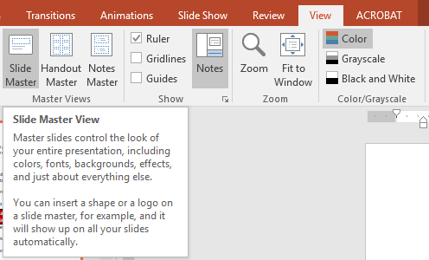
Notes on layout, Graphics & Fonts
Congratulations! Your school’s team has worked hard to create your Ci3T plan, and now you are ready to share it with your faculty and staff through this presentation. The template for this presentation begins on the next slide.
This template is intended to help minimize the layout and assembly work of finalizing your presentation in 3 ways:
Red text indicates a place for your school name, Ci3T Leadership Team names, or your school expectations.
Several slides are marked with a silver text box stating “draft” – delete these text boxes after the faculty has had a chance to provide input, and when the plan is finalized.
TIP: Use the slide master (View > Slide Master) to change the theme colors to match your school colors
Thank you for the opportunity to be part of
your process over these last several months.
Again, congratulations on your hard work!
Sincerely,
Ci3T Trainers
Text in a red box will indicate if a slide is to be shown as a sample,
or whether it’s a place to insert material from your implementation plan.

Slide 2
Comprehensive, Integrated, Three-Tiered (Ci3T) Model of Prevention
Insert School Mascot / Logo
School Name

Slide 3
Our School’s Ci3T Leadership Team
Name | Principal
Name | General Education Teacher
Name | General Education Teacher
Name | Special Education
Name | Counselor
Name | Title I
Name | Parent Representative
Name | Ci3T Coach
Name | District Representative

Slide 4
Planning Checklist
✓Selected school Ci3T Leadership Team
✓Full faculty and staff completed the Schoolwide Expectations Survey for Specific Settings (SESSS)
✓ Ci3T team attended training to design a Ci3T model of prevention
✓ Drafted the primary (Tier 1) plan
✓ Drafted procedures for teaching
✓ Drafted procedures for reinforcing
✓ Drafted procedures for monitoring
Faculty presentation and feedback
Make revisions based on faculty and staff feedback

Slide 5
Why do we need a three-tiered model of prevention?
comprehensive, integrated, three-tiered (Ci3T) model of prevention addressing academic, behavior, and social domains

Slide 7
Primary (Tier 1) Prevention:
Prevent Harm
All students are eligible for participation
  Lane, Robertson et al., 2006
  Sugai 2013
  Bradshaw, Mitchell, & Leaf (in press)
  Horner, Sugai, Smolkowski, Tood, Nakasato, & Esperanza (in press)
Approximately 80% of students respond to this level
  Gresham, Sugai, Horner, Quinn, & McInerney, 1998
  Sugai & Horner, 2006
  Bradshaw, Reinke, Brown, Bevans, & Leaf, 2008
Examples of primary (Tier 1) prevention
Add examples of your school’s
primary prevention strategies here

Slide 8
Secondary (Tier 2) Prevention:
Reverse Harm
Students who do not respond to the primary (Tier 1) prevention plan
10-15% of students
Focused intervention to address academic, behavior, or social concerns:
  Acquisition (can’t do)
  Fluency (trouble doing)
  Performance (won’t do)
Examples of secondary (Tier 2) prevention
  -
Add examples of your school’s
secondary prevention strategies here

Slide 9
Tertiary (Tier 3) Prevention:
Reduce Harm
Students who do not respond to the primary (Tier 1) or secondary (Tier 2) prevention
5-7% of students
Intensive and individualized interventions
Examples of tertiary (Tier 3) supports
  -
  -
Add examples of your school’s
tertiary supports here

Slide 10
SESSS Results
Schoolwide expectations survey for specific settings

Slide 11
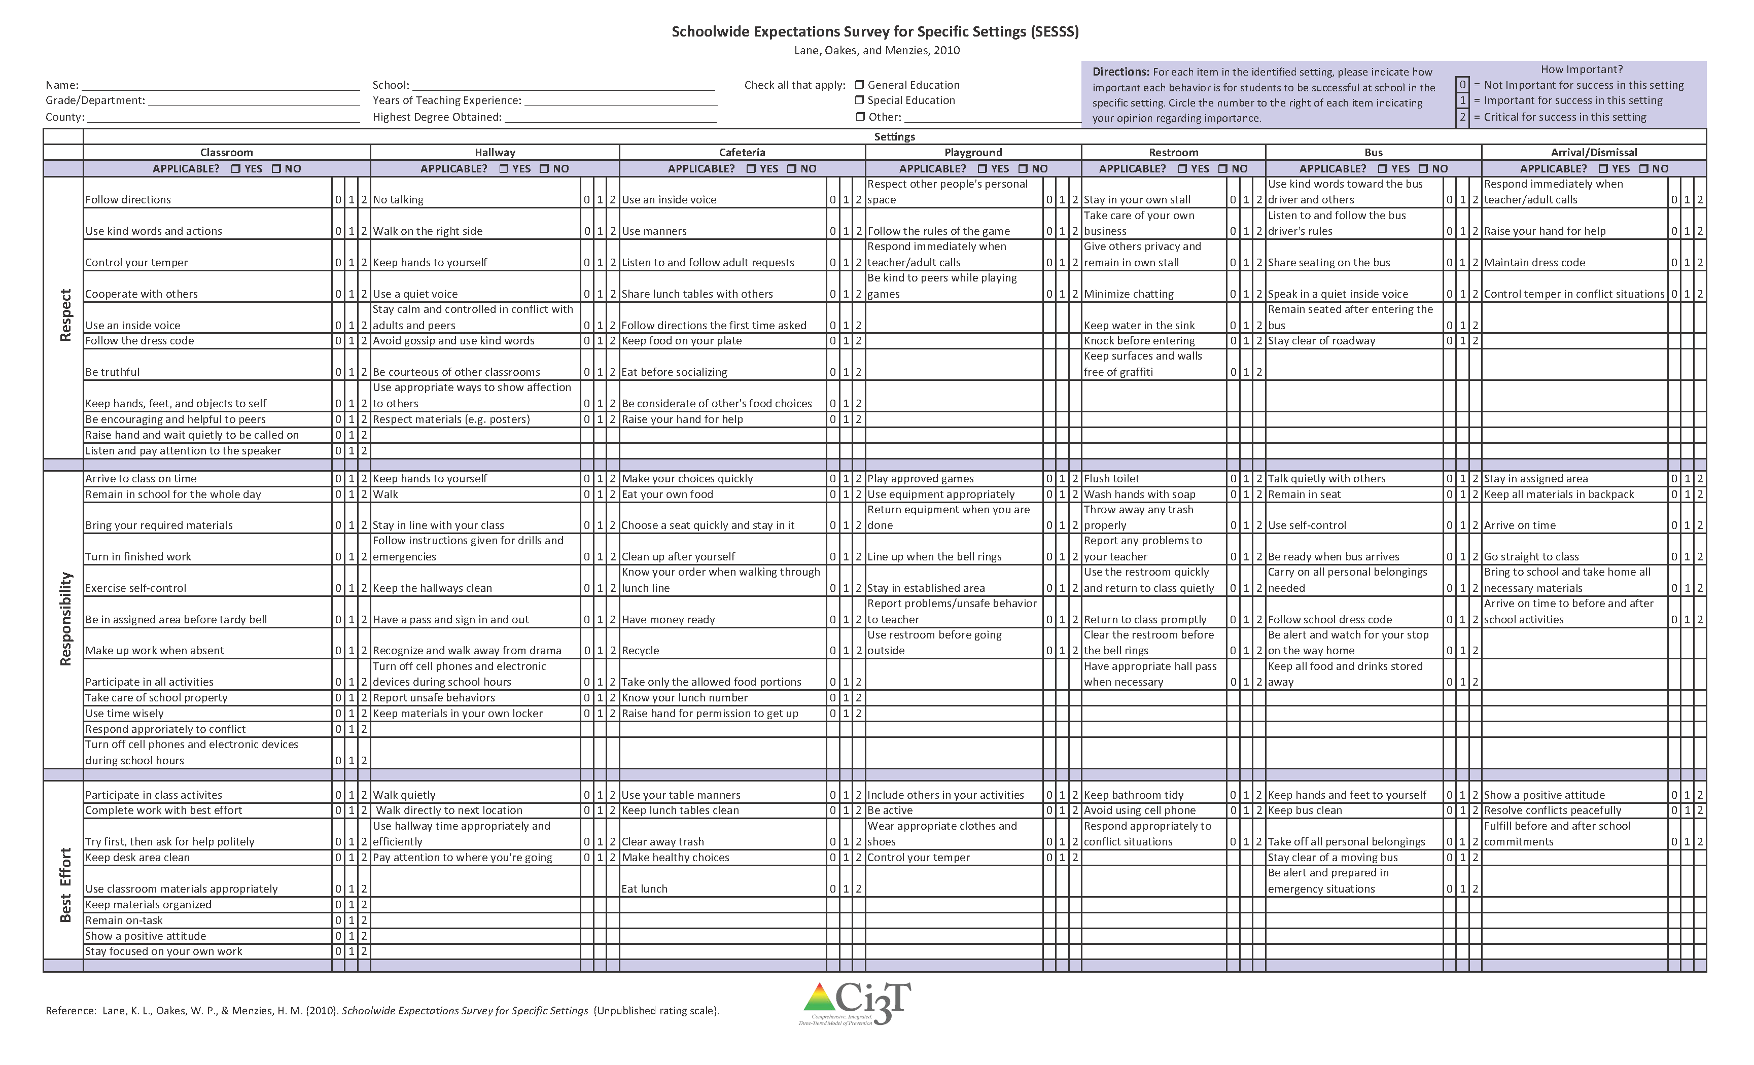
What do your faculty and staff expect?
    The Schoolwide Expectation Survey for Specific Settings
Follow Directions 0 1 2
Use kind words 0 1 2
Control your temper 0 1 2
Cooperate with others 0 1 2
Use an inside voice 0 1 2
Respect
Arrive to class on time 0 1 2
Remain in school for the whole day 0 1 2
Bring your required materials 0 1 2
Turn in finished work 0 1 2
Exercise self-control 0 1 2
Responsibility
Participate in class activities 0 1 2
Complete work with best effort 0 1 2
Ask for help politely 0 1 2
Best Effort

Slide 12
Our School’s Plan
Draft

Slide 13
SCHOOL NAME
Mission Statement
Statement of Purpose
Add text
Add text
Copy and paste your school’s info
from your Ci3T Blueprint A Primary (Tier 1) Plan
Draft

Slide 14
Our School’s Expectations
3-5 Expectations Identified
  Clearly stated
  Taught
  Reinforced
Explicitly defined for each school setting
Teacher expectation survey results were used to establish school priorities
Notes:
12

Slide 15
Our School’s
Expectations
Expectation 1
Expectation 2
Expectation 3
Insert your school’s three to five
behavior expectations from
your Ci3T Blueprint C Expectation matrix

Slide 16

Sample

Slide 17
What do these behaviors look like in our school?
Step 1: Identify Settings
Step 2: Establish Expectations
Operationalize expectations for each setting.
What does each behavior look like?
The results from the SESSS faculty and staff completed was used to draft our descriptions.
ADD SETTINGS HERE
Add the settings your team chose to
include in Ci3T Blueprint C Expectation Matrix
Notes:
List the areas you defined here.

Slide 18
Copy and paste your school’s
Ci3T Blueprint C Expectation Matrix
Draft

Slide 19
Elements of the primary plan
Academic
Social Skills
Behavior

Slide 20
An Instructional Approach
Academic engagement & success are maximized
Behavioral expectations taught directly like academic skills
Influence of instructional support is considered
    George Sugai, National PBIS Technical Assistance Center;
    Horner, R. H., Sugai, G., Smolkowski, K., Eber, L., Nakasato, J., Todd, A. W., & Esperanza, J. (2009). A randomized, wait-list controlled effectiveness trial assessing school-wide positive behavior support in elementary schools. Journal of Positive Behavior Interventions, 11, 133-144.
Notes:
22

Slide 21
Area I: Academic

Slide 22
Academic Component
Why? Academic performance influences student behavior
  Teachers’ behavior will reflect students’ behavior
How? Academic expectations should be stated clearly, enforced consistently
  Fosters an environment which sets the stage for productive academic time
Consider:
  High traffic areas
  Praise: Correction statement ratio
  Entry activities and closing activities
Notes:
3

Slide 23
STUDENTS - Area 1: Academics
Draft
RESPONSIBILITIES. Students will:
  -
  -
  -
  -
  -
  -
Add your school’s information here

Slide 24
Faculty & staff - Area 1: Academics
Draft
RESPONSIBILITIES. Faculty & staff will:
  -
  -
  -
  -
  -
  -
Make sure to name your core curriculum and/or how you address standards; include the dosage for primary prevention efforts.
Add your school’s information here

Slide 25
Parents - Area 1: Academics
Draft
RESPONSIBILITIES. Parents will:
  -
  -
  -
  -
  -
  -
Add your school’s information here

Slide 26
Administrators - Area 1: Academics
Draft
RESPONSIBILITIES. Administrators will:
  -
  -
  -
  -
  -
  -
Add your school’s information here

Slide 27
Area II: Behavior

Slide 28
School Behavior Plan: Two-fold
School-wide consequences for inappropriate behaviors
2. Proactive
Clearly stated expectations
Explicitly teach expectations
Model expectations
Give students opportunities to display expectations
Provide feedback and reinforcement
Monitor behavior
1. Reactive
Flow chart to illustrate what is managed in the classroom and in the office
Definition of infractions

Slide 29
Primary (Tier 1) Prevention:
Coming to Agreement
Prevention
  Rules
    Ex. Tardy means “not being inside the room when the bell rings”
  Routines
    Ex. A warning bell will sound two minutes before the tardy bell to alert students
  Arrangements
    Ex. Faculty and staff will stand in the hallway outside their rooms and provide prompts to students

Slide 30
Elements of a School-wide Behavior Plan
Common approach to discipline
Clear set of positive behavioral expectations
Procedures for teaching expected behavior
Continuum of procedures encourage expected behavior
Continuum of procedures discourage inappropriate behavior
Procedures for on-going monitoring and evaluation

Slide 31
STUDENTS - Area 2: Behavior
Draft
RESPONSIBILITIES. Students will:
  -
  -
  -
  -
  -
  -
Refer to this plan specifically as a positive behavior intervention and support (PBIS) plan
Add your school’s information here

Slide 32
Faculty & staff - Area 2: Behavior
Draft
RESPONSIBILITIES. Faculty & staff will:
  -
  -
  -
  -
  -
  -
Add your school’s information here

Slide 33
Parents - Area 2: Behavior
Draft
RESPONSIBILITIES. Parents will:
  -
  -
  -
  -
  -
  -
Add your school’s information here

Slide 34
Administrators - Area 2: Behavior
Draft
RESPONSIBILITIES. Administrators will:
  -
  -
  -
  -
  -
  -
Add your school’s information here

Slide 35
Area III: Social Skills

Slide 36
Social Skills Plan
We used school-wide data to identify primary concerns within school
  Schoolwide Expectations for Specific School Settings (SESSS)
  Results used to identify common behaviors critical to success.
Our concerns include
  YOUR CONCERNS HERE
Add any examples of concerns
your team may have

Slide 37
Area 3: Social Skills
Students will:
  _
  _
Faculty & staff will:
  _
  _
Parents will:
  _
  _
Administrators will:
  _
  _
Please name the validated plan you and your district have selected; include the dosage for primary prevention efforts.
Draft

Slide 38
Teaching
Students, Faculty & Staff, Community

Slide 39
Teaching Students
More than preventing problem behavior
Focuses on teaching more appropriate functional skills that promote success in the school environment and provides a context for the practice and reinforcement of these skills
    Lewis et al. 2002; Turnbull et al., 2002; Sugai 2013; Lane, Oakes, & Menzies, 2014

Slide 40
Procedures for Teaching
How will the school-wide expectations be taught to all stakeholders?
  Faculty and Staff
    -
    -
  Students
    -
    -
  Community
    -
    -
Add information from your school’s
Ci3T Blueprint A Primary (Tier 1) Plan
Draft
Notes:
4

Slide 41
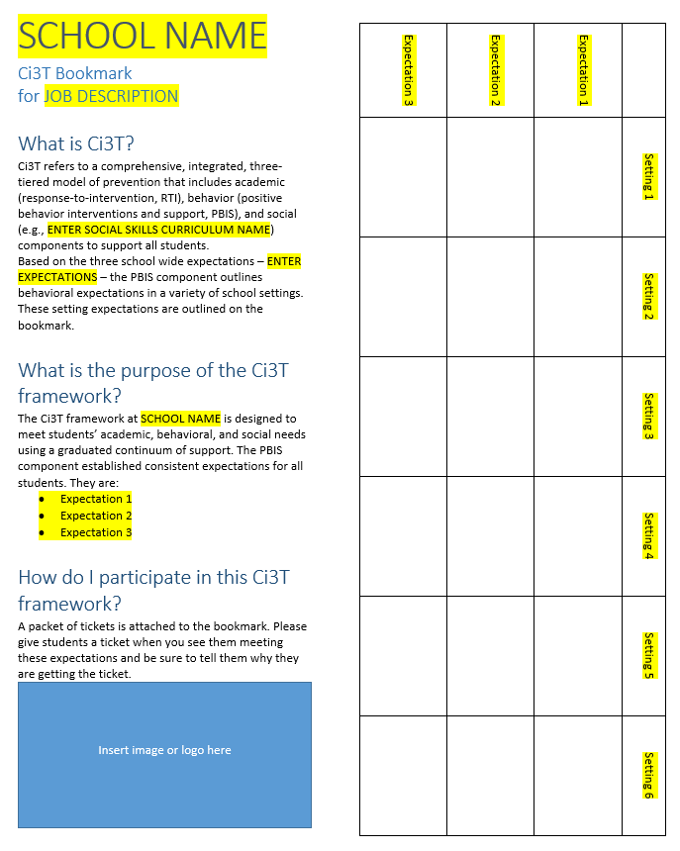
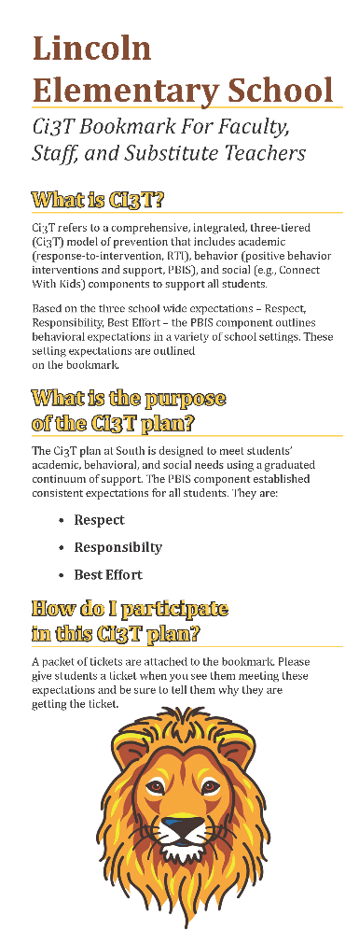
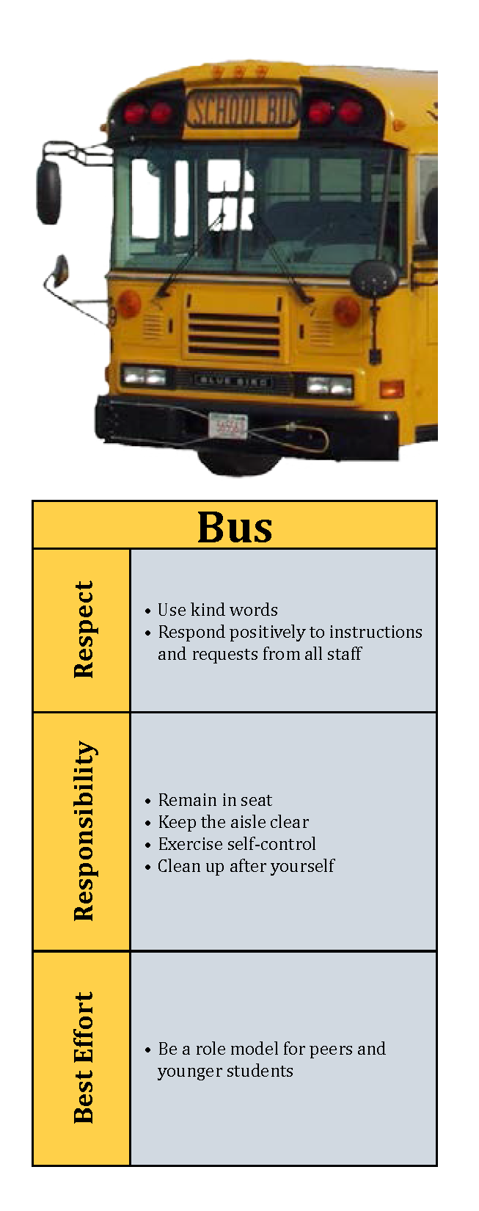
Example Bookmark

Slide 42
Ticket Tip sheet
When giving a ticket for positive behavior, always pair behavior specific praise. Example, “Lori, thank you for walking down the hallway with a quiet voice and your hands at your side. For showing responsibility, you have earned a PBIS ticket.”
In the first days and weeks of implementing a Positive Behavioral Interventions and Support system, flood students with tickets to increase effectiveness. Over time, fade tickets and provide intermittent reinforcement.
School staff should try to be consistent with ticket distribution. Portions of staff meetings can be used to discuss ticket distribution.
To ensure student buy-in, survey students to gain an understanding of what reinforcements are desired.
Explicitly teach students how tickets can be earned and what tickets can be used for once they are received.
Explain to students that they need to fill out all of the required information on the ticket in order for it to be used.
Once a student has earned a ticket, never take the ticket back!
Students should be able to earn tickets for appropriate behavior (meeting the school expectations) in various settings such as: arrival/dismissal, bus, cafeteria, hallway, playground, library, office, classroom, and specials (PE, art, etc.)
School-wide staff (teachers, administrators, bus drivers, custodial and culinary staff, librarians, nurse, etc.) should distribute tickets intermittently when appropriate behavior is displayed.
Tickets can also be used to reinforce appropriate behavior displayed in some students while decreasing inappropriate behavior in others (you see a group of students walking down the hall, the first four students are talking and laughing and the others are quiet so you give the quiet students in the back tickets and thank them for walking quietly).
Sample

Slide 43
Sample Cafeteria Expectations
Lesson Plan
Show Respect to All includes:
Use an inside voice.
Use manners.
Listen to and follow adult directions.
Own My Behavior includes:
Make your choices quickly.
Eat your own food.
Do not exchange food or money.
Choose a seat and stay with it.
Clean up after yourself.
Always Follow Instructions includes:
Follow cafeteria procedures
Follow the table sign.
Ready to do My Best includes:
Get all necessary items before sitting down.
Follow the table sign.
Objective: Students will demonstrate S.O.A.R. expectations for the cafeteria
Introduce the cafeteria expectations and ask questions about them.
  Today we’re going to talk about ways you can show S.O.A.R. characteristics in the cafeteria.
  What are some things that happen in the cafeteria that cause problems for you and for others?
  How do you usually react in these situations?
  What are some good ways to act in order to keep these things from happening?
Define the skill and discuss the key terms.
  Show Respect to All means…
  Own My Behavior means…
  Always Follow Instructions means…
  Ready to do my Best means…
Sample

Slide 44
Cafeteria Expectations Lesson Plan (continued)
Discuss why this is important.
  You, your friends, or adults can get hurt if we are not respectful and responsible.
  If you show respect to others, they are more likely to show respect to you.
  The cafeteria needs to be a place where we feel safe and enjoy time away from class.
Show/Discuss
  Using one of the following situations, model, role-play, or discuss the following situations.
  For negative modeling, respond in one of the following ways: not listening, not following instructions, raising your voice, arguing, getting upset, and so on.
  For positive modeling, respond by engaging in one of the expectations above (e.g., using positive and supportive language) and encouraging other to do so as well.
Situations
  An adult in the cafeteria asks you to pick up a wrapper on the floor. But you didn’t drop the wrapper, and the wrapper isn’t yours. What should you do?
  You forgot to do your homework last night and had planned to do it during lunch. Unfortunately, you are the last one in the lunch line. You are in a big hurry. What should you do?
  You forgot your lunch money and you are so hungry! Your “friend” says that he steals food all of the time. “It’s no big deal,” he says. You are feeling really pressured to steal, especially because you are so hungry. What should you do?
Sample

Slide 45
Cafeteria Expectations Lesson Plan (continued)
Ask students to
  State the expectations.
  Tell why the expectations are important.
  Think of ways to help them remember the expectations when they are in the cafeteria.
Follow Through and Practice
1. Generate and Role-Play or Discuss Situations
  Invite students to generate additional situations that result in problems in the cafeteria. Role-play or discuss several of these. You may want to go into the cafeteria and re-enact some situations!
2. Use Incidental Teaching
  Whenever a conflict situation arises in the cafeteria, use that situation to review the skill.
Sample

Slide 46

Show Respect to all
Use an inside voice
Use manners
Listen to and follow adult directions
Cafeteria Expectations
Sample

Slide 47
High School Parking Lot Expectations Lesson Plan
Objective: The student will demonstrate the school traits of promptness, respect, and responsibility
Promptness includes:
Be out of the parking lot by first bell
Allow enough time to arrive and depart school on time
Respect includes:
Park in assigned, designated space
Clean up after yourself
Be a courteous driver
Maintain dress code
Use positive, supportive language in the parking lot
Responsibility includes:
Adhere to traffic laws in parking lot
Follow adult instructions on school property
Park and drive only in appropriated designated areas
Sample

Slide 48
Parking Lot Expectations Lesson Plan Continued
Tell
1. Introduce the parking lot expectations and ask questions about them.
Today we’re going to talk about ways you can show promptness, respect, and responsibility in the parking lot.
What are some things that happen in the parking lot that cause problems for you and for others?
How do you usually react in these situations?
What are some good ways to act in order to keep these things from happening?
2. Define the skill and discuss the key terms.
Showing promptness in the parking lot means …
Showing respect in the parking lot means…
Showing responsibility in the parking lot means …
3. Discuss why this is important.
You, your friends, or adults can get hurt if we are not respectful and responsible
If you show respect to others, they are more likely to show respect to you.
The parking lot needs to be a place where we feel safe and enjoy time away from class.
Sample

Slide 49
Show/Discuss
Using one of the following situations, model, role-play, or discuss the following situations.
For negative modeling, respond in one of the following ways: not listening, not following instructions, raising your voice, arguing, getting upset, and so on.
For positive modeling, respond by engaging in one of the expectations above (i.e. using positive and supportive language) and encouraging other to do so as well.
Situations
You arrive at school. You think you are going to be late and it is raining. The parking lot is full except for the handicap spot and a couple spots a million miles away. What should you do?
As you are walking through the lot, you see a car hit another car and drive away. You recognize the driver. What should you do?
Do
Ask the students to
State the expectations
Tell why the expectations are important.
Think of ways to help them remember the expectations when they are in the parking lot.
Follow Through and Practice
1. Generate and Role-Play or Discuss Situations
Invite students to generate additional situations that result in problems in the parking lot. Role-play or discuss several of these.
2. Use Incidental Teaching
Whenever a conflict situation arises in the parking lot, use that situation to review the skill.
3. Discuss why this is important.
You, your friends, or adults can get hurt if we are not respectful and responsible
If you show respect to others, they are more likely to show respect to you.
The parking lot needs to be a place where we feel safe and enjoy
time away from class.
Sample

Slide 50
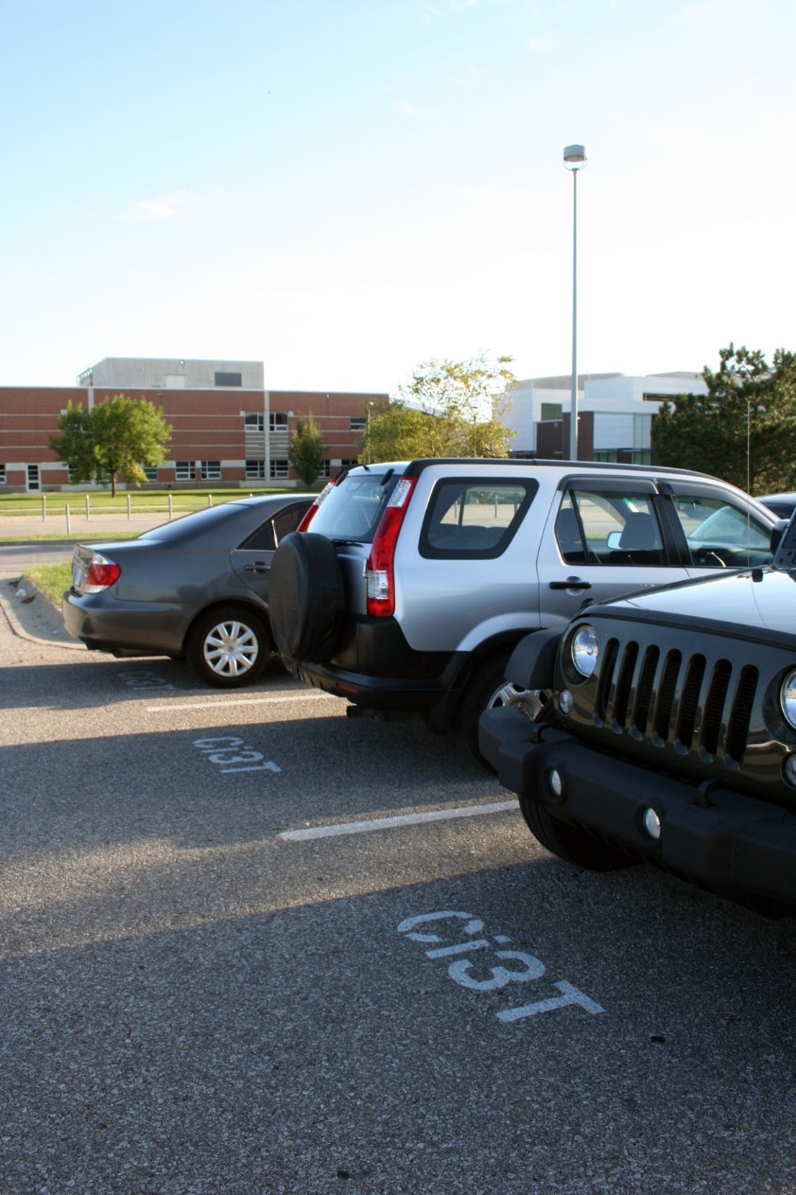
SHOW RESPECT TO YOUSELF AND OTHERS in the parking lot
Park in assigned, designated space
Clean up after yourself
Be a courteous driver
Maintain dress code
Use positive, supportive language
Sample
Notes:
50

Slide 51


Thank you for helping to make School Name’s Ci3T plan a success!
Sample
Business Sign

Slide 52
Reinforcing

Slide 53
Procedures for Reinforcing
How will the school-wide expectations be reinforced with all stakeholders?
  Faculty and Staff
    -
    -
  Students
    -
    -
  Community
    -
    -
Include options for reinforcers that allow people to “access” and/or “avoid”
Add information from your school’s
Ci3T Blueprint A Primary (Tier 1) Plan

Slide 54

Earn Your Tickets Today!
Include the date and setting where they earned the ticket; consider listing the social skills topics as well as school-wide expectations.
Expectation Met:
Respect
Responsibility
Best Effort
Student Name: ______________
Sample

Slide 55
Monitoring

Slide 56
Procedures for Monitoring
Academic Student Performance
    -
    -
Behavioral Student Performance
    -
    -
Social Skills:
    -
    -
Add information from your school’s
Ci3T Blueprint A Primary (Tier 1) Plan
Draft
Notes:
4

Slide 57
Assessing Risk: A Proactive Approach to Serving Students
Incorporate systematic screening tools to monitor the level of risk at a given school to identify students whose behavior patterns suggest non-responsiveness.
Available tools:
  Systematic Screening for Behavior Disorders (SSBD 2nd Ed.; Walker, Severson & Feil, 2014)
  Student Risk Screening Scale (SRSS; Drummond, 1994)
  Student Risk Screening Scale- Internalizing & Externalizing (SRSS-IE; Lane, & Menzies, 2009)
  Strengths and Difficulties Questionnaire (SDQ; Goodman, 1997)
  Behavior and Emotional Screening System (BASC-2 BESS; Kamphaus & Reynolds, 2008)
  Social Skills Improvement System – Performance Screening Guide (SSiS-PSG; Elliott & Gresham, 2008)
Add information from your school’s
selected screening tools
Notes:
57

Slide 58
School Assessment Schedule
Measure | Aug | Sep | Oct | Nov | Dec | Jan | Feb | Mar | Apr | May | Jun
School Demographics
Student Demographic Information
Screening Measures
Behavior Screener:
Academic Screeners:
Student Outcome Measures - Academic
Student Outcome Measures - Behavior
Program Measures
Social Validity - PIRS
Schoolwide Evaluation Tool (SET) or Tiered Fidelity Inventory (TFI)
Ci3T Treatment Integrity
Add your
Ci3T Blueprint D Assessment Schedule

Slide 59
Guiding Considerations
Use data your school has access to
Handle data as few times as possible
Take no more than 1% of school day to collect and manipulate data
Build data collection into daily routines
Establish data collection and use as a conditioned positive reinforcer

Slide 60
Next Steps:
Faculty and staff complete Primary Intervention Rating Scale (PIRS) survey to offer their opinions on the drafted plan.
Team revises plan during next training session.
Implementation materials and final plan presented to faculty and staff.
Please take this time to complete
your PIRS survey.

Slide 61
School and classroom environment
Teaching
Monitoring
Reinforcing

Slide 62
Almost There!
✓ Selected school Ci3T Leadership Team
✓ Full faculty and staff completed the Schoolwide Expectations Survey for Specific Settings (SESSS)
✓ Ci3T team attended training to design a Ci3T model of prevention
✓ Drafted the primary (Tier 1) plan
✓ Drafted procedures for teaching
✓ Drafted procedures for reinforcing
✓ Drafted procedures for monitoring
Faculty presentation and feedback
Make revisions based on faculty and staff feedback

